Slide 1
After Brexit: the future of construction and housing in Wales Cardiff 6 September 2017 Professor Brian Morgan Cardiff Metropolitan University

Slide 2
Session Outline
The Construction sector
The housing challenge and capacity constraints
The current business model in the housing sector
Creating more value added
Off-site manufacturing
Brexit implications
Conclusion

Slide 3
Construction and the economy
Construction: a very important (but often neglected) sector
“For every £1 invested in construction, £2.84 is generated in the wider economy.”
But these are UK figures.
The multiplier figures for Wales are much lower:
“For every £1 invested in construction, only £1.8 is generated in the wider economy.”
This is a key challenge for Wales:
How do we generate more regional economic impact from the Welsh construction sector?

Slide 4
The Construction Pipeline
Significant opportunities arising from increased demand for:
Housing
Commercial property / Industrial buildings
Plus investment in UK infrastructure – transport, energy etc.
A £500 billion investment pipeline is in place
Over 600 large projects and programmes
Even more investment is in prospect following Brexit
The strategic challenge:
Can we deliver this growth alongside improvements in productivity in housebuilding and construction?

Slide 5
Demand for Housing
The UK needs to build an additional 200,000 homes per year to meet demand
Wales needs to build at least 10,000 additional homes per year to meet future demand
The Welsh Government aims to build 20,000 additional affordable homes by 2021
And also to provide the investment funds needed to achieve this target
But it is not going to be easy to satisfy the demand for housing by increasing the supply

Slide 6
Housing Market Problems
Significant supply shortage, + high levels of employment, + very low borrowing costs + a (slow) increase in incomes have pushed up house prices
They now act as a floor under the current high levels.
Weakness of sterling continues to attract foreign buyers into the London market - with knock-on effects
Currently, levels of unsold stock remain at record lows
With both supply and borrowing costs so low, an imminent collapse in house prices post Brexit looks remote

Slide 7
Affordability
Growing divergence between house prices and affordability
Property prices are currently rising at roughly 5 times the rate of wages
Lack of affordable housing and social housing coupled with a growing population – is now a major political issue
The rental market is becoming the main beneficiary of these trends
And the proportion of owner occupiers is falling

Slide 8
Rental market
Already more than half of renters are over 30, and more people are likely to rent for longer.
Owner occupation has fallen – from 60% to 39% for people aged 25 to 34
Hence developers are increasingly building homes to rent, rather than to buy as people are being priced out of the property market
The Build to Rent market is expanding
But, lack of supply remains the biggest problem
Can it be solved?

Slide 9
Capacity constraints
Since the 2008 downturn the number of housebuilders and construction companies has fallen sharply
In addition skilled personnel have left the industry
Exacerbated by an ageing workforce:
a 20% shortfall in skilled labour is predicted by 2025
100,000 additional people will be required
Also there has been chronic underinvestment:
(i) in training and skills (ii) in capital assets
The result - significant capacity constraints

Slide 10
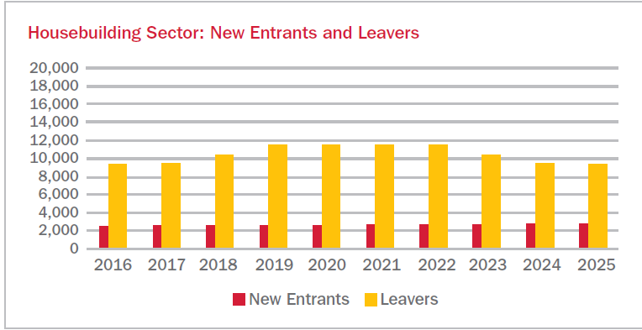
Source: The Farmer Review

Slide 11
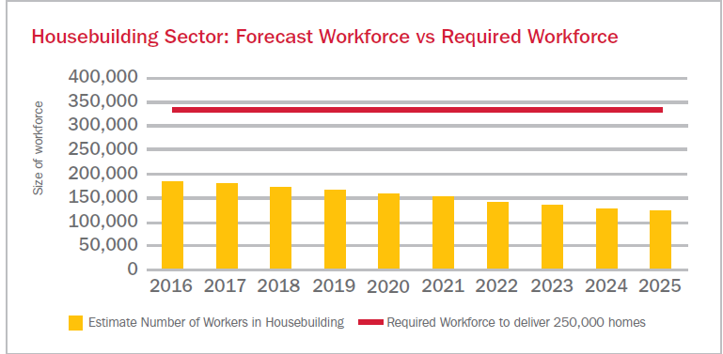
Source: The Farmer Review

Slide 12
A faulty supply model?
The problems in construction are long term and are unlikely to be significantly affected by Brexit
The house-building sector has significant on-going structural problems:
continuing skills shortages,
low margins,
resistance to change,
a failure to embrace the digital revolution, and
the continued reliance on traditional (but inefficient) on-site production methods,

Slide 13
Digital Revolution
Productivity problems are undermining the industry’s incentives to invest for the long term
e.g. ‘Industry 4.0’ describes the fourth industrial revolution – refers to ‘smart’ production techniques.
But, despite the (slow) introduction of ‘BIM’ it is clear that construction (and house building in particular) has not even made the transition to ‘Industry 3.0’ status,
There is no large scale use of electronics and IT to automate house building
BIM is being used increasingly in large public sector projects but rarely in housebuilding

Slide 14
Creating more value added in house building
Wales needs a housing sector that creates better value and generates larger economic impact multipliers
But housebuilders continue to rely on traditional on-site construction methods
A ‘change programme’ is needed that creates better value through:
1) better use of off-site manufacturing
2) significant investment in the skills of the future
3) long term funding models

Slide 15
Integration with manufacturing
Three key developments are needed:
Improved performance of existing house builders through upskilling of crucial roles
The creation of an additional supply chain structure that moves house building and construction closer to manufacturing.
[These two supply chains will need to become fully integrated to create a more productive industry,]
A sustainable funding structure that provides better access to investment for smaller firms – could Brexit help or hinder ?

Slide 16
Off-site opportunities
These changes are needed to produce better value and increase productivity
Some improvements are already being introduced:
Funding - pension funds and housing associations are beginning to collaborate to provide better access to investment
There is growing interest in Build-to-Rent modular projects (easier to fund?)
The L&G pension fund has invested in production capacity to manufacture modular housing off-site.
550,000 sq. ft. factory in Yorkshire to deliver precision-engineered accommodation modules using timber panels

Slide 17
Benefits of Off-site manufacturing
Reduced onsite construction time; - reduced Health & Safety exposure; - lower repair costs; - better thermal performance; - greater sustainability; - and a lower carbon footprint
Modular homes are built more quickly but they can be designed to a high specification and with reduced impact on both local residents and the environment
Modular houses can more easily be solar powered – so it’s a win-win for the environment
And it also offers a great opportunity for the construction sector in Wales

Slide 18
What Wales needs post Brexit
Wales should lead the way in developing an industrialisation strategy for the construction sector
The social housing shortfall could be addressed more easily by radical innovation in building practices and greater use of well designed modular housing
This could be a key area for inward investment – a large off-site manufacturing facility in the Valleys would be ideal for the City Region
It could be part funded through the City Deal – a twenty year housing bond – with similar developments in Swansea and North Wales

Slide 19
Brexit Implications: Some questions
Will restrictions on free movement of labour lead to even greater skills shortages? Probably yes in the short run but a huge upskilling programme is required even without Brexit
Free movement of goods – why are we reliant on Belgium for bricks? On Italy for glass? And on Germany for pre-fabricated buildings?
Can we sustain a £5bn annual trade deficit in construction materials with the EU?
The same question is being asked in the motor industry and in agriculture – will Brexit enable us (or force us) to address the chronic trade deficits in these sectors?

Slide 20
Questions continued
Funding –with a highly efficient financial services sector shouldn’t the UK be able to replace EIB funding without too much disruption?
Similar arguments apply to ERDF – but do we trust the government to deliver?
VAT – we need the government to be more flexible on introducing exemptions from VAT for refurbishing and insulating buildings – this would be beneficial to the industry and the environment
Procurement – “we need a public sector that is competent and confident to deploy its power (especially its power of purchase)” post Brexit

Slide 21
Conclusion
The current housing model is flawed - but it’s not obvious that Brexit will help or hinder our ability to fix it
It under-invests in training and needs to raise productivity in the face of rising demand for new housing and infrastructure
It needs to be supported to introduce new methods of production, such as off-site manufacturing
Perhaps Brexit will provide the short, sharp shock needed to transform this underperforming sector
Post Brexit, Wales could lead the way

Slide 22
Thank you
Questions
brianmorgan@cardiffmet.ac.uk

