Slide 1
Autodesk – Improving quality and client satisfaction
Mike Keane
UK & I Construction

Slide 2
Objectives

Slide 3
Objectives
To demonstrate how Autodesk can help you deliver a better product, faster, and with less defects.
Post sales engagement and improving client satisfaction – closing the feedback loop.
Work with us to identify, and quantify, the opportunities
Implement and measure return

Slide 4
Reducing Risk through Lifecycle
DELIVER QUALITY
Automate fixes and evidence
ENTERPRISE DATA
Reporting and Analytics
IMPROVE
Address issues and spread best Practice
ENGAGE
Ongoing client dialogue
COMMUNICATE
What and How

Slide 5
Agenda

Slide 6
Agenda
Housing market dynamics and challenges
Communicating standard process to improve quality and reduce waste
Using data to gain early insight into quality, health & safety, and progress
Reducing handover issues to improve client satisfaction
Beyond the sale – closing the feedback loop
Improving post-sales support at reduced cost
Continuous client engagement

Slide 7
Construction Challenges

Slide 8
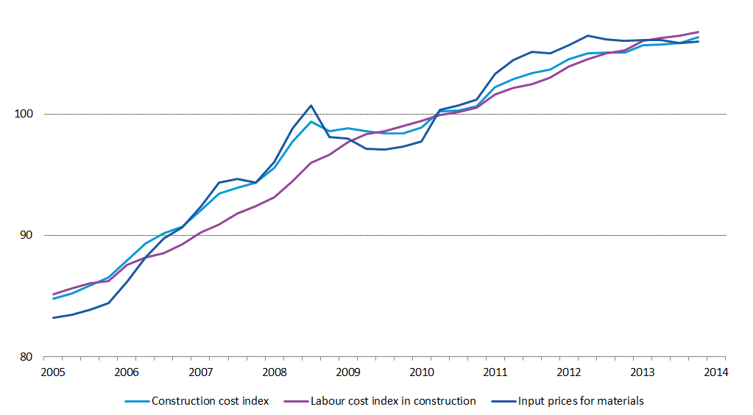
Trends and Risks
Market share of top 10 housebuilders increasing, parallels with grocery market dynamics
Increasing drive to differentiate and create brand loyalty
Rises in input costs – waste and delays are more expensive
Significant gap between housing production and demand – high profile political issue, Minister cites poor adoption of technology as a major issue
Shortage of skilled labour causing wage pressure, increased waste, and impacting production rates and quality
PR exposure of poor quality causing reputational damage – social media to national press
EU Quarterly construction cost and its components
Source : European Commission, Eurostat

Slide 9
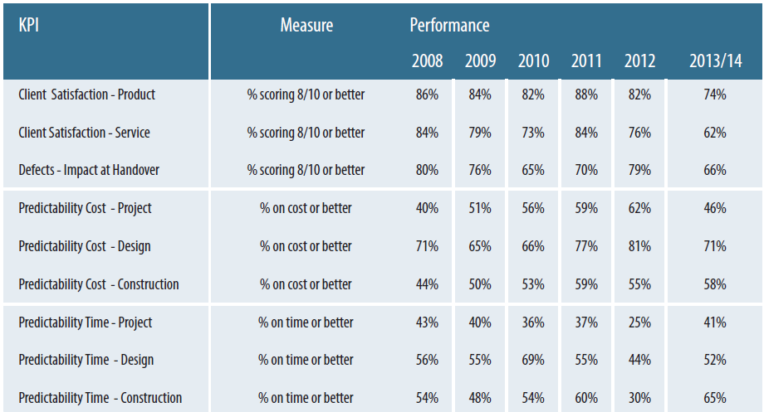


Productivity and Quality
No common platform to measure and evidence quality, activity, and progress on site
Multiple paper based processes lead to errors, and difficulty in addressing issues quickly
Difficult or impossible to identify trends and implement remediation quickly
Lack of skilled labour could impact quality, programme, and waste levels unless clear instructions are given (IKEA)
Social media gives opportunity to broadcast bad experience, and amplifies the risk to reputation
Source : Glenigan

Slide 10
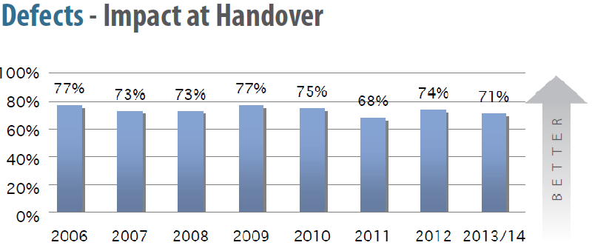
Addressing skills shortages
Skills shortages leading to increased issues with communication and quality of site work
Design quality is being diluted, as no common delivery “best practice” exists
Visual communication and guidance reduces ambiguity and supports better quality and accelerated delivery
All development drawings, standards, 3d views, checklists, and commissioning materials on one device
Capture and share best practice to upskill and empower workforce
Communicate WHAT and HOW
Source : Glenigan

Slide 11

Our Role
Together, we can;
De-risk all phases of the development
Improve Productivity
Reduce costly errors and rework
Produce enterprise data to identify and address root causes of issues
Improve customer loyalty and reduce cost of warranty support
Differentiate your company through innovation and quality

Slide 12




Why Autodesk?
Over 12 million pro users and 170 million consumer apps users
You are using our software throughout your business
Over £500m invested in Research and Development in past 12 months
Unrivalled consulting and support resources to ensure project success and measurable results
Strategic partnerships and integration capabilities

Slide 13
Autodesk BIM360 Field

Slide 14
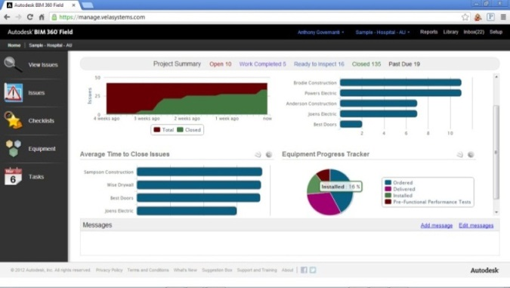
What is BIM360 Field?
BIM360 Field is a construction field management solution that accelerates project delivery, improves quality, safety and profitability for construction projects of all sizes.
All construction documents on iPad
Simply communicate design and delivery
2d and 3d projects
Integration with Autodesk tools
Subscription - Expertise – Adoption
iPad app to manage work on site
Web reporting and analytics

Slide 15


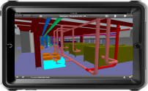
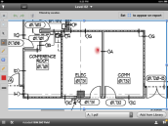
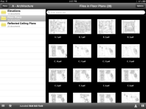
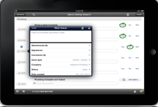
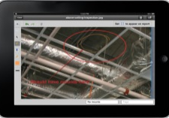
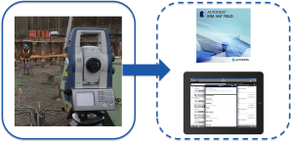
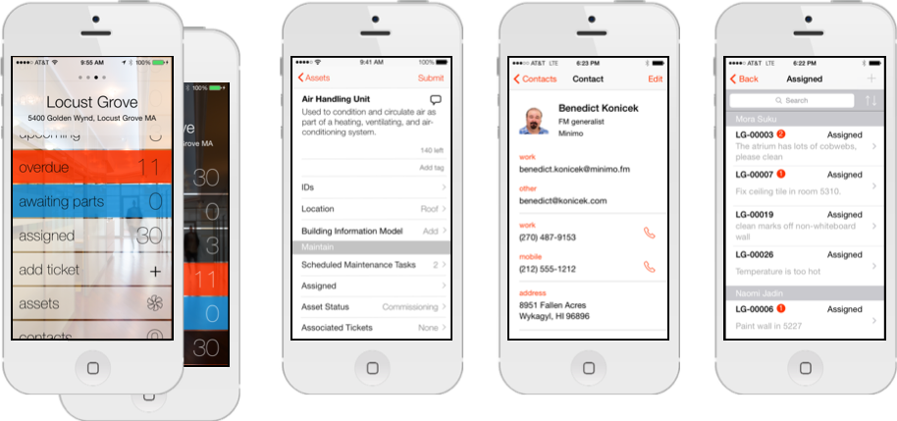
Autodesk® BIM 360
What:
Design Collaboration and Coordination
Quality Programs
Safety Programs
Documents to
the Field
Geometric Control
Equipment: Commissioning, Handover, Operations
Design Collaboration and Coordination
Quality Programs
Safety Programs
Documents to
the Field
Setting Out
Equipment: Commissioning, Handover, Operations
Design Interaction, Mark up and Clash Detection
Online & Mobile Document Library with Mark-up
Checklists with
Company-wide Templates
Issues & Work Tasks Snagging & More
Setting Out & As built information
Analytical Reporting for Operations & FM
How:
How:
PUSH PULL with Autodesk Desktop Design Platforms
Notes:
So what is Autodesk BIM 360 Field? BIM 360 field is a collection of cloud based service offerings purpose built for construction professionals. These services address key construction workflows through the lens of applying Field Management techniques for Quality Programs, Safety Programs, Documents to the field, and equipment commissioning, handover and operations.
An online and mobile document library with markup, checklists and Tasks for tracking issues for work complete, punch lists and more all based on company wide standards, and then analytical reporting for management of all the field information all make up a suite of capabilities for Field Management, Commissioning and Handover.
Last but not least, if you have Building Information Models, you can tie the objects and their data into these capabilities and programs by viewing and interacting with the models in the field on the iPad.

Slide 16


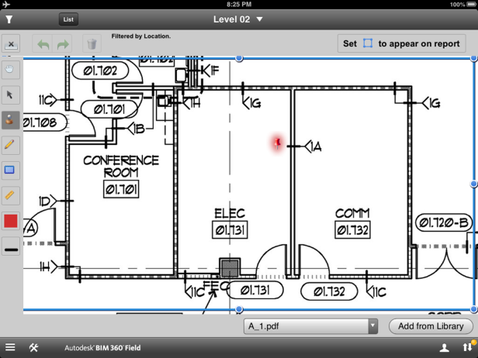
Quality
Problem
  Paper based data capture is onerous and inefficient
  Difficult to report on
  Provides limited audit trail
BIM360 Feature
  Electronic QA/QC Checklists
  Photograph issues/snags, mark-up, push-pin 2D/3D docs and models and distribute info
Benefit
  Productivity gains
  Reduction in profit eating rework
  Project acceleration
  Improved margins
Notes:
As we mentioned earlier, BIM 360 Field is a cloud based service, with a full featured website that contains all of the project information. This information can be downloaded to an IPad, taken out into the field, worked on in a disconnected fashion for Field Management activities, and then uploaded back to the website with updates.

Slide 17
Automating the Quality process
Work Complete
(HOUSE or PROCESS COMPLETE and READY FOR INSPECTION)
QC Inspection (DETAIL and EVIDENCE linked to LOCATION)
Remediation report issued (FIX REQUIRED – TIMER STARTS)
Remediation complete (READY FOR INSPECTION)
Approved (COMPLETE)– release payment
FEWER QUALITY ISSUES, LOWER FIX COST, AND HAPPY CLIENT

Slide 18


Typical workflow comparison

Slide 19
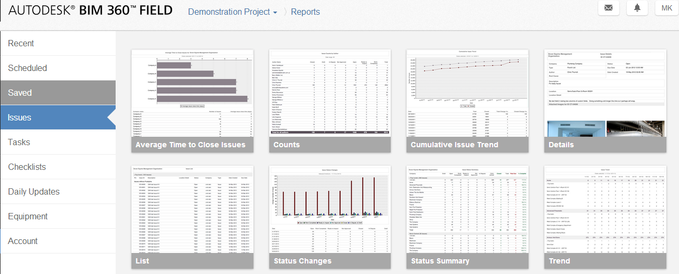
Reporting and Analytics
Notes:
Automate the production and delivery of reports and data to all relevant stakeholders
Dashboards updated daily

Slide 20
Return on Investment
Notes:
Whilst there are many pressures and trends impacting on your operations I would like to highlight a few of the key areas that we have helped clients address over the past 12 months

Slide 21
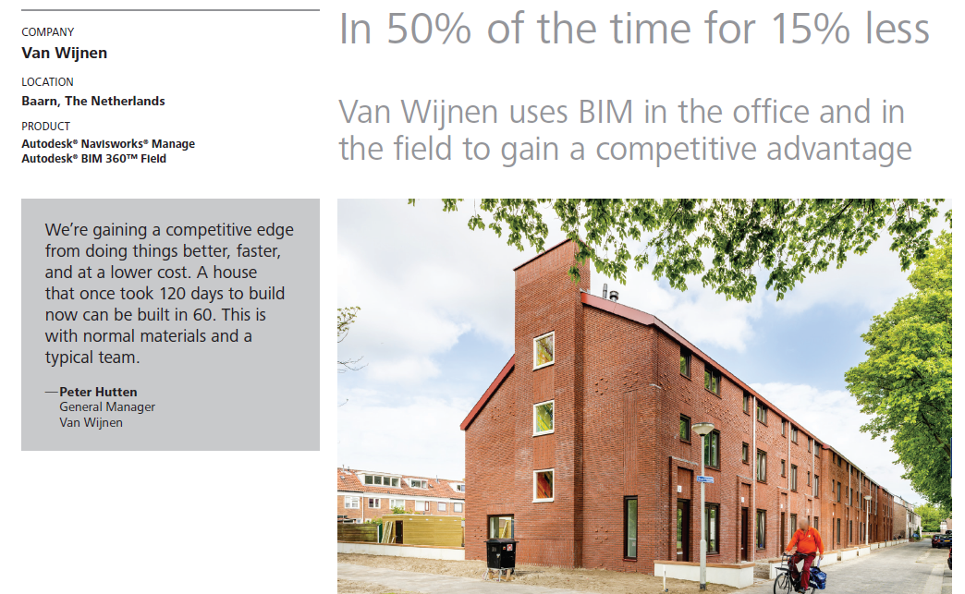

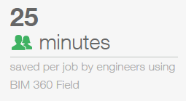

What does the ROI look like?
9 hours saved per operative, per week, on site

Slide 22
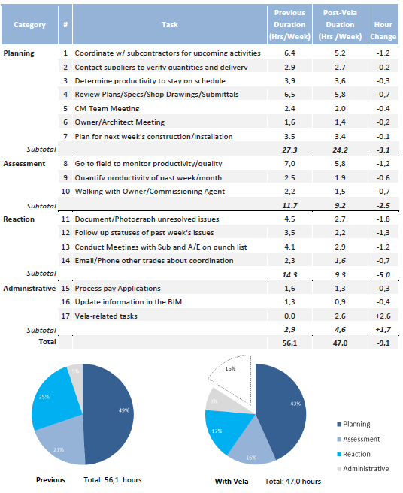
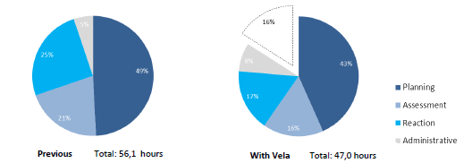
Measuring the benefits of a field data (M. Moran, 2012)
Average weekly hour changes for 38 Skanska construction management staff :
Average 9.1 hours saved per week per construction manager
Biggest gains in reaction tasks involving documenting, reporting and following up the status of construction issues.
34% total reduction in time spent on reaction tasks.
16% of time made available for preventative management and value adding tasks

Slide 23
9
Hours/User/Week
Notes:
REGION: Region/Country
DATE PUBLISHED: 0/0/00
SPEAKER NOTES: (If copied and pasted from previously approved copy, additional editorial and legal review is not required. However, if copy is written specifically for this slide, please have reviewed by editorial and legal prior to including with the Customer PPT Deck).

Slide 24
BIM360 Field Demonstration
Notes:
Whilst there are many pressures and trends impacting on your operations I would like to highlight a few of the key areas that we have helped clients address over the past 12 months

Slide 25


Access Documents in the Field
Problem
  Time wasted retrieving paper based docs from site office
  High printing/reproduction costs
  Acting on out of date information
BIM360 Feature
  Document Library - Access 2D and 3D files on-line or off-line
Benefit
  Productivity gains
  Access to latest project information
  Reduced printing/reproduction costs
Notes:
As we mentioned earlier, BIM 360 Field is a cloud based service, with a full featured website that contains all of the project information. This information can be downloaded to an IPad, taken out into the field, worked on in a disconnected fashion for Field Management activities, and then uploaded back to the website with updates.

Slide 26
Autodesk® BIM 360 Field
Safety Program with
Autodesk BIM 360 Field
Outcome:
Create safety checklists – make everyone “safety observers”
Safer projects
Track positive
& negative outcomes with root causes
Understand root causes
Prevent problems
Analyze & manage trends in safety information
Reduced
insurance costs
Notes:
With a managed Safety program using BVIM 360 Field, you can create safety checklists that proactively enable everyone safety observers, can track positive and negative outcomes with their root causes, and can analyze and manage trends in the safety information that is coming in real-time to make adjustments or change behaviors. The outcome for your project and your firm are Safer projects, that enable a better understanding or what causes problems, with a system that helps prevent accidents and minimizes quality and safety risks and ultimately insurance costs.

Slide 27
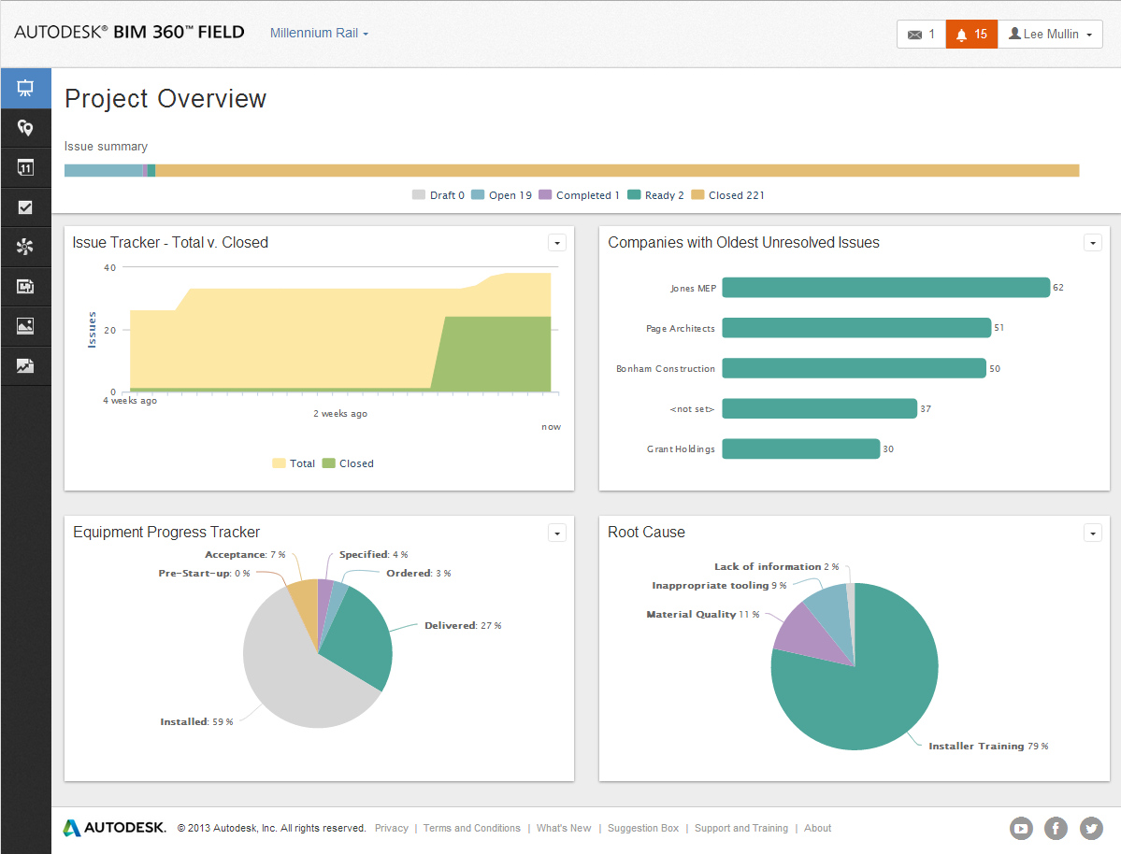
Field Management Website
Notes:
This is where all the information that is coming from the field management activities on the IPad can be viewed, organized and reported on. We have project specific dashboards that are defined by the individual user to show the data and analysis they need most often.

Slide 28
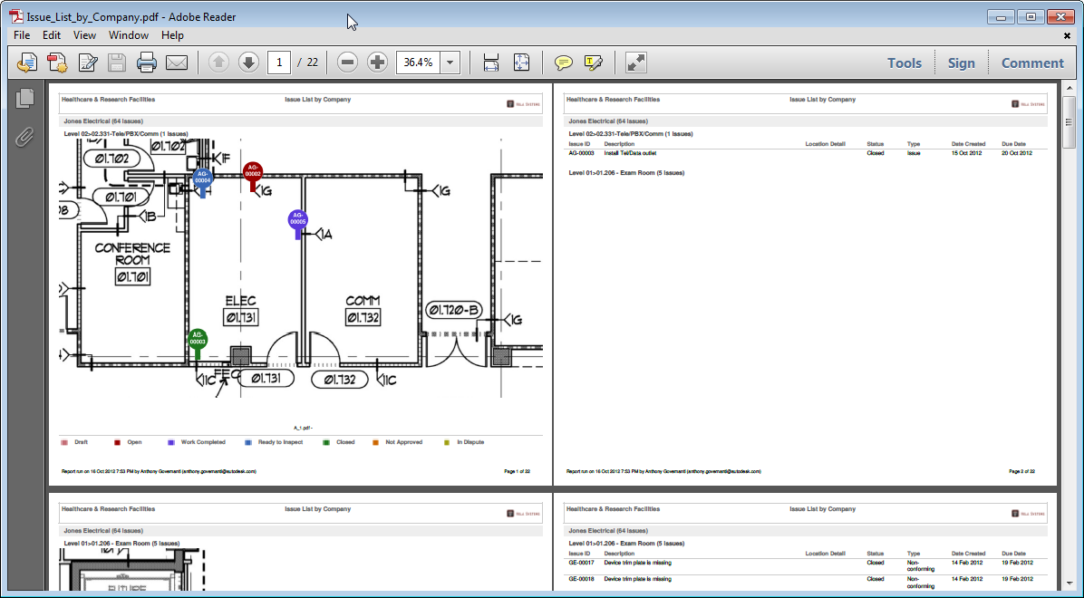
Run or Schedule PDF Reports with Pins
Notes:
We also have reports that can be run showing pushpins for issues, all sorted as we need them. In this report things are grouped by a subcontractor, color coded by status, and include any attachments, photos and markups associated with the items being reported.

Slide 29
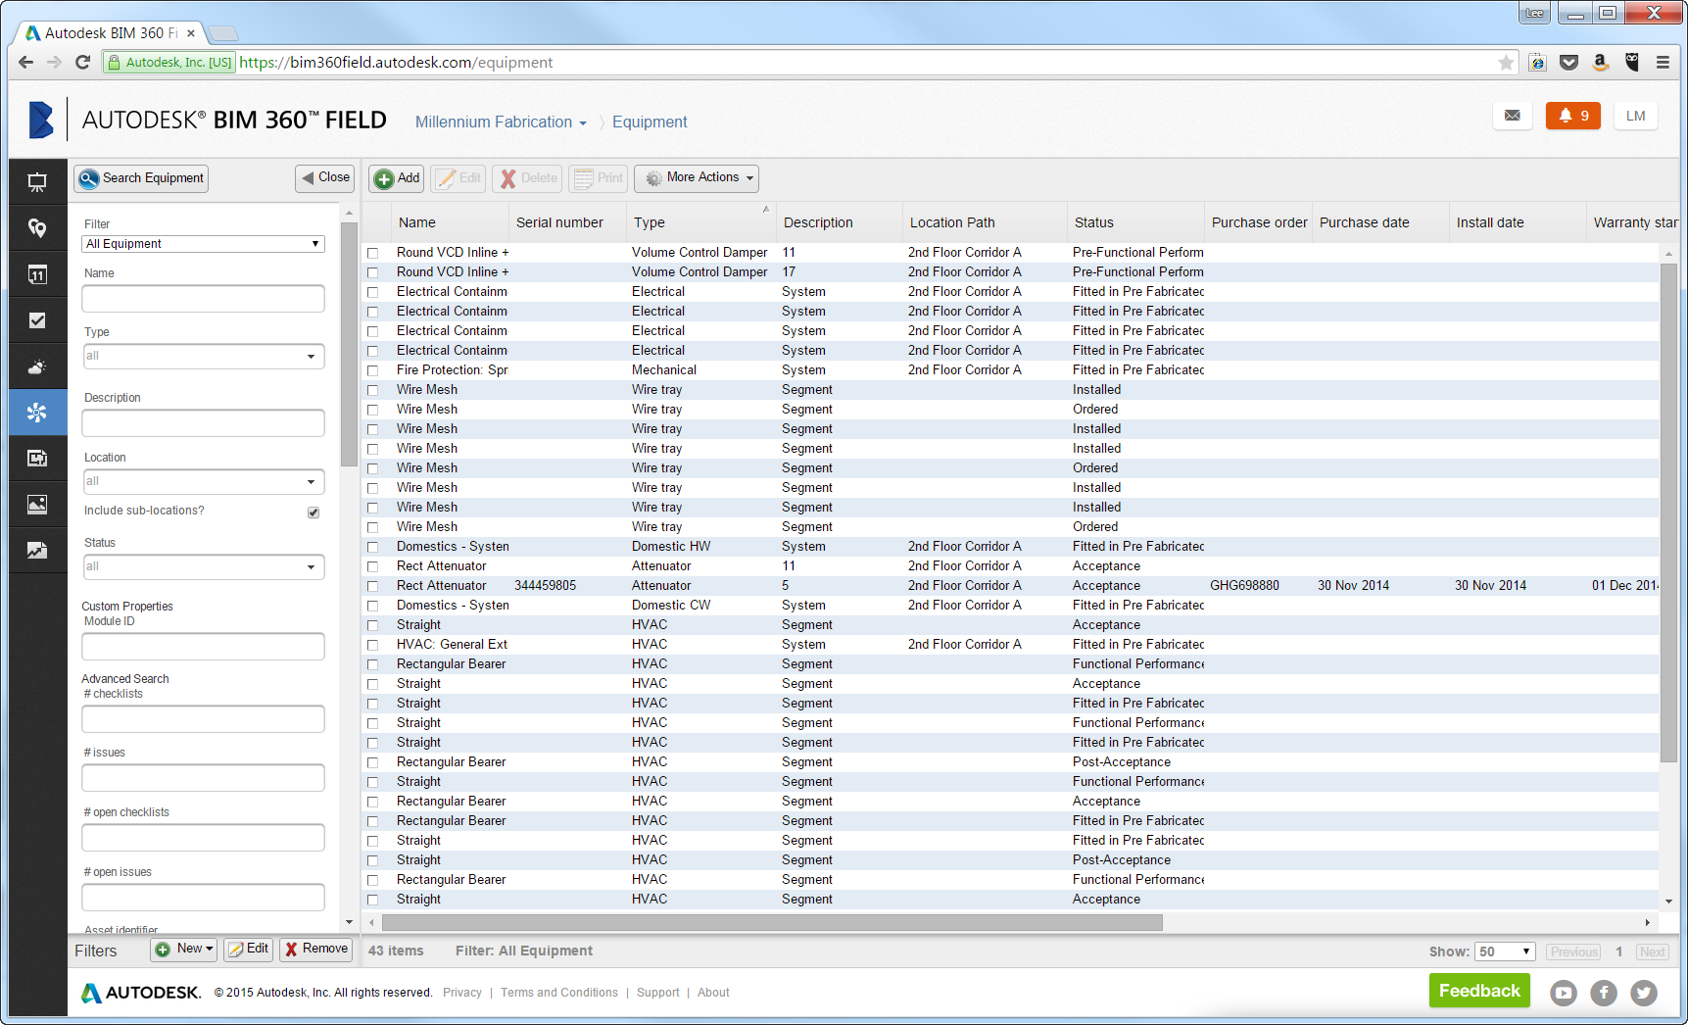
Manage the Equipment Database
Notes:
The equipment database we saw earlier on the iPad is also available via the website, where again we can see a whole project view or use filters to get to just the components we need. We see the equipment names, serial numbers, install dates and so on.

Slide 30
Autodesk Building Ops
Notes:
Whilst there are many pressures and trends impacting on your operations I would like to highlight a few of the key areas that we have helped clients address over the past 12 months

Slide 31
Summary

Slide 32



Summary
Communicate more effectively to reduce risk and uncertainty
Measure and report on site activities, quality, and productivity
Analyse and address root causes and drive positive behaviours
Capture and resolve post sales issues more effectively
Explore post-sale opportunities and revenue streams

Slide 33
Summary
DELIVER QUALITY
Automate fixes and evidence
ENTERPRISE DATA
Reporting and Analytics
IMPROVE
Address issues and spread best Practice
ENGAGE
Ongoing client dialogue
COMMUNICATE
What and How
Notes:
Reducing risk across the business
Delivering on time, on budget, and at the right quality

Slide 34
Next Steps

