Slide 1
Digital Construction
Craig C Ferrans MCIAT – HBF Technical Director

Slide 2
Agenda
What is BIM?
House Builders Journey
Supply Chain Support
External Stake Holders
HBF response
Benefits of Digital Construction
Q&A Session

Slide 3
What is Building Information Modelling?
“An integrated digital process providing coordinated, reliable, shareable data throughout all project phases, from design through construction and into operation”

Slide 4
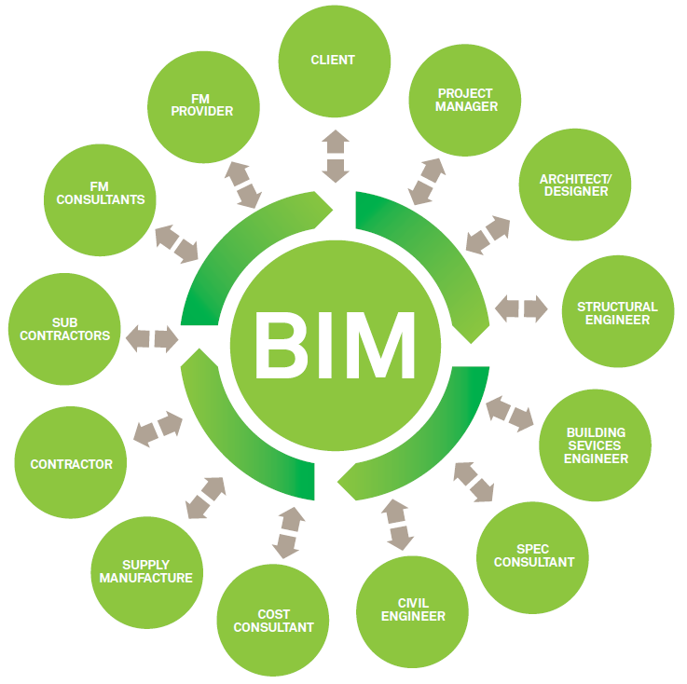
What is BIM?
“BIM is about people and process as much as it is about software”

Slide 5
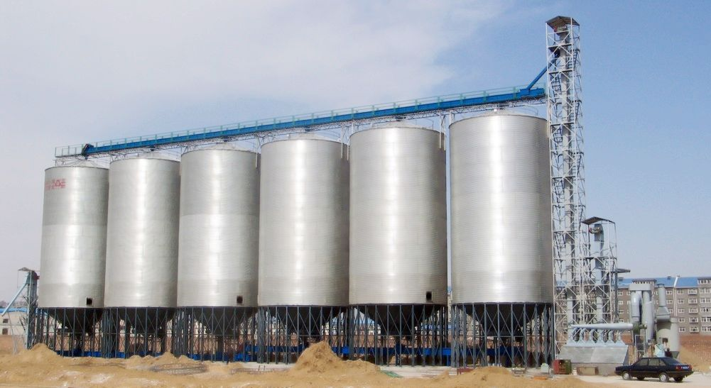
Silo Mentality

Slide 6

House Builders Journey
Started the process in 2010
BIM just a buzz word?
Media research
Is there any added value to the business?
Carbon agenda was influential
Improve accuracy
3D Visualisation to assist planning
Collaborate with stakeholders

Slide 7

Fact Finding
Software demonstration
Change in vocabulary
Components fully parametric
Automated scheduling
Work with Worksets
Tap into visualisation
Supply chain involvement
Drive standardisation

Slide 8

IT Hardware and Infrastructure

Slide 9

Taking the Plunge

Slide 10
Taking the Plunge
2011 Software was installed
Only Central Team used Revit
All BIM content was created by Miller homes
Incredibly steep learning curve
Internal service levels maintained
All standard house types drawn in native Revit software
Original working drawing packs replicated

Slide 11


Terminology
Blocks
Family’s

Slide 12
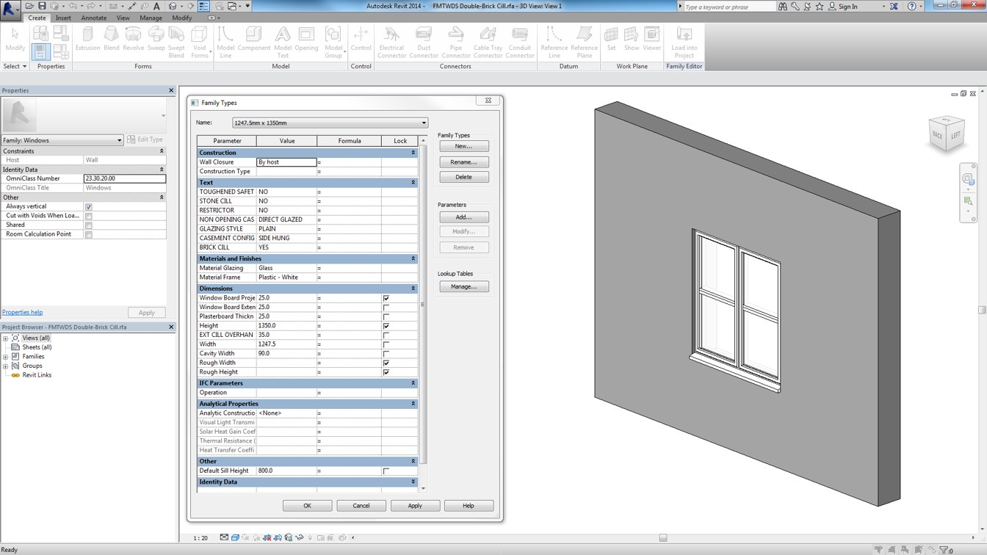
Family Creation

Slide 13
Asset Data Examples
Product details
Maintenance schedules
Contractual & guarantee information
Thermal Details
Travel distances
Installation instructions
Quantities
Costs
Storage
Delivery times
Health and Safety
Recycling & disposal suggestions
URL’s

Slide 14
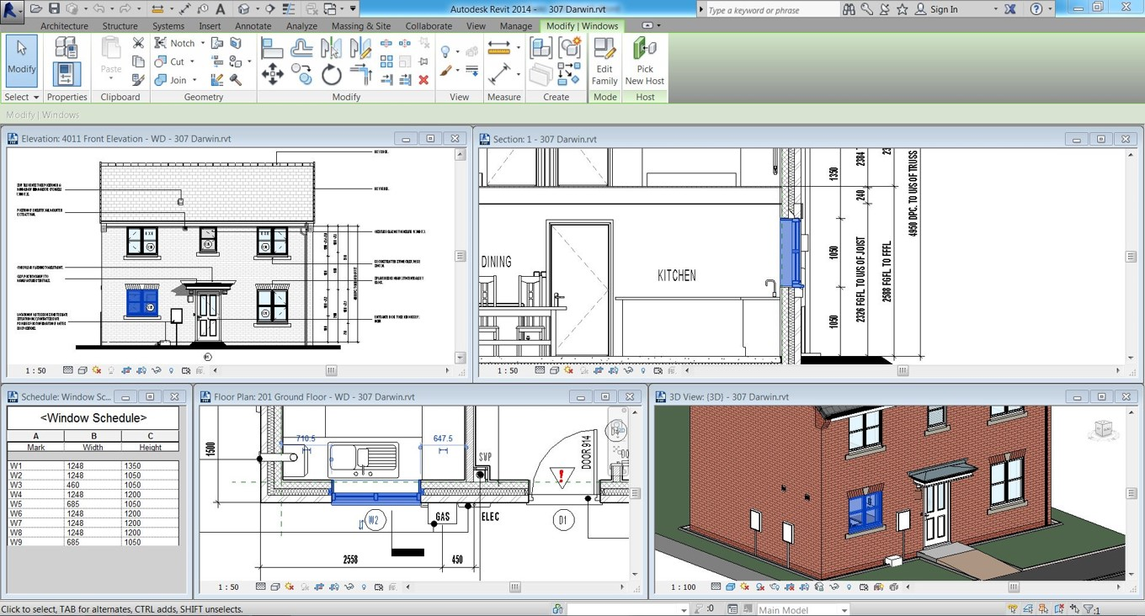
Live Views

Slide 15
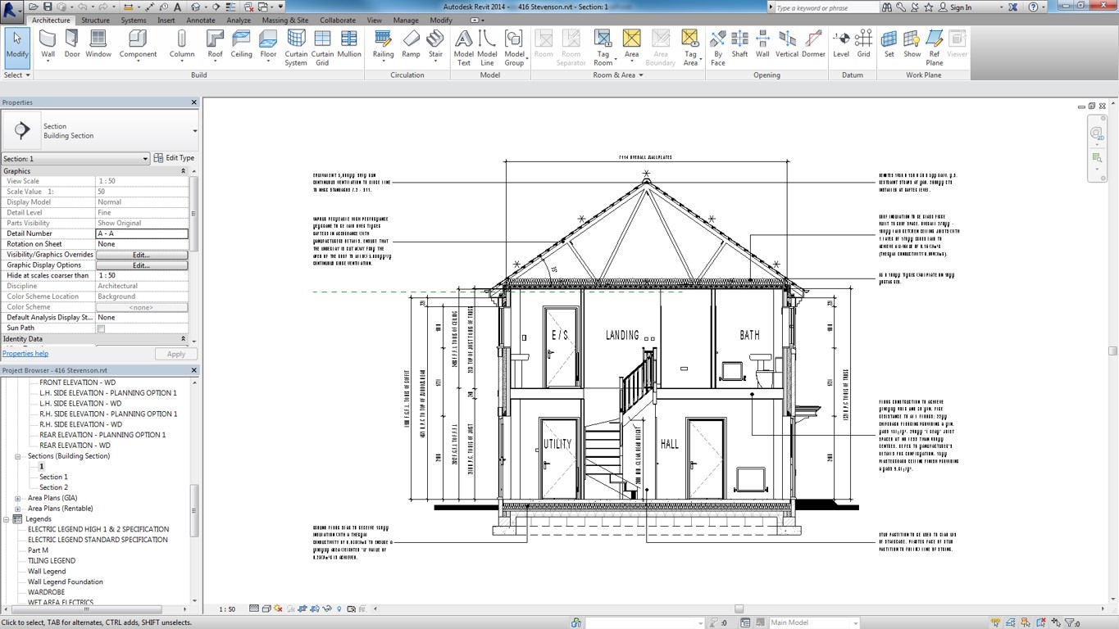
Annotation

Slide 16
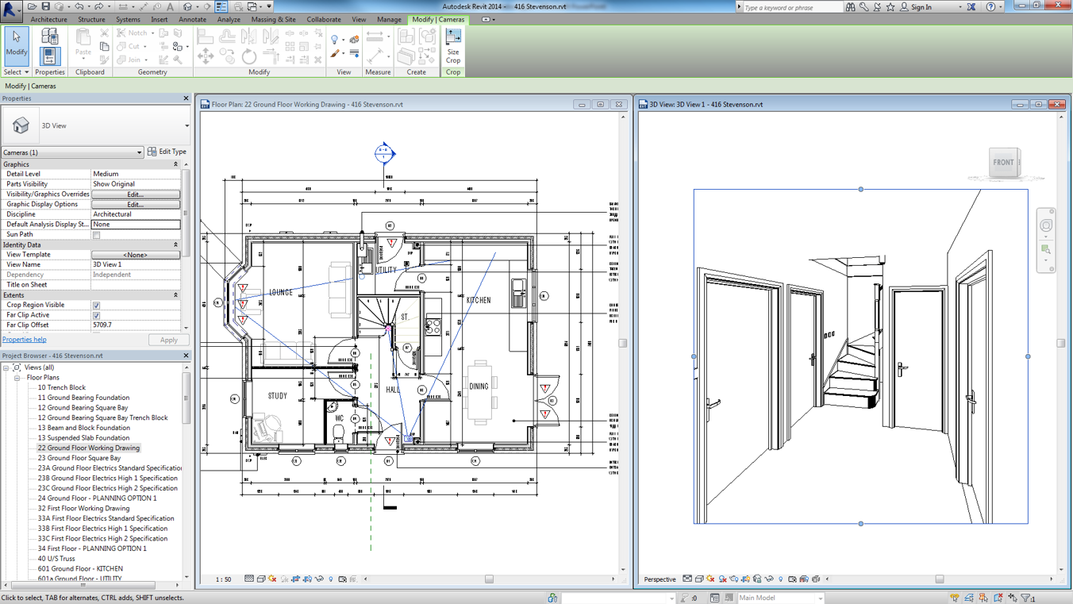
Live Views

Slide 17
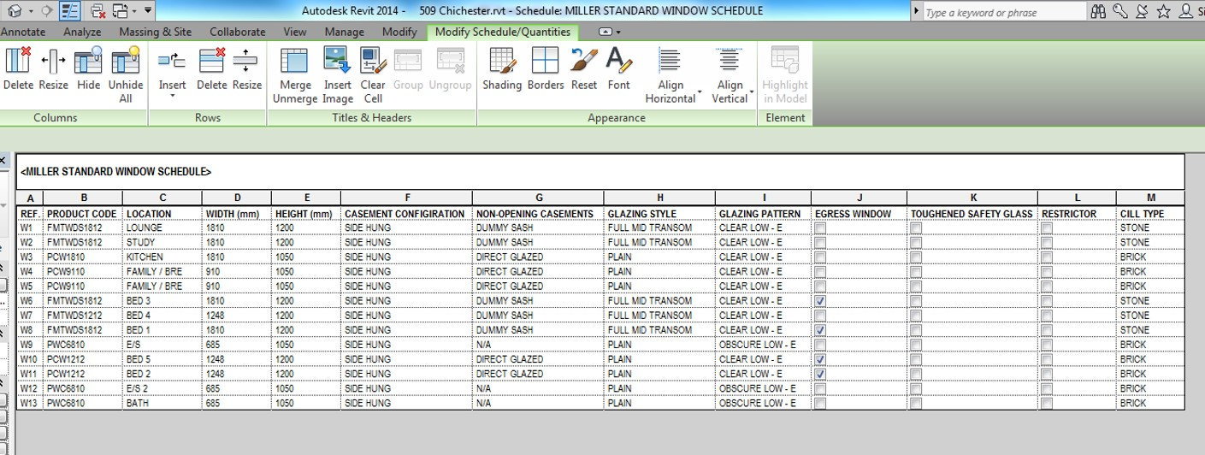
Schedules

Slide 18
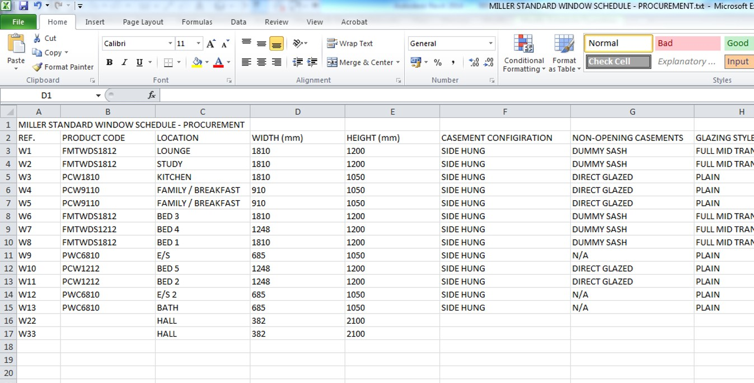
Exporting Information

Slide 19

Tail Chasing

Slide 20

Supply Chain Support

Slide 21

Supply Chain
Contribute in different ways
    Provide BIM content
    Collaborate directly within the model
    Schedule information & drawings

Slide 22
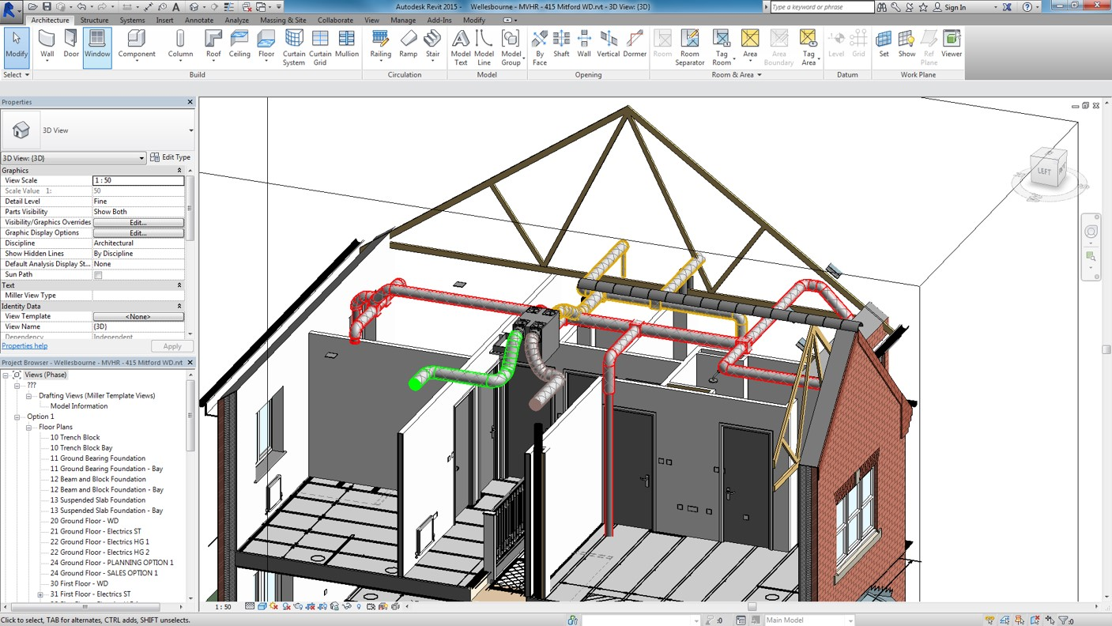
Collaboration

Slide 23


External Portals

Slide 24
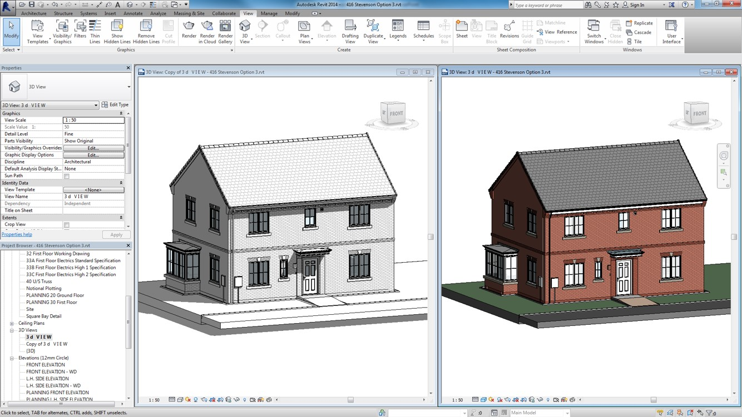
Working Drawing Information

Slide 25
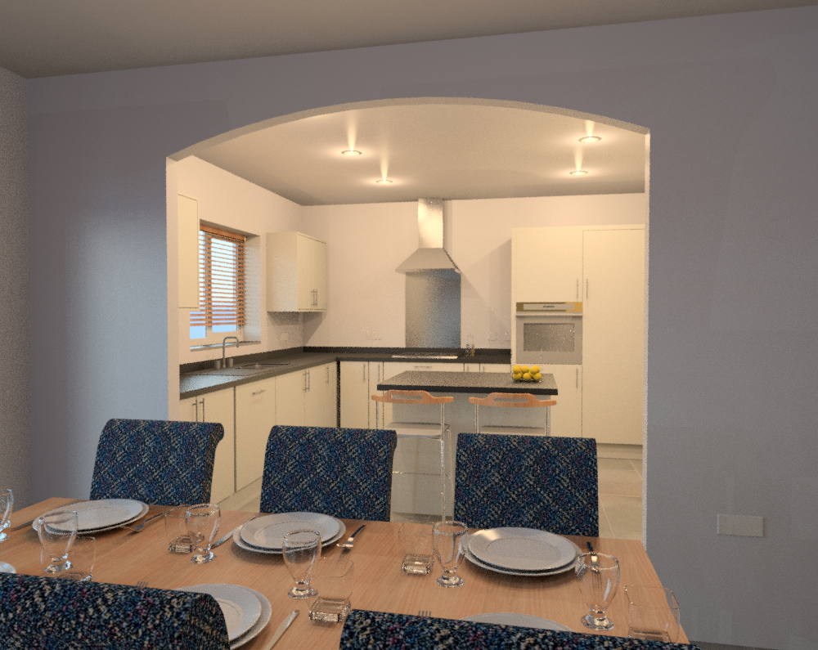
Internal Design

Slide 26
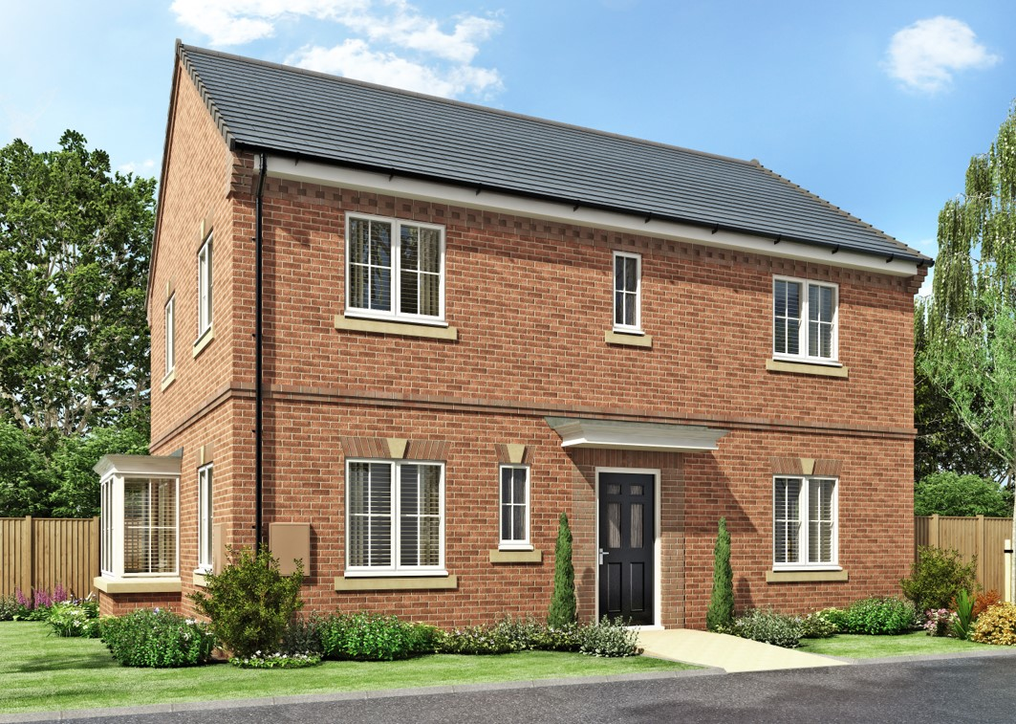
Visualisation

Slide 27
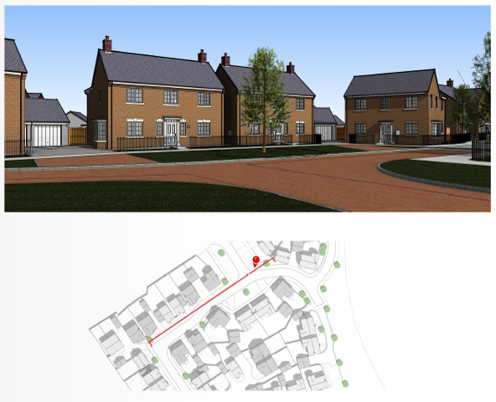
Street Scenes

Slide 28
Street Scenes

Slide 29
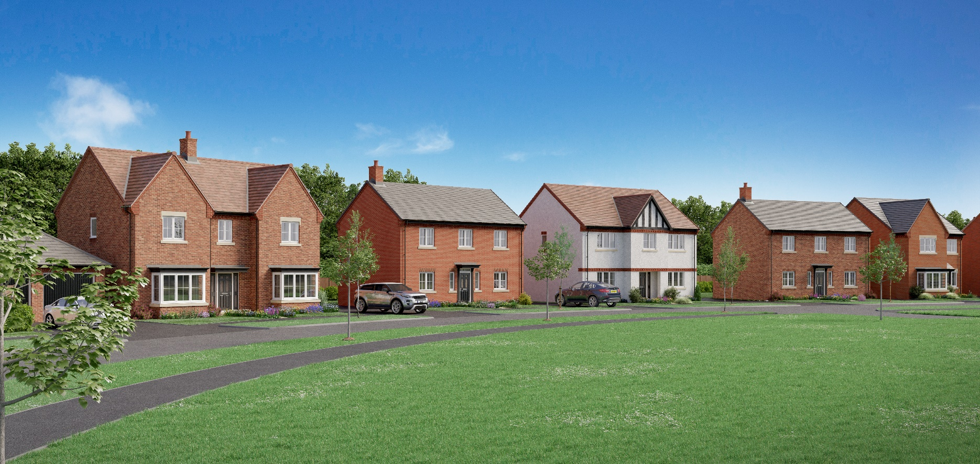
Street Scenes

Slide 30
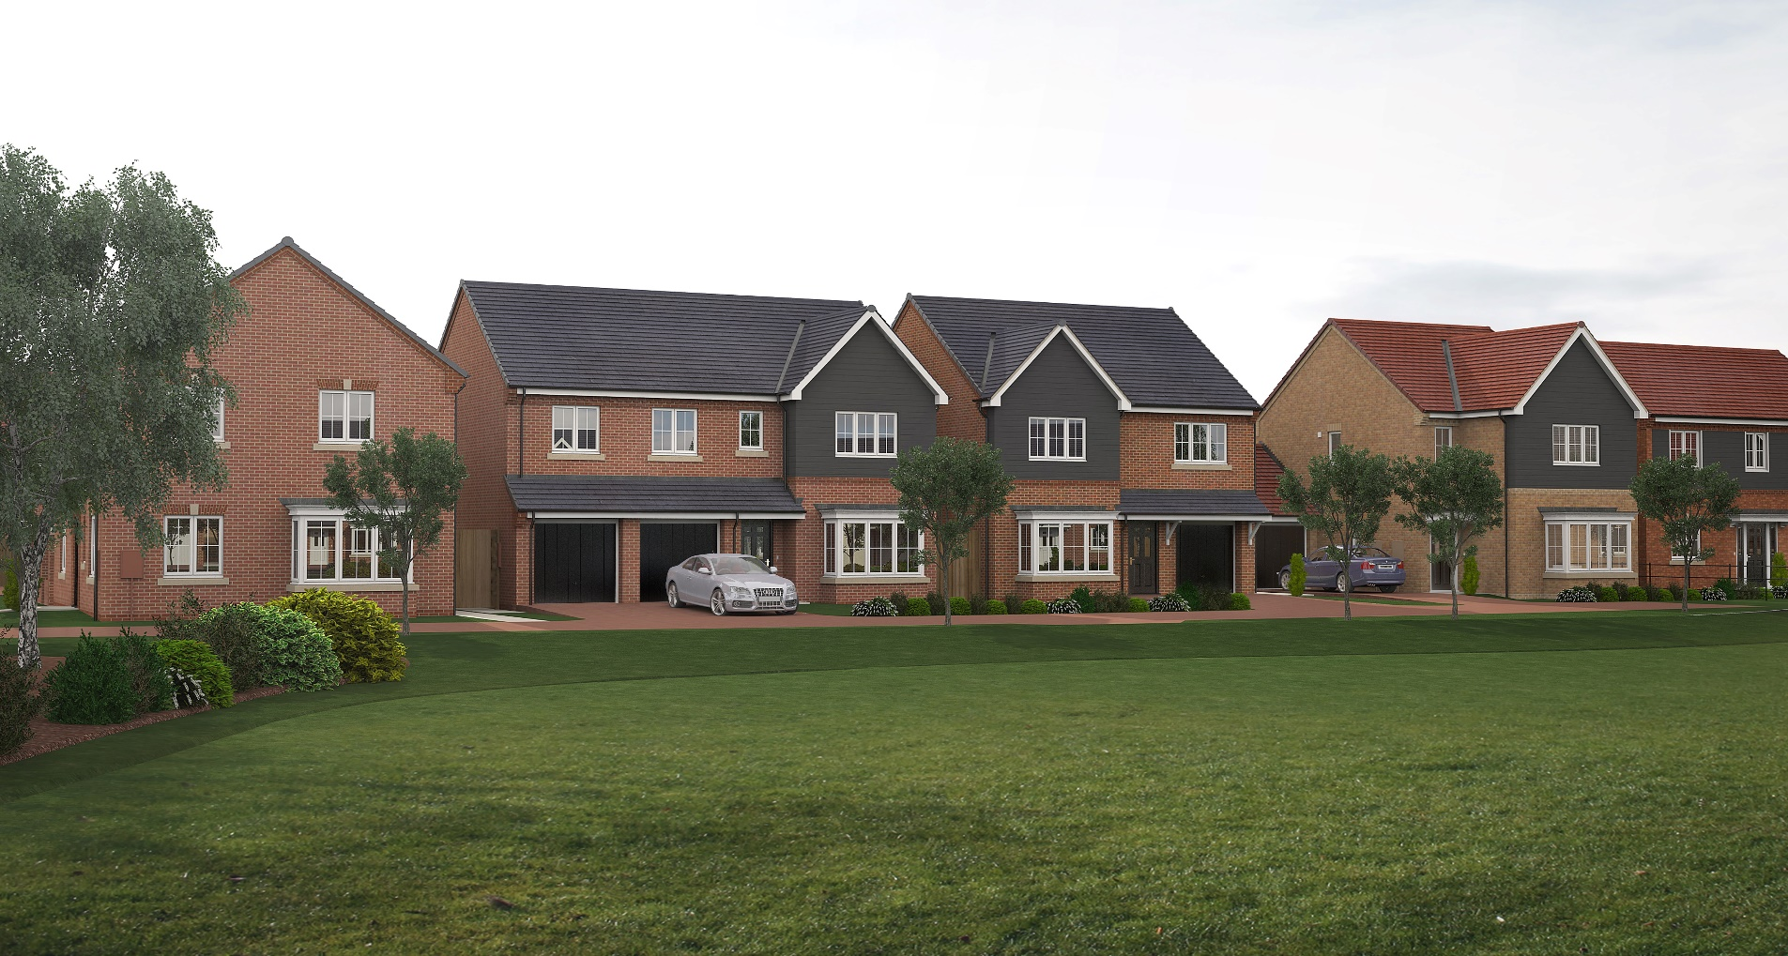
Street Scenes

Slide 31
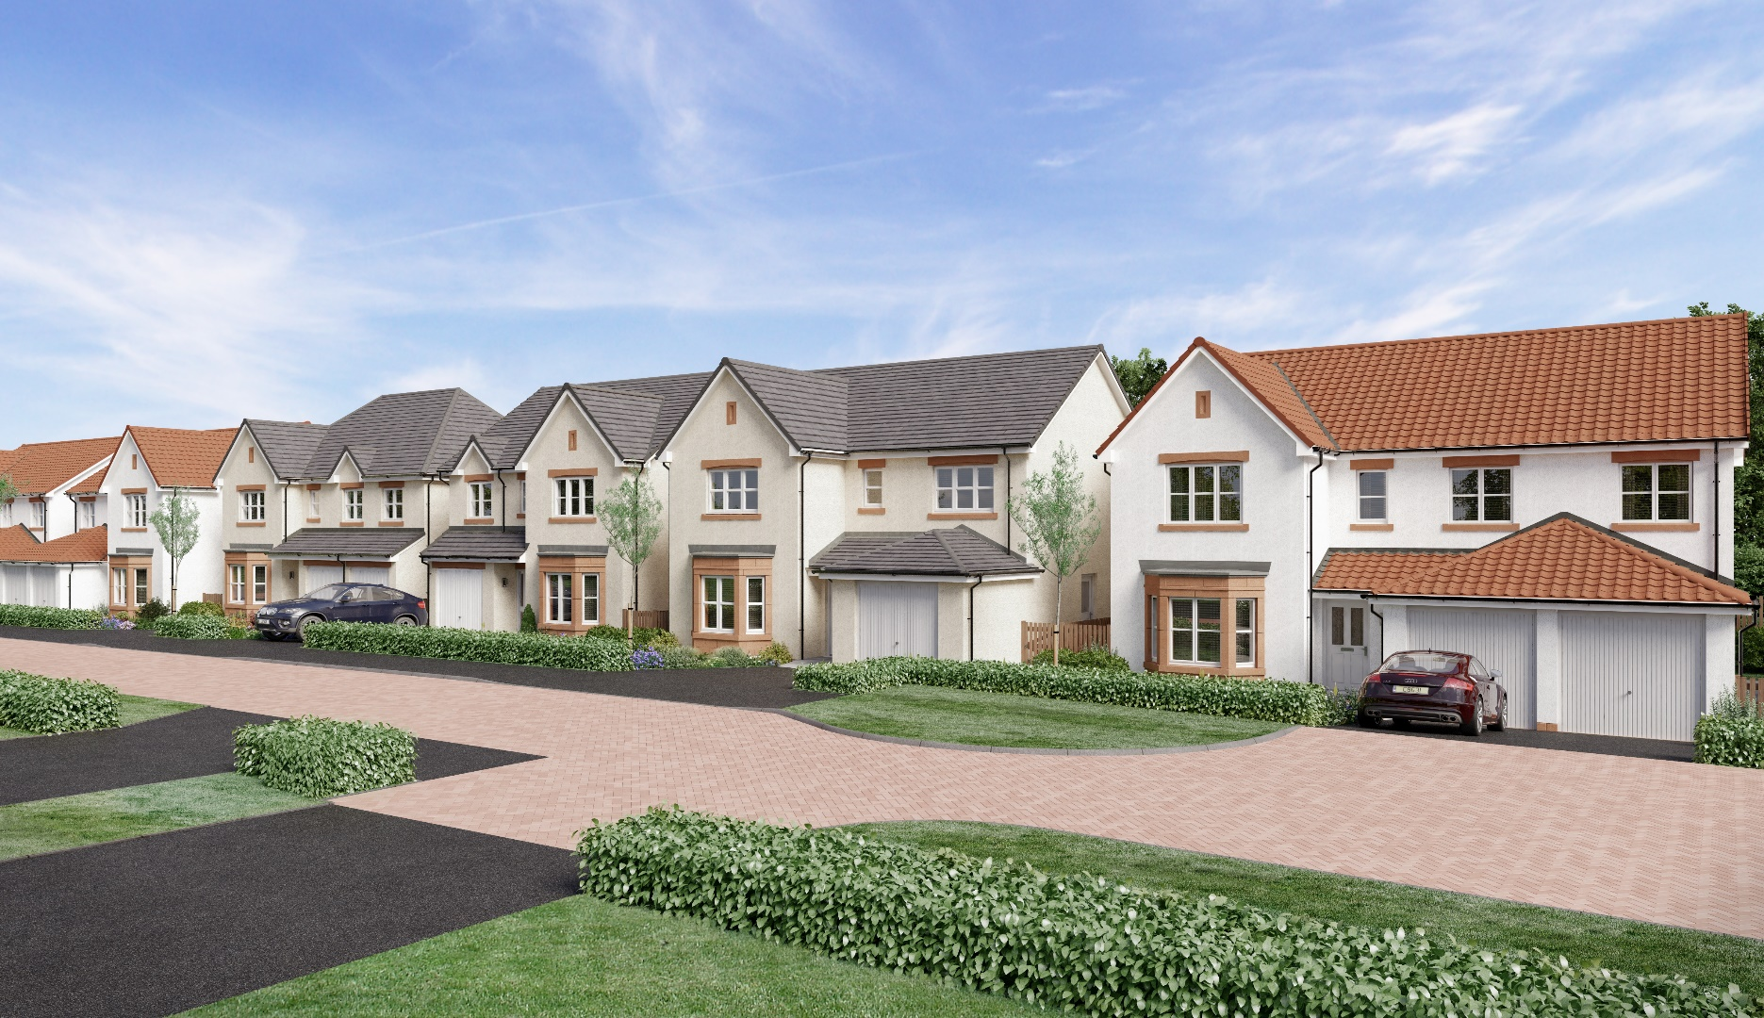
Street Scenes

Slide 32
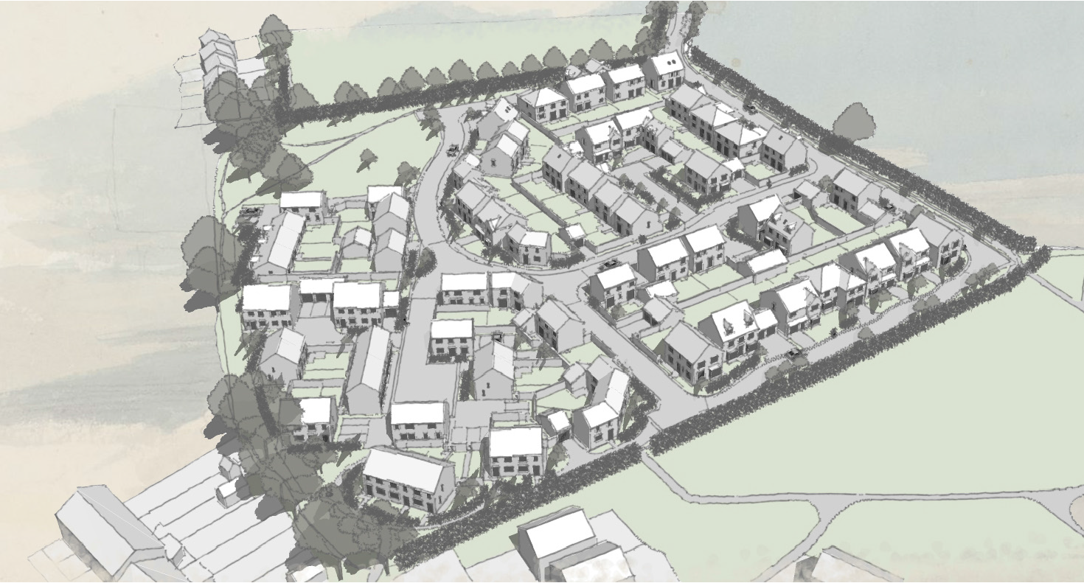
Site Layout Design

Slide 33
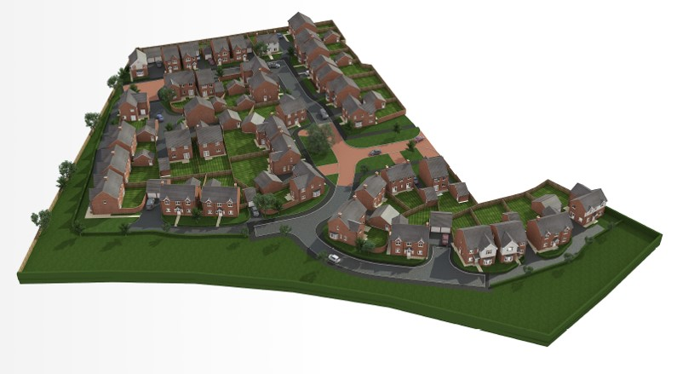
Site Layout Design

Slide 34
Solar Studies

Slide 35
Site Animation
https://www.youtube.com/watch?v=uetjCMXgInw

Slide 36
Business Conclusion
Initial set up cost
Reducing error improve consistency
Supply chain readiness
Collaboration
Skills and Training
Excellent design tool
De-risk all phases of the development process
Provide more to home owners
Not a one stop shop

Slide 37

Quality and Customer Satisfaction

Slide 38

Helping Charity

Slide 39
HBF Digital Construction Group
Promotes Digital Construction
Support network for House Builders
Share best practice
Removes ambiguity
Enhance communication with key stakeholders
Reports back to the wider housebuilding community
Seeks to push boundaries and innovate
HBF Supplier Readiness Survey

Slide 40
Potential Benefits
More accurate information
Greater transparency of compliance
Actual visual representation of new development
Specification accountability for design and as built
Innovation opportunities
Provides invaluable data sets
Links with other compliance tools

Slide 41

Perseverance

Slide 42

Q & A Session

