Slide 1
Digital Construction
Dave Mitchell – HBF Technical Director
Craig C Ferrans MCIAT – HBF Technical Director

Slide 2
Agenda
What is BIM?
House Builders Journey
Supply Chain Support
External Stake Holders
HBF response
Benefits of Digital Construction (win-win)?
Q&A Session

Slide 3
What is Building Information Modelling?
“An integrated digital process providing coordinated, reliable, shareable data throughout all project phases, from design through construction and into operation”

Slide 4
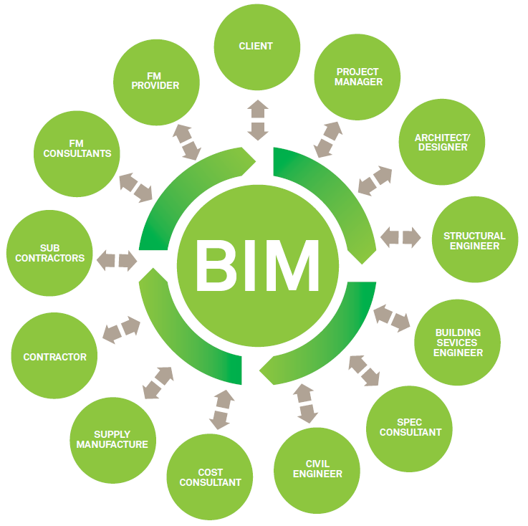
What is BIM?
“BIM is about people and process as much as it is about software”

Slide 5
House Builders Journey
Started the process in 2010
BIM just a buzz word?
Media research
Is there any added value to the business?
Carbon agenda was influential
Improve accuracy
3D Visualisation to assist planning
Collaborate with stakeholders

Slide 6
Fact Finding
Software demonstration
Change in vocabulary
Components fully parametric
Automated scheduling
Work with Worksets
Tap into visualisation
Supply chain involvement
Drive standardisation

Slide 7
IT Hardware and Infrastructure

Slide 8
Taking the Plunge

Slide 9
Taking the Plunge
2011 Software was installed
Only Central Team used Revit
All BIM content was created by Miller homes
Incredibly steep learning curve
Internal service levels maintained
All standard house types drawn in native Revit software
Original working drawing packs replicated

Slide 10
Terminology
Blocks
Family’s

Slide 11
Family Creation

Slide 12
Asset Data Examples
Product details
Maintenance schedules
Contractual & guarantee information
Thermal Details
Travel distances
Installation instructions
Quantities
Costs
Storage
Delivery times
Health and Safety
Recycling & disposal suggestions
URL’s

Slide 13
Schedules

Slide 14
Exporting Information

Slide 15
Live Views

Slide 16
Tail Chasing

Slide 17
Sections

Slide 18
Annotation

Slide 19
Collaboration

Slide 20
Supply Chain Support

Slide 21
Supply Chain
Contribute in different ways
Provide BIM content
Collaborate directly within the model
Schedule information & drawings

Slide 22
Supply Chain
Component & specification schedules
Use in subcontract tenders
Visibility of pricing
Compliance; less interpretation
Consistent and accurate costings
Increased cost knowledge
Less errors; reduced wastage
Improvement in installation quality

Slide 23
Supply Chain
Potential to align BIM schedules with build programme
Delivery dates & requirements
JIT deliveries?
Better stock management
Focused stock levels
Right product & right time
Visibility of forecasted requirement

Slide 24
External Portals

Slide 25
Working Drawing Information

Slide 26
Internal Design

Slide 27
Visualisation

Slide 28
Street Scenes

Slide 29
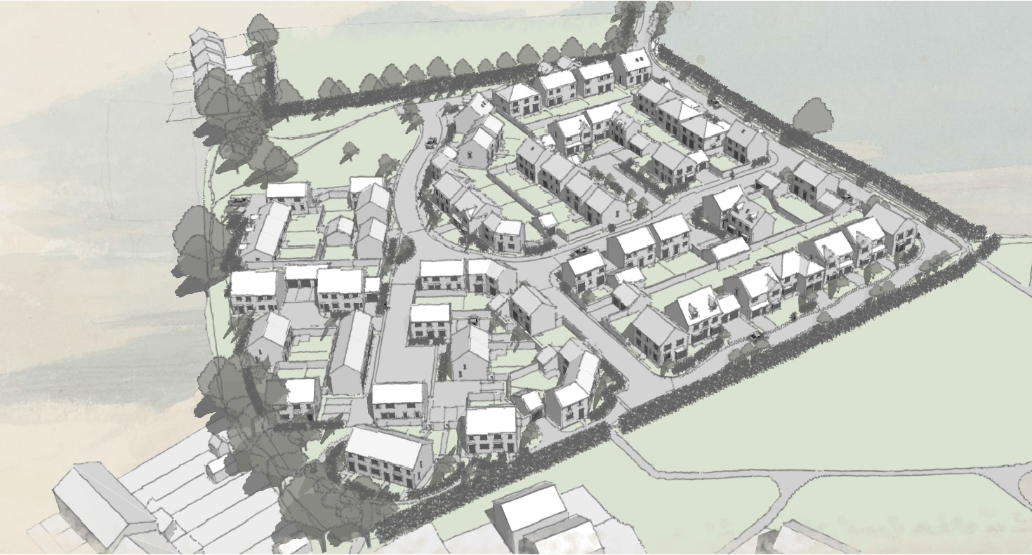
Site Layout Design

Slide 30
Site Layout Design

Slide 31
Solar Studies

Slide 32
Site Animation
https://www.youtube.com/watch?v=uetjCMXgInw

Slide 33
Business Conclusion
Initial set up cost
Reducing error improve consistency
Supply chain readiness
Collaboration
Skills and Training
Excellent design tool
Consistency
Provide more to home owners
Not a one stop shop

Slide 34
Helping Charity

Slide 35
HBF Digital Construction Group
Promotes Digital Construction
Support network for House Builders
Share best practice
Removes ambiguity
Enhance communication with key stakeholders
Reports back to the wider housebuilding community
Seeks to push boundaries and innovate

Slide 36
Potential Benefits
More accurate information
Greater transparency of compliance
Actual visual representation of new development
Specification accountability for design and as built
Innovation opportunities
Provides invaluable data sets
Links with other compliance tools

Slide 37
Perseverance

Slide 38
Q & A Session

