Slide 1
Reduced Energy Costs for Future New-Builds
13 November 2017
Craig Ferrans – Technical Director

Slide 2
About HBF
The Home Builders Federation represents over 200 house builders and more than 200 associate members from businesses across the UK
HBF members build around 80% of new homes
We lead the industry on policy and regulatory affairs and have successfully lobbied the government to ensure a positive operating environment for members
HBF is key stakeholder for all government discussions on house building and has helped to inform the government on key policies, such as the NPPF and Help to Buy

Slide 3
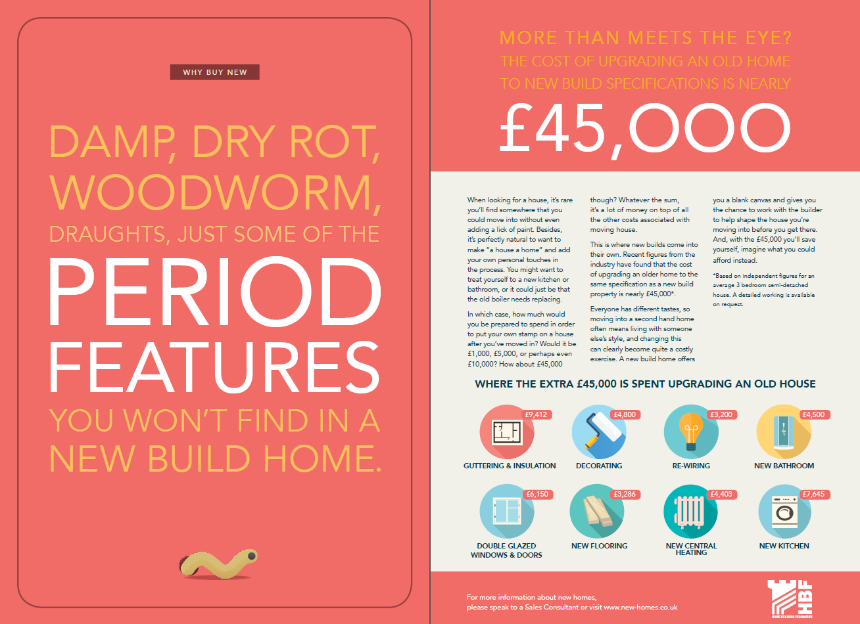


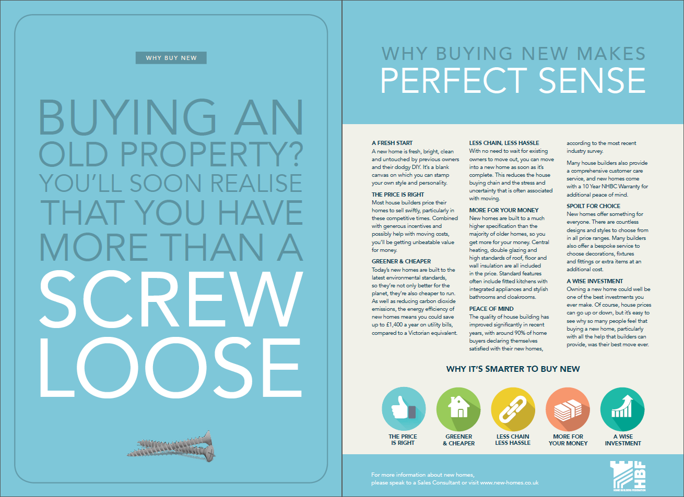


What we do – Factsheets: Why buy new?

Slide 4
Part L1a History Snapshot
Initially Part L1 1985 was a functional requirement to make reasonable provision for the conservation of fuel and power – Elemental Fabric.
Part L was updated in 1995 and again in 2002 and was divided into domestic and non-domestic section and a carbon performance calculation methodology was introduced.
In 2003 the Energy Performance of Buildings Directive was adopted requiring EU member states to adopt a whole building calculation method for assessing carbon.
Then, in 2006 Part L SAP became more focused on compliance and EPCs were produced in 2007, Air Tightness and set criteria.
In 2010 Energy improvements to fabric providing a 25% improvement.
In 2016 Further improvements to carbon reduction were made with additional take-off measurements considered with further option carbon reductions.

Slide 5
HBF Report – You’ve got the power
Promoting energy performance in new homes

Slide 6
Highlights
According to EPC data for the second quarter of 2017, 84.4% of new builds are rated A-B for energy efficiency while just 2.2% of existing properties fall into these categories.
Average fuel costs for a new build as of the year to June 2017 were £443
per year (£276 heating, £108 hot water, £60 lighting) compared with a
total of £1072 for older homes.
The £629 PER YEAR / £52 PER MONTH on average saving
A latte from Starbucks each working day of the year.
The cost of a mobile phone contract and home broadband.
The average Premier League season ticket and seven away matches.
An off-peak return flight to New Zealand.
More practically, it would cover three and a half weeks of an average mortgage.

Slide 7
Immediate context
Building Regulations requirements remain at those of Part L 2016
These requirements believed to be found adequate under the EPBD 5 year review process
Government not pursuing former zero carbon homes policy as a headline objective
Awaiting Government’s response to consultation on SAP, the software methodology for assessing energy efficiency design performance:
  – can potentially impact on technology and design choices for the future.

Slide 8
Longer term position
Leaving the EU will not affect UK statutory commitments under our Climate Change Act 2008 – 80% emissions reduction by 2050
Domestic binding emissions reduction targets are more ambitious than those set by EU legislation
EPBD will be transferred to UK legislation under the EU Withdrawal Bill – but could subsequently be changed
October 2017: Clean Growth Strategy envisages some further steps

Slide 9
Clean Growth Strategy (1)
Measures for housing include:
  Support around £3.6 billion of investment to upgrade around a million homes through the Energy Company Obligation (ECO)
  As many existing homes as possible to be at EPC Band C by 2030-35
  Following the outcome of the independent review of Building
  Regulations and fire safety, and subject to its conclusions, Government intends to consult on strengthening energy performance standards for new and existing homes under Building Regulations, including futureproofing new homes for low carbon heating systems
  Offer all households the opportunity to have a smart meter to help them save energy by the end of 2020

Slide 10
Clean Growth Strategy (2)
Other policies include:
  Build and extend heat networks across the country, underpinned with public funding
  Phase out the installation of high carbon fossil fuel heating in new and existing homes currently off the gas grid during the 2020s, starting with new homes
  Improve standards on the 1.2 million new boilers installed every year in England and require installations of control devices to help save energy
  Reform the Renewable Heat Incentive, spending £4.5 billion to support innovative low carbon heat technologies in homes and businesses between 2016 and 2021
  Innovation programmes to develop new energy efficiency and heating technologies to enable lower cost low carbon homes

Slide 11
Industry Issues
Despite the falling away of the zero carbon homes policy, there are industry issues we are tackling:
  Possible changes to SAP and their impact on design
  Overheating – definition, modelling methodologies, weather mapping, defining risk
  Ventilation and indoor air quality – interaction with the way people live, installation and commissioning
  U-values – are assumptions for walls correct? Implications for plumbing and heating design.
  Thermal imaging – being used more by purchasers: industry guidance needed on understanding/interpretation

