Slide 1
Competition Law for Housebuilders: What You Need to Know
HBF Webinar: 7 July 2026

Slide 2

Chair
Steve Turner
Executive Director
Home Builders Federation

Slide 3

Housekeeping slides
One hour and a half session, with time at the end for Q&A
Feel free to pose questions throughout the session via the Q&A function, instead of chat
A recording of the session will be circulated and made available on the HBF website.

Slide 4
Sarah Cawthorne
Assistant Director, Competition Enforcement
Competition and Markets Authority

Slide 5
Complying with competition law: what you need to know about bid-rigging & information exchange

Slide 6
Background
How we investigate
Who the CMA is
What competition law is
How we open investigations
Our powers of investigation
Information exchange
Where to find out more
How to report
Q&A
When information exchange is problematic
Real-life examples
How to comply

Slide 7

Background
1.

Slide 8
Understanding the CMA
Who
Why
How
What
UK’s primary competition and consumer law enforcement agency
Our purpose: promote competition and protect consumers
Formed out of the Office of Fair Trading and Competition Commission in 2014
Strong legal powers to:
Independent, non-ministerial department sponsored by Department for Business and Trade
Offices in Belfast, Cardiff, Darlington, Edinburgh, London and Manchester
Clear end goal: driving economic growth and improving household prosperity
Tackle cartels
Scrutinise mergers
Address unfair practices
Investigate markets with potential competition and consumer issues

Slide 9
Competition Act 1998: competition law in a nutshell
Chapter I: anticompetitive agreements
Chapter II: abuse of a dominant market position
Chapter I prohibits agreements and concerted practices between businesses that prevent, restrict or distort competition
Often involves business cartels
Conduct we investigate includes:
  Bid rigging
  Price fixing
  Market sharing
  Output restrictions
  Exchange of competitively sensitive information
  Resale Price Maintenance
Overlap with other types of fraud
Includes informal agreements (eg ‘gentlemen’s agreements’)
Chapter II prohibits abuse of a dominant market position
An abuse can be exclusionary (making it difficult for competitors to compete) or exploitative (taking advantage of customers not being able to switch to alternative suppliers)
Examples of exclusionary abuse include:
  Tying or bundling
  Disadvantaging competitors / ‘self-preferencing’
  Controlling important inputs
  Requiring customer loyalty
  Blocking or restricting entry by potential competitors
Exploitative abuses can take the form of charging unjustifiably high prices or imposing unfair T&Cs

Slide 10

Why this matters to you
All businesses must comply with UK competition law, regardless of their size.
The consequences of breaching competition law can be serious and can include:
  Fines of up to 10% of a business’s global turnover
  Company directors involved in breaching competition law can be disqualified from acting as a company director for up to 15 years
  Debarment from public procurement
  Damages claims
Low awareness of risk

Slide 11

How we investigate
2.

Slide 12
Our investigations
Leniency
Intelligence-led
If your business has been involved in a cartel, you can benefit from applying for leniency
Under our new leniency guidance, being the first in to apply for leniency the only way to guarantee immunity from:
  Penalties
  Director disqualification
  Criminal prosecution
  Exclusion from public contracts
Investigating reports of anti-competitive behaviour from:
  Public officials – including procurers and counter-fraud teams
  Other businesses
  Whistleblowers or informants
  Members of the public
  Other intelligence sources
Screening public procurement data to identify suspicious patterns

Slide 13

Powers of investigation
Dawn raids
Interviews
Compelling companies to provide us with documents and information
Surveillance powers
Covert Human Intelligence Sources
Communications data

Slide 14

Information Exchange
3.

Slide 15
Background to our investigation
Housebuilding Market Study
The CMA published a market study report on the housebuilding industry in 2024.
Evidence found during the study indicated some housebuilders may be sharing commercially sensitive information with their competitors.
Investigation into suspected exchanges of commercially sensitive information by housebuilders
Following the Market Study, the CMA opened an investigation into suspects exchanges of commercially sensitive information by certain housebuilders.
The housebuilders offered a package of legally binding commitments to address the CMA’s concerns. These commitments included:
  a combined £100 million payment to be split between affordable housing programmes across all 4 UK nations.
  work with the Home Builders Federation and Homes for Scotland to develop industry-wide guidance on information sharing.
  agree not to share certain types of information with other housebuilders, including the prices houses have been sold for, except in limited circumstances.
The CMA accepted the commitments in October 2025. As a result, the CMA discontinued the investigation with no decision made as to whether the case parties infringed competition law.

Slide 16
Information exchange: key principles
What you need to know
UK competition law prohibits the exchange of competitively sensitive information (‘CSI’) between competitors, with only limited exceptions.
This applies however CSI is exchanged, including (but not limited to) when information is shared directly between competitors in meetings, by email, phone calls, face-to-face, through messaging apps, or on social media.
Competition law also prohibits the indirect exchange of CSI with competitors (eg through a third party such as an agent, trade forum or lender).

Slide 17
Information exchange: key principles
What is Competitively Sensitive Information (CSI)?
Competitively sensitive information covers any non-public strategic information about a business’s commercial policy. It includes, but is not limited to, future pricing and output plans.
Whether information is competitively sensitive usually depends on whether it is useful to a competitor when setting its competitive strategy (including pricing) or whether it otherwise reduces uncertainty around how the relevant market operates.
Ask yourself:
Is this information which is not in the public domain?
If my competitor knew this information, would they be able to change their market behaviour in response to the information (e.g. by adapting their pricing)?
If either of the questions above is “yes”, the information could be CSI.

Slide 18
Key do’s and don’ts for housebuilders
do
don’t
Do use only your own information or public information when setting prices or incentives.
Do protect your company’s own confidential information from disclosure.
Do use formal agendas and take minutes if you are meeting competitors and ensure CSI is not shared
Do object and report it if a competitor offers to share CSI and, if necessary, leave the discussion.
Do be mindful of information received from third parties and whether it is suitably aggregated, anonymised, public or historic.
Do familiarise yourself with competition law and guidance
Don’t share CSI with your competitors – including through social channels (eg Whatsapp; social media)
Don’t discuss with competitors information about:
  the price at which sales are agreed
  incentives agreed with customers
  sales volumes (including reservations, cancellations and completions)
  visitor information
Don’t share information with others (lenders, agents etc) unless you have sought confirmation it will be not be shared further unless aggregated & anonymised

Slide 19

Find out more & how to report
4.

Slide 20

Where to find out more
Our Cheating or Competing campaign page houses:
Free e-learning module on bid-rigging dangers
Series of animated explainer films and reporting info
Case studies
VISIT: gov.uk/cheating-or-competing
CMA blog on leniency: why being first in matters more than ever
HBF & HfS Industry guidance on compliance with competition law
CMA video on information you shouldn't share with other businesses
CMA 2014 guidance on managing competitively sensitive information
CHEATING OR COMPETING

Slide 21
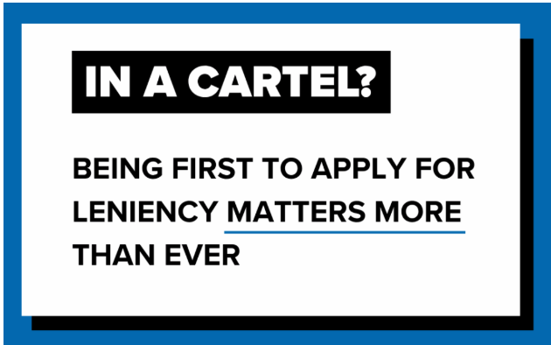

How to report to us
If your business has been involved…
If you are not involved in a cartel but know about one…
Read our leniency guidance online
Leniency enquiry line: 020 3738 6833
Alternatively:
report via our online reporting form
email: cartelshotline@cma.gov.uk

Slide 22
Questions

Slide 23

Thank you for joining us
Follow us on LinkedIn:
the-home-builders-federation
And X: @HomeBuildersFed
Feedback on today’s session and recommendations for future sessions: comms@hbf.co.uk
Scan the QR code to view future events

