Slide 1
Partner a College
Site Visit Induction
FE College Students
Preparing students for a safe and informative site visit

Slide 2
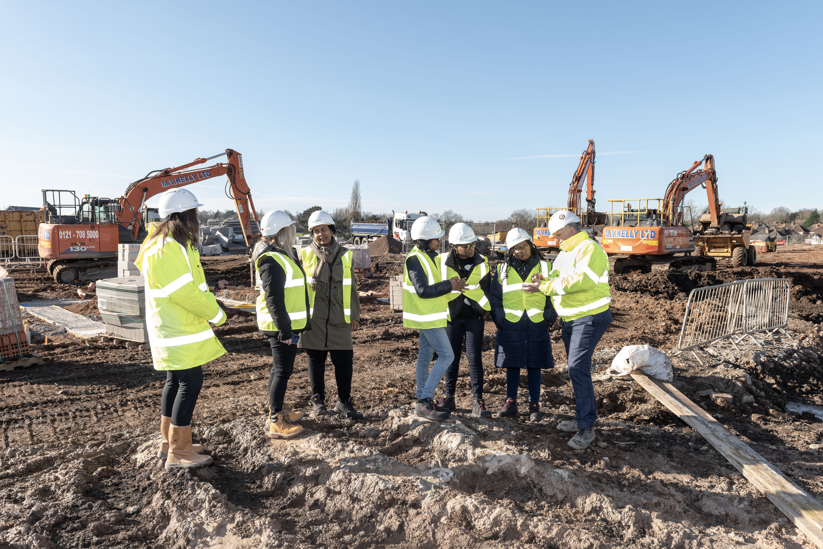
How to use this resource
This site visit induction has been designed specifically for college students to ensure that everyone attending the visit understands the purpose of the day, the expectations placed upon them, and, most importantly, how to remain safe while on a live construction site.
Review and edit the slides to tailor the induction in line with your organisation and the site in question.

Slide 3
Site Visit Induction
Safety Priority
Safety is the top priority during the site visit and must be maintained at all times by all attendees
Visit Structure and Expectations
The induction outlines the visit's purpose, schedule, participants, and expected conduct
Learning and Career Insight
The visit offers real-life construction experience and insights into potential career pathways in the industry
Professionalism and Responsibility
Students are encouraged to act responsibly, stay attentive, and respect the professional workplace environment
Notes:
This opening slide establishes the importance of professionalism, awareness, and respect, which are essential qualities for anyone considering a future career in construction or the built environment. Site rules and induction - HSE
Note: Site inductions should be provided to those who visit it on a once-only basis (e.g. students). The inductions should be proportionate to the nature of the visit. Inductions provided to escorted visitors need not have the detail that unescorted visitors should have. Escorted visitors only need to be made aware of the main hazards they may be exposed to and the control measures. Ref Site rules and induction - HSE

Slide 4
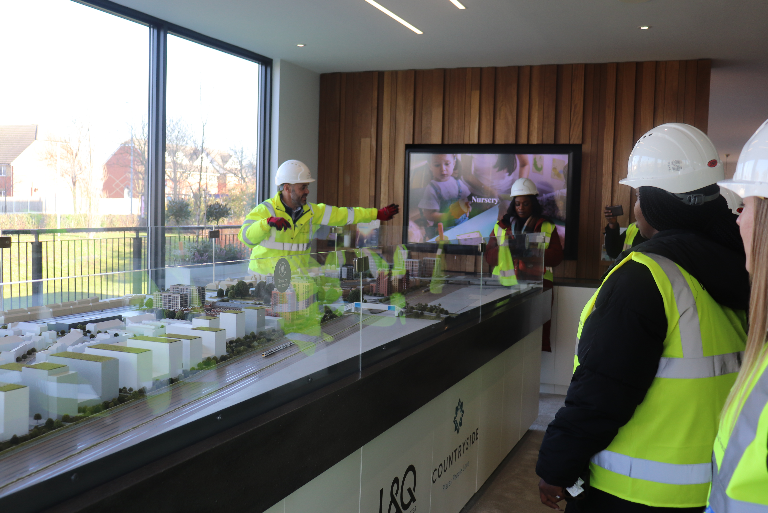
Welcome and Introduction
Introduction of Site Team
Students meet key site team members responsible for project safety and delivery
Company Overview
Overview of the company explains its role, specialisation, and position within the wider construction sector
Purpose and Objectives
Clear explanation of visit purpose to guide students on expected outcomes and experiences. Encourage students to ask questions, and observe trades
Visit Agenda and Expectations
Outline of visit duration and agenda helps manage behaviour and maintain focus for an engaging experience
Notes:
The welcome and introduction section is an important opportunity to set expectations and build a positive relationship between the site team and the visiting students. At the start of the visit, students will be introduced to key members of the site team, such as the Site Manager, Health and Safety Lead, and other relevant staff. These individuals are responsible for the safe and successful delivery of the project and will often have many years of experience within the construction industry.
Providing an overview of the company allows students to understand who is delivering the project, what type of work the company specialises in, and how the organisation fits within the wider construction sector.
The purpose of the visit should be clearly explained, highlighting the learning objectives and what students are expected to gain from their time on site. This may include understanding how construction projects are managed, seeing different trades in action, and learning about health and safety in a real-world environment. The site team should also explain the expected duration of the visit and the agenda for the day, so students know what will happen and when. This clarity helps to manage behaviour, maintain focus, and ensure the visit runs smoothly. By starting with a structured and welcoming introduction, students are more likely to feel engaged, respected, and motivated to participate responsibly throughout the visit.

Slide 5
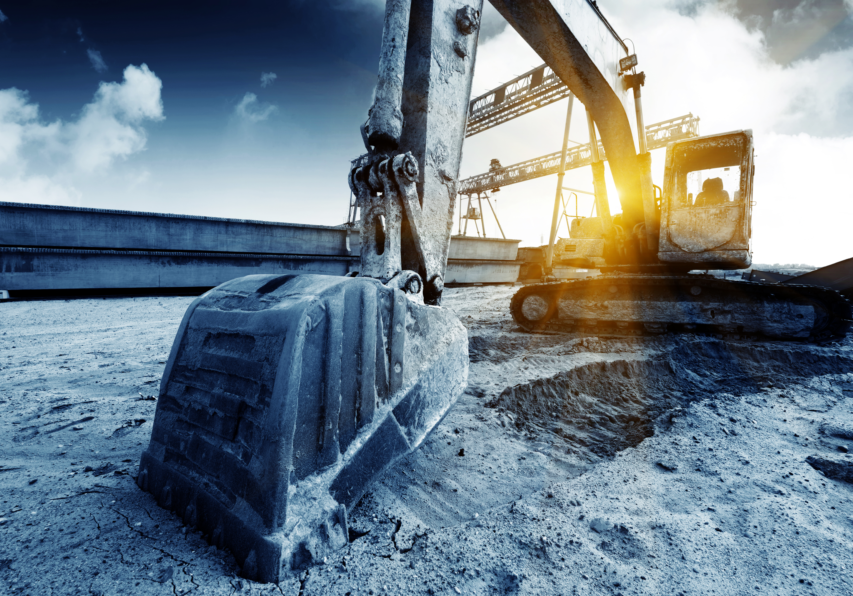
Site Overview
Project Type and Scale
  Explain the type of construction project and its overall scale and timeline to provide essential context.
Current Construction Phase
  Describe the current phase of works such as groundworks, structural construction, or internal fit-out to clarify ongoing activities.
Key Trades Involved
  Introduce key trades like groundworkers, carpenters, electricians, and bricklayers and how they work together to build the development.
Community Impact
  Highlight how the development benefits the local community through housing, jobs, and infrastructure improvements.
Notes:
The site overview provides students with essential context about the construction project they are visiting. This section explains the type of development being built, such as residential, commercial, educational, or infrastructure, and outlines the overall scale and timeline of the project. Understanding the size and duration of a project helps students appreciate the level of planning, coordination, and teamwork required in construction.
The site team should also explain the current phase of works, for example groundworks, structural construction, or internal fit-out, so students can better understand what activities they are observing during the visit. Introducing the key trades currently working on site, such as groundworkers, carpenters, electricians, or bricklayers, allows students to see how different roles contribute to the overall project. This is particularly valuable for students considering specific career paths within the industry.
Finally, highlighting the importance of the development to the local community helps students understand the broader impact of construction projects. This may include providing housing, creating jobs, improving infrastructure, or supporting local services. By linking the technical aspects of construction to social and community benefits, students gain a more holistic understanding of why construction work matters and how it contributes to society.

Slide 6
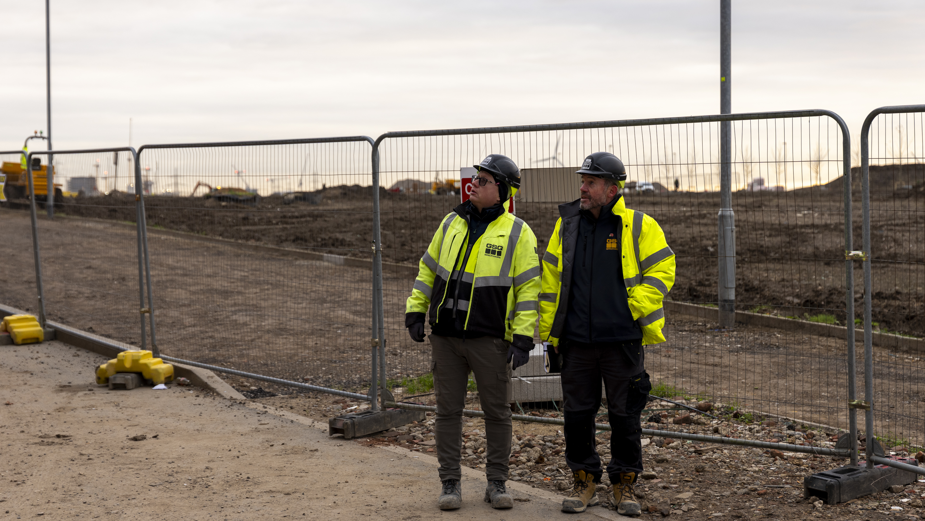
Health & Safety
Follow Site Staff Instructions
Always follow guidance from site staff who understand hazards and safe management on construction sites
Stay with Designated Guide
Remain with the designated guide to avoid unsafe or restricted areas during the site visit
Avoid Unsafe Behaviours
Unsafe actions such as running are prohibited to prevent serious accidents on site. Be aware of vehicles and plant. No phones and no photography unless authorised
Report Hazards Promptly
Report any unsafe conditions or hazards immediately to site staff to ensure prompt action.
Notes:
Health and safety is the most critical aspect of any construction site visit and must be taken seriously at all times.
This section clearly communicates the rules that students must follow to protect themselves and others. Students must always follow instructions given by site staff, as these individuals understand the hazards present and how to manage them safely. Remaining with the designated guide at all times ensures that students do not enter unsafe or restricted areas.
Running, fooling about, or any form of unsafe behaviour is strictly prohibited, as even small actions can lead to serious accidents in a construction environment.
Students must remain aware of moving vehicles, machinery, and plant, which may have limited visibility and restricted stopping distances. Any hazards, unsafe conditions, or concerns must be reported immediately to a member of the site team so that they can be addressed promptly. This section reinforces the idea that safety is a shared responsibility and that everyone on site has a role to play in maintaining a safe working environment. By understanding and following these rules, students help ensure that the visit is safe, controlled, and educational for all involved.

Slide 7
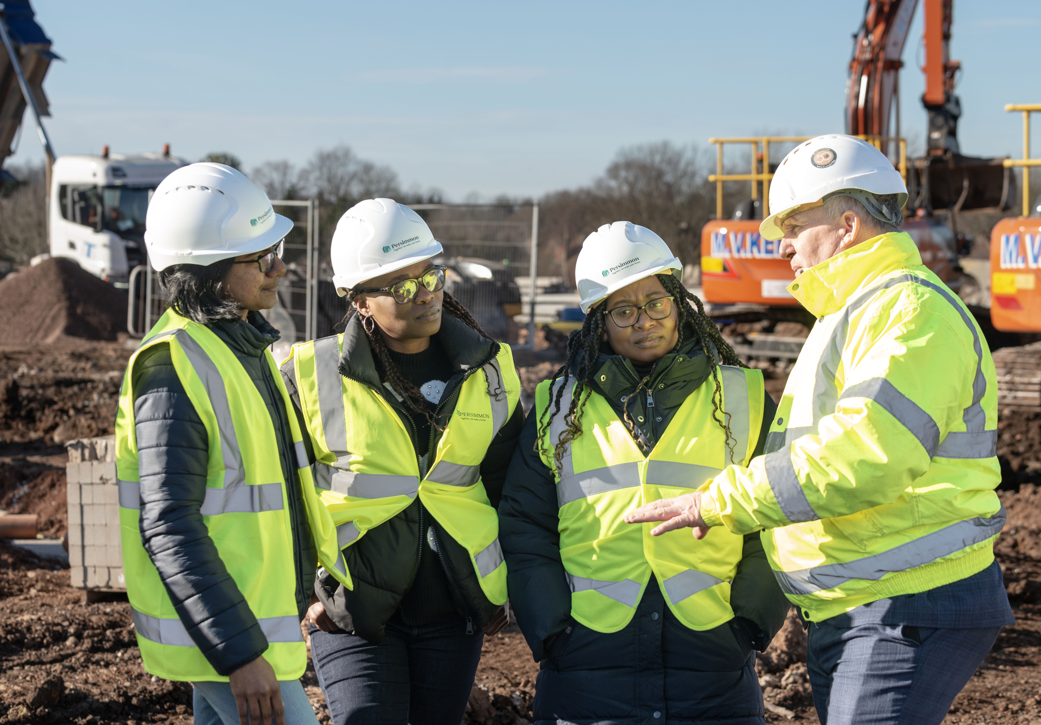
Personal Protective Equipment
Importance of PPE
  PPE is essential for reducing injury risks and acts as the last line of defence on construction sites
Standard PPE Items
  Standard PPE includes hard hats, high-visibility vests, and safety boots for protection against various hazards
Correct Usage and Safety
  Students must wear PPE correctly, respect site rules, and report damaged or ill-fitting equipment immediately
Notes:
Personal Protective Equipment, (PPE), is essential for reducing the risk of injury on a construction site. Students must be informed that PPE is not optional and must be worn correctly at all times while on site.
The standard PPE required for this visit includes a hard hat to protect against falling or moving objects, a high-visibility vest to ensure students can be easily seen by plant operators and drivers, and safety boots to protect feet from heavy objects, sharp materials, and uneven surfaces. The purpose of PPE should be clearly explained so that students understand that it is a last line of defence against hazards that cannot be completely eliminated. Wearing PPE correctly also demonstrates
professionalism and respect for site rules. Students should be reminded not to remove or adjust their PPE without permission and to inform the site team if any equipment is damaged or does not fit properly. By reinforcing the importance of PPE, this section helps students develop good safety habits that will be expected of them in future construction-related education or employment.
Using personal protective equipment (PPE) to control risks at work: Overview - HSE

Slide 8
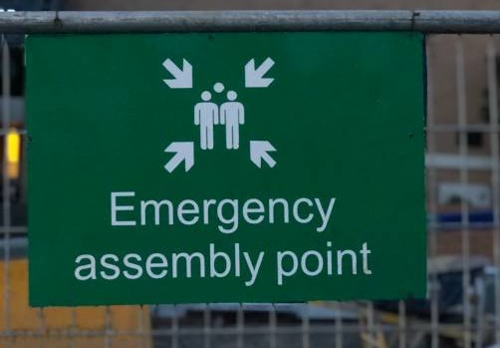
Emergency Procedures
Emergency Response Actions
Students must go directly to the assembly point during an alarm without collecting belongings to ensure safety
Emergency Communication Methods
Emergencies are communicated via alarms or verbal instructions to guide everyone calmly and clearly
First Aid and Injury Reporting
First aid arrangements and contact info for trained responders must be clear; all injuries should be reported promptly
Notes:
Understanding emergency procedures is essential before entering a construction site.
This section explains what students must do in the event of an emergency, such as a fire, serious incident, or evacuation. The location of the site assembly point should be clearly identified, and students must be instructed to go directly to this location if an alarm sounds, without stopping to collect personal belongings.
The site team should explain how emergencies are communicated, for example through alarms or verbal instructions, and emphasise the importance of remaining calm and following directions. First aid arrangements should also be outlined, including who the trained first aiders are and how they can be contacted. Students should be encouraged to report any injury, no matter how minor, so it can be properly recorded and treated. RIDDOR – Reporting of Injuries, Diseases and Dangerous Occurrences Regulations - HSE
This information ensures that students know what to do in unexpected situations and helps minimise confusion or panic. Being prepared for emergencies is a key part of site safety and reinforces the professional standards expected on a live construction site.First aid - HSE

Slide 9

Welfare Facilities
Health & Hygiene Facilities
Designated Break Areas
Access & Responsibility
Legal & Ethical Awareness
Welfare facilities include toilets and handwashing stations essential for maintaining good hygiene on construction sites
Break areas are clearly identified to provide workers and visitors a safe place to rest and refresh during work hours
Students and visitors must use welfare facilities responsibly and only access authorised areas to respect site rules
Understanding welfare facilities helps students learn about employers’ legal and ethical duties towards health and safety
Notes:
Welfare facilities are provided on construction sites to support the health, comfort, and wellbeing of everyone on site, including visitors.
Students should be shown the location of toilets and handwashing facilities and reminded to use them responsibly. Good hygiene is particularly important on construction sites, where dust, dirt, and materials can pose health risks if not managed properly. Designated break areas should be identified, and students should be informed when and where breaks are allowed. It is important that students understand they must not enter welfare facilities without permission or use areas designated for workers unless authorised.
This section also reinforces respect for shared spaces and the need to keep facilities clean and tidy for others. By understanding how welfare facilities are managed on site, students gain insight into the legal and ethical responsibilities employers have towards workers and visitors. Have the right workplace facilities - Overview - HSE

Slide 10

Tour Guidance
Site Visit Overview
  Tour guidance outlines the visit plan and clarifies site areas students will explore and avoid.
Restricted Areas Explanation
  Restricted zones are identified due to hazards such as unfinished structures and dangerous materials.
Safe Movement Instructions
  Students receive safety instructions including using walkways and maintaining distance from active work areas.
Importance of Safety Compliance
  Following tour guidance ensures a controlled visit, minimising risks and maximising learning opportunities.
Notes:
Tour guidance explains how the site visit will be conducted and what students can expect during the walk around the site. The site team should clearly identify which areas will be visited and explain why certain areas are restricted or off-limits. Restricted areas may contain higher-risk activities, unfinished structures, or hazardous materials, and must not be entered under any circumstances. Students should be instructed on how to move safely around the site, including using designated walkways, maintaining safe distances from working areas, and remaining alert to changing conditions. This section helps students understand that construction sites are constantly evolving and that safe routes and access points may change. By following tour guidance, students help ensure that the visit remains controlled and that everyone can focus on learning without unnecessary risk. Protecting the public - HSE

Slide 11
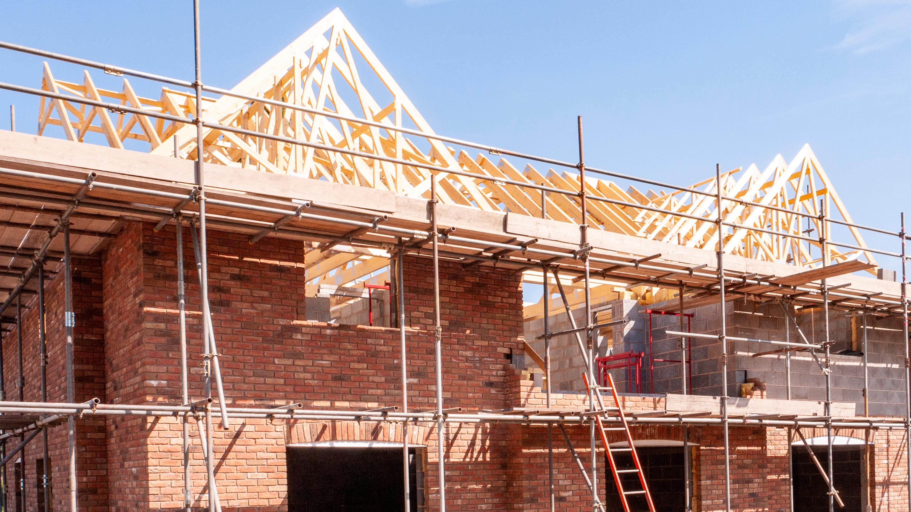
Learning & Engagement
Active Participation
  Students are encouraged to ask questions to enhance their understanding during the site visit.
Real-World Learning
  Observing trades in action helps students connect classroom theory with practical construction processes.
Career Pathways Insight
  Site visits offer insights into various careers like site management, bricklaying, and roofing.
Informed Decision Making
  Engaging with a real live site environment helps students to make better choices about future education and careers.
Notes:
The learning and engagement section encourages students to make the most of their site visit by actively participating and asking questions.
Students should feel comfortable seeking clarification about construction processes, job roles, and safety practices, as this helps deepen their understanding. Observing different trades in action allows students to see how classroom learning translates into real-world applications. The site visit also provides an opportunity to consider potential career pathways within construction, such as skilled trades, site management, engineering, or office based roles. By engaging with site staff and observing the working environment, students can gain valuable insight into the skills, attitudes, and qualifications required in the industry. This section reinforces that the visit is not just about observing but about learning, reflecting, and making informed decisions about future education and career choices.

Slide 12
Questions & Close
Opportunity for Final Questions
  Encourage students to ask final questions about what they have seen on the visit, or careers to clarify their understanding.
Recap of Health and Safety
  Site representatives should reinforce key health and safety messages
  Professional Closing and Sign-off
  Thank attendees and complete formal sign-off with optional evaluation and signatures to confirm understanding and cooperation.
Notes:
The questions and close section provides a structured end to the site visit, allowing students to clarify any remaining points and reflect on what they have learned. Students should be given the opportunity to ask final questions about the project, site operations, or careers in construction.
The site representative should recap the key health and safety messages to reinforce their importance and ensure they remain memorable.
Thanking students for their attention, cooperation, and positive behaviour helps end the visit on a professional and respectful note. This section may also include an evaluation, formal sign-off, with signatures from the college group leader and the site representative, confirming that the induction has been delivered and understood. Ending the visit in a clear and organised way reinforces the importance of communication, accountability, and professionalism, which are essential qualities in the construction industry.

