Slide 1
Planning challenges in home building – A regional perspective

Slide 2
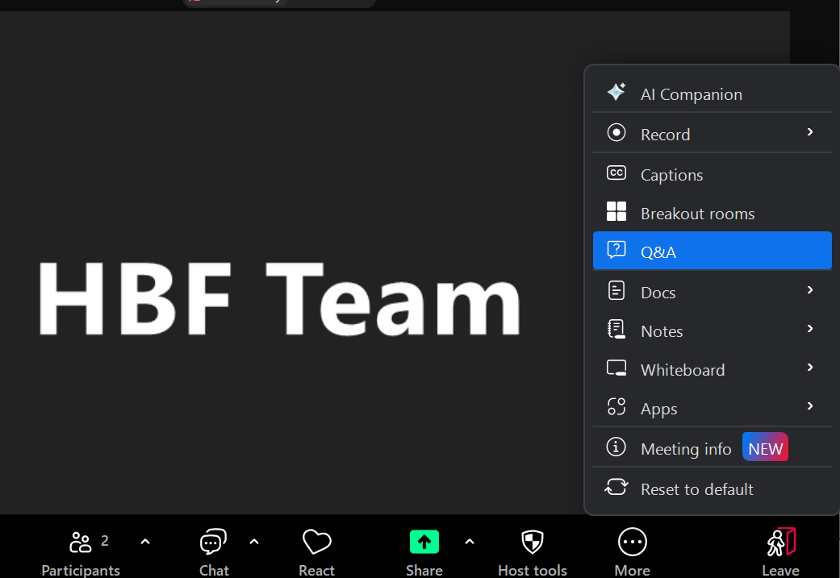
Housekeeping slides
90-minute session with time at the end for Q&A
Feel free to pose questions throughout the session via the Q&A function, instead of chat
A recording of the session will be circulated and made available on the HBF website

Slide 3
HBF Planning team

Slide 4
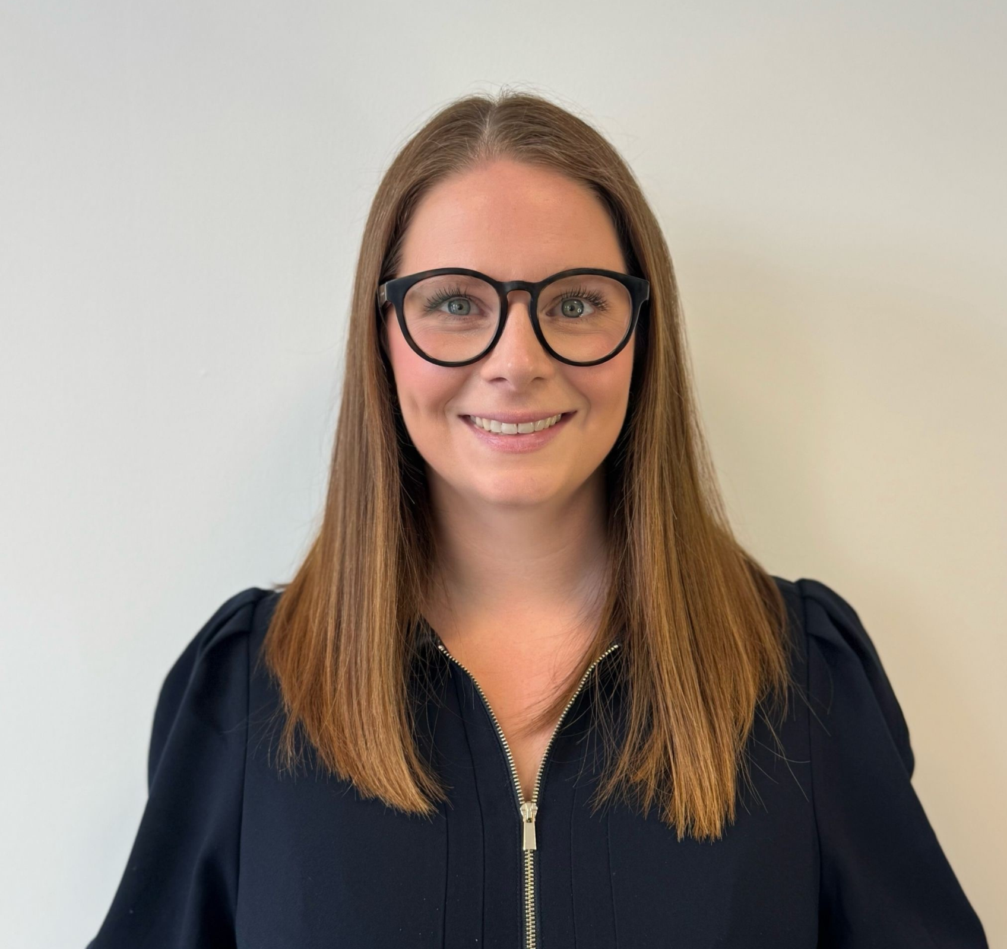
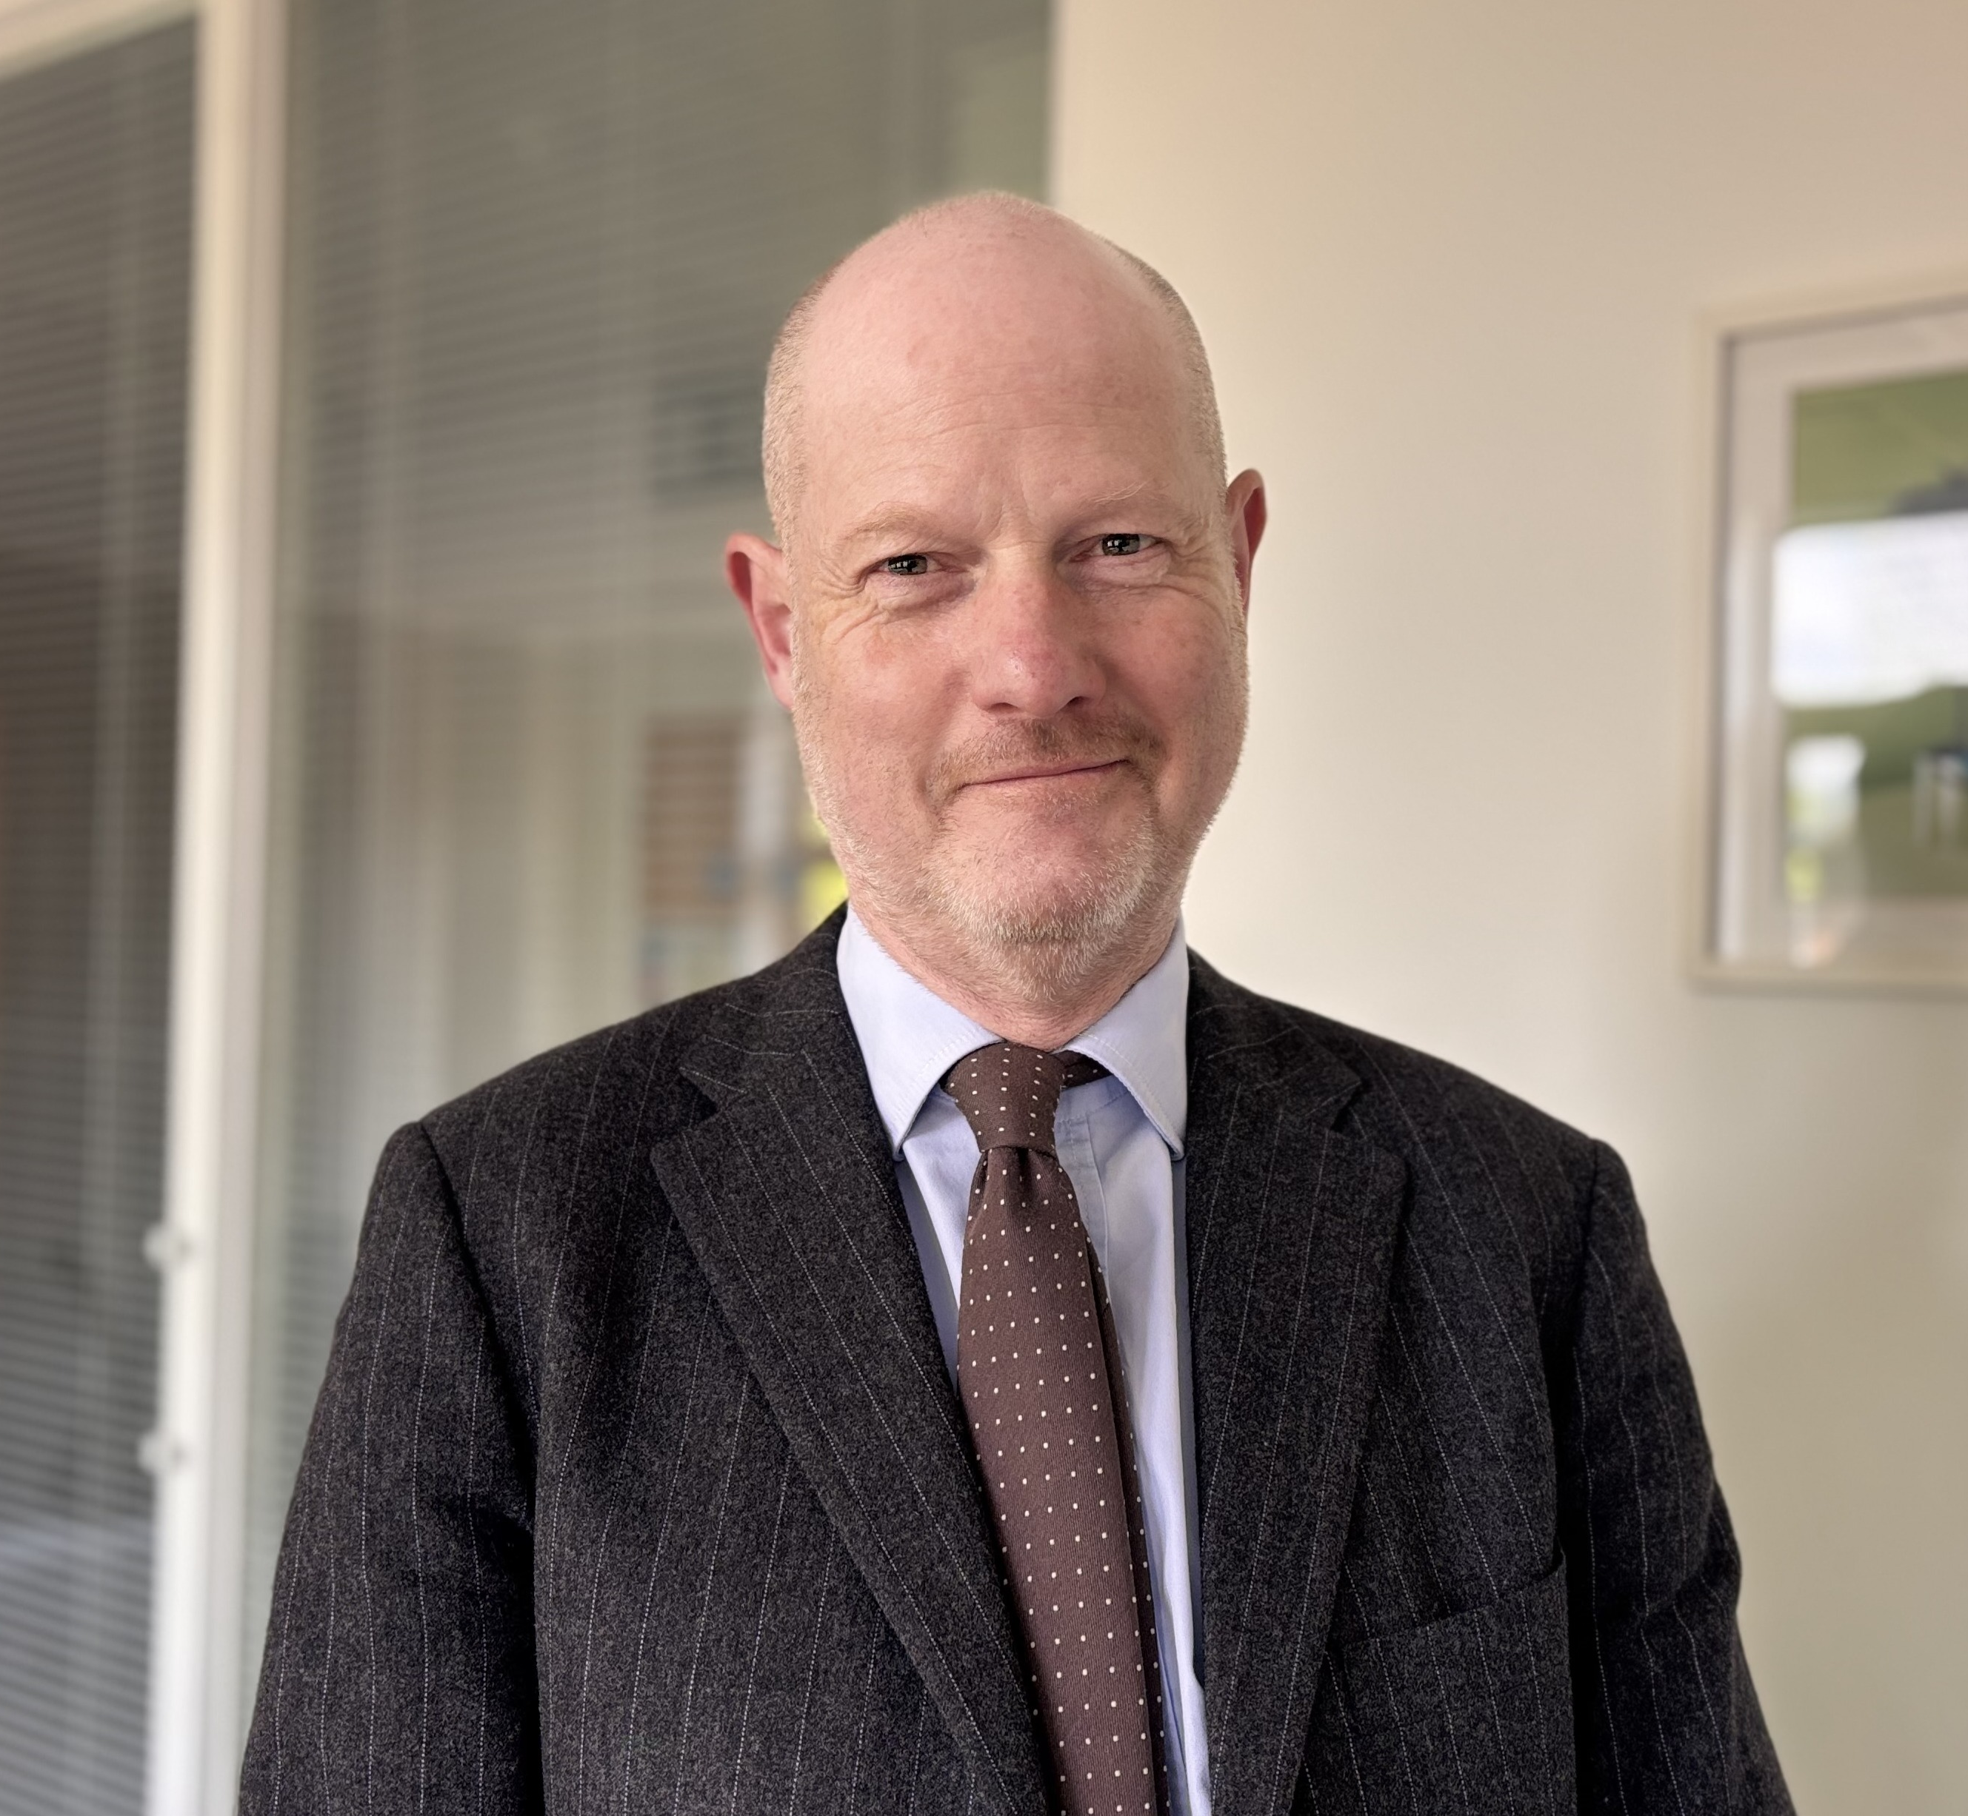
Catherine Williams
James Stevens
Director for Cities
Planning Director

Slide 5
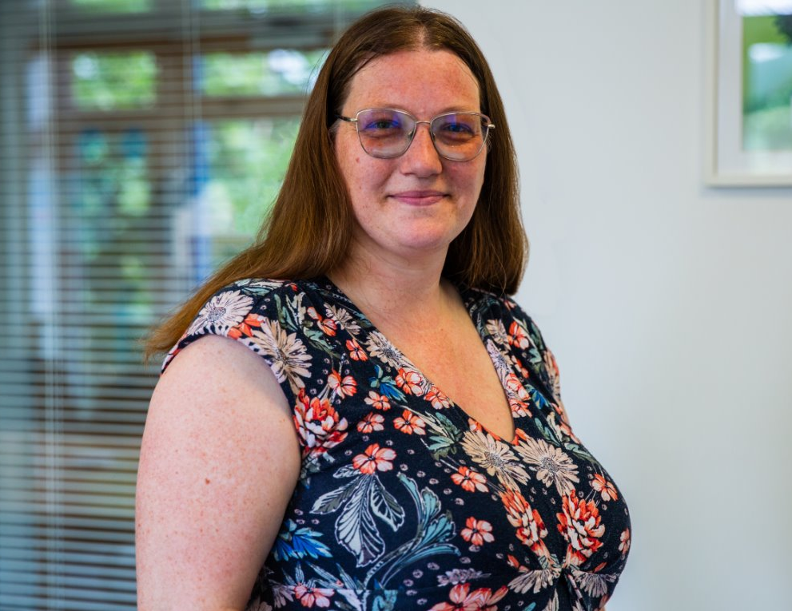
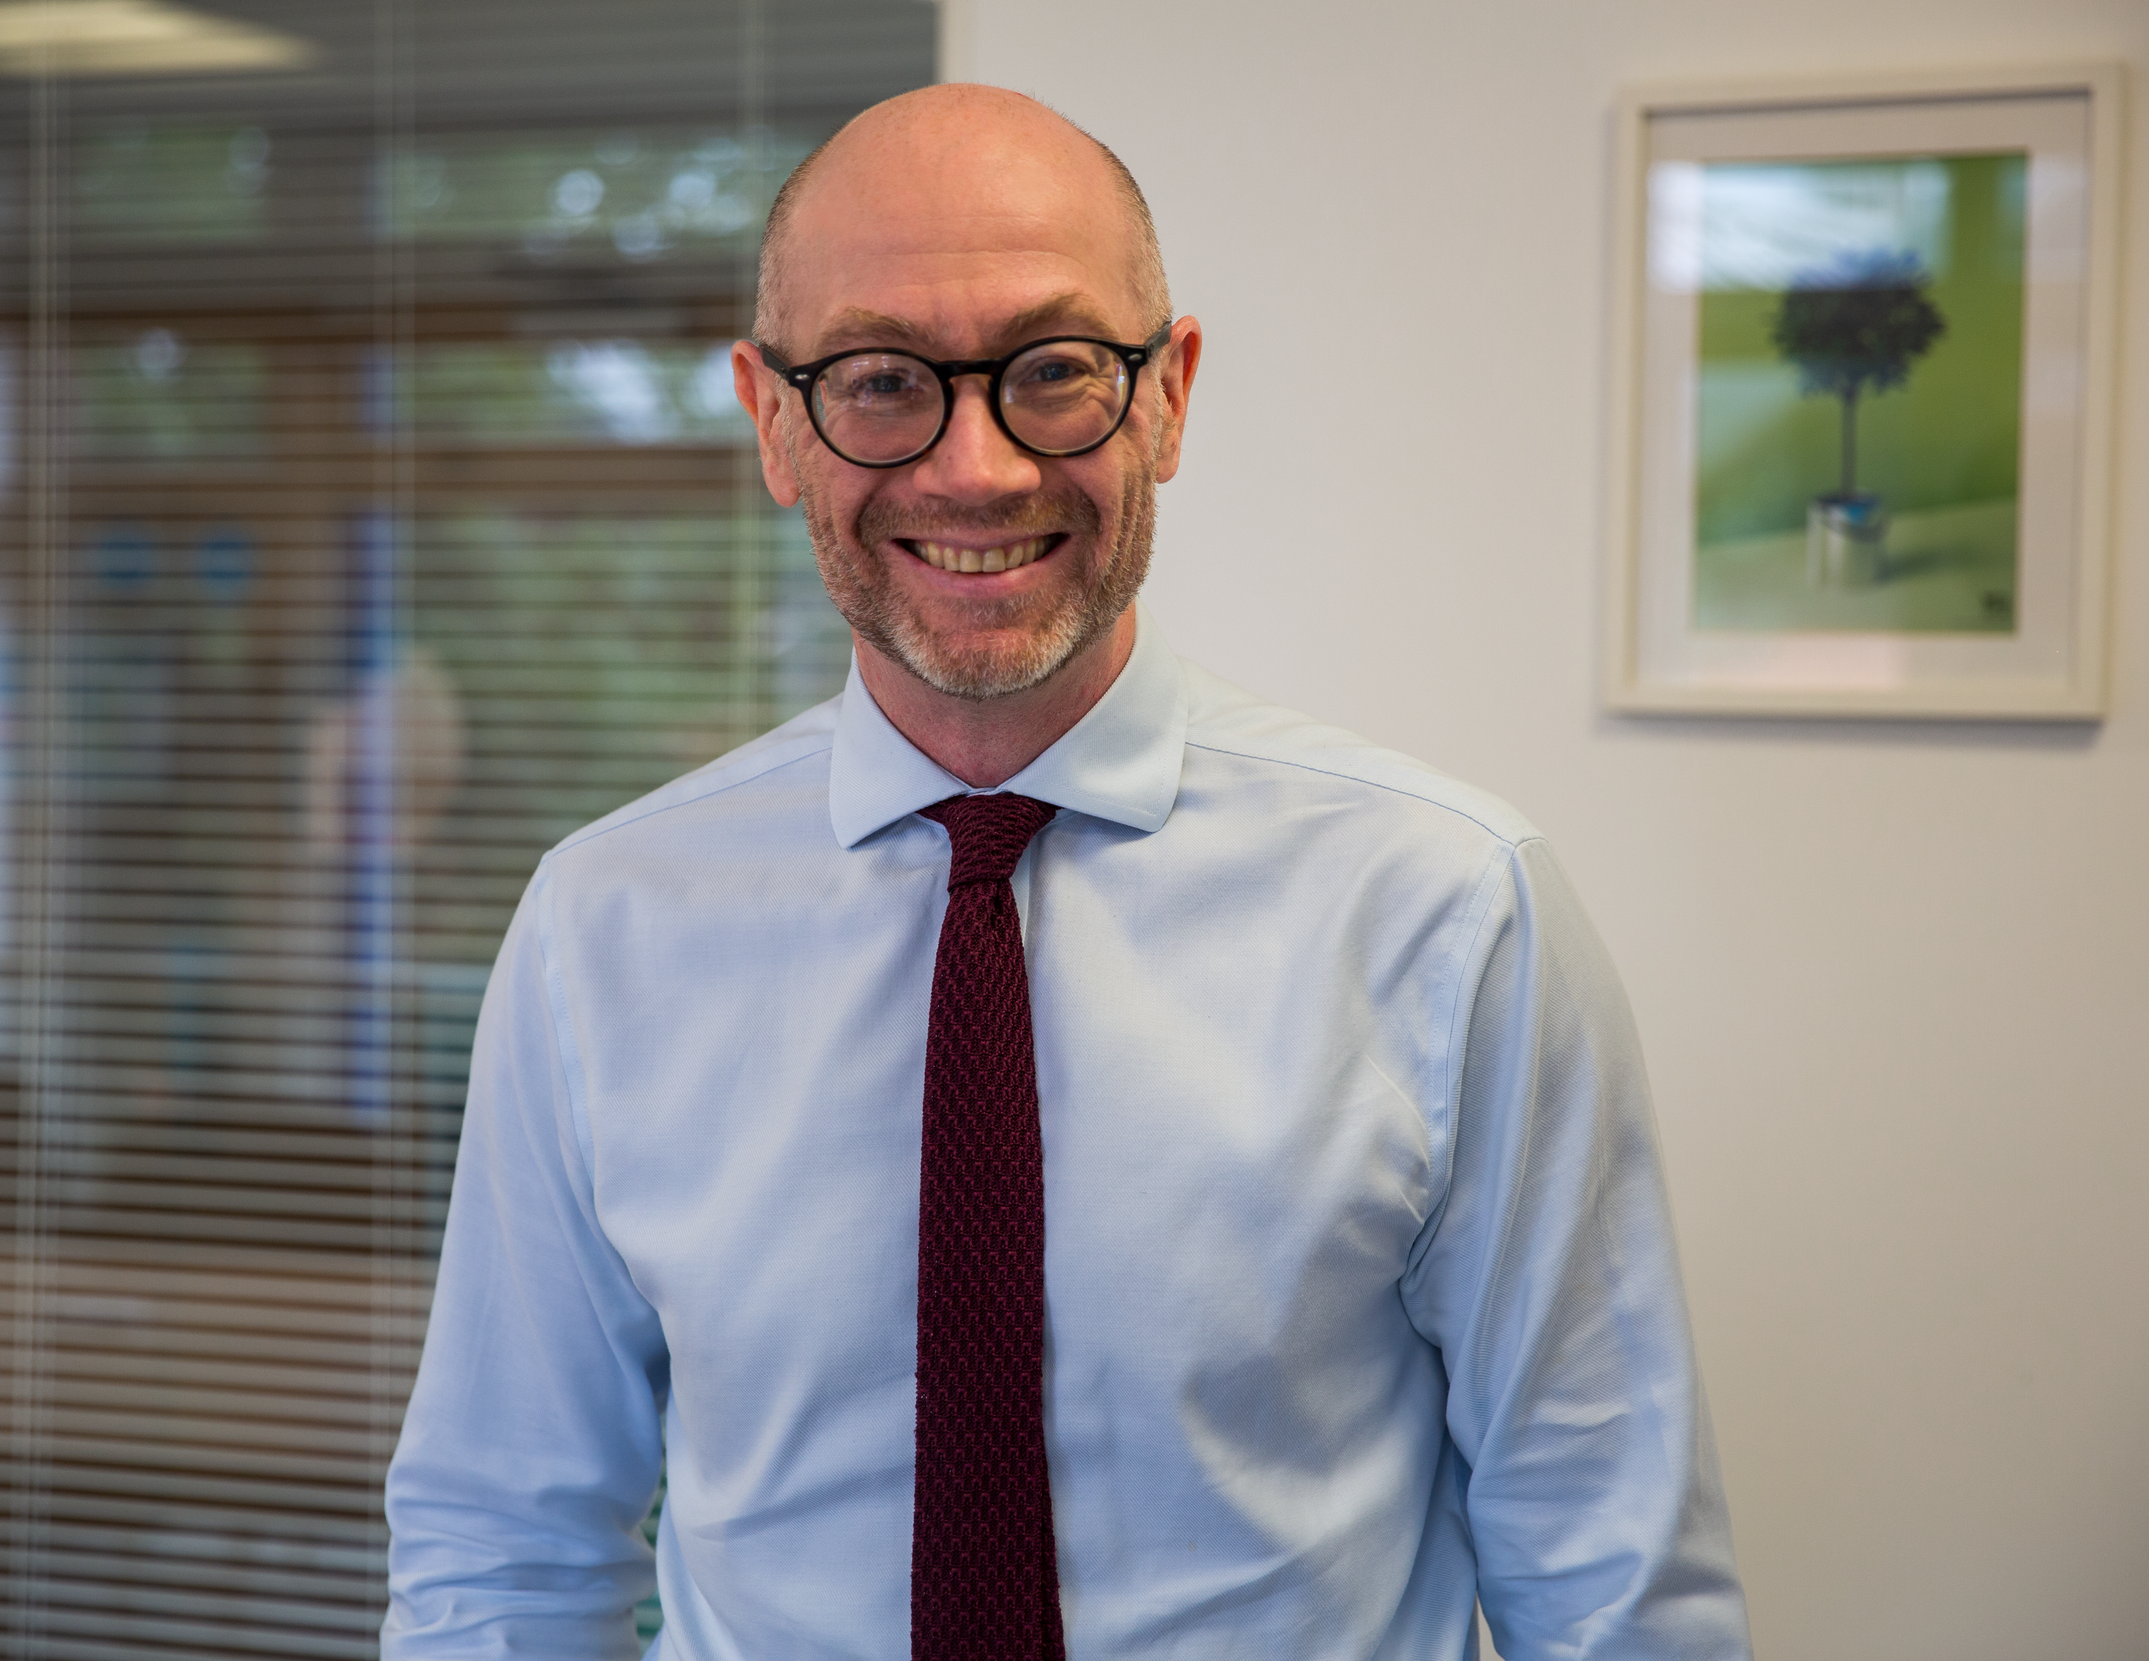

Rachel Danemann
Regional Planning Manager
Midlands and South West
Mark Behrendt
Regional Planning Manager
Southern and East of England
Chris Martin
Regional Planning Manager
North West, North East and Yorkshire

Slide 6
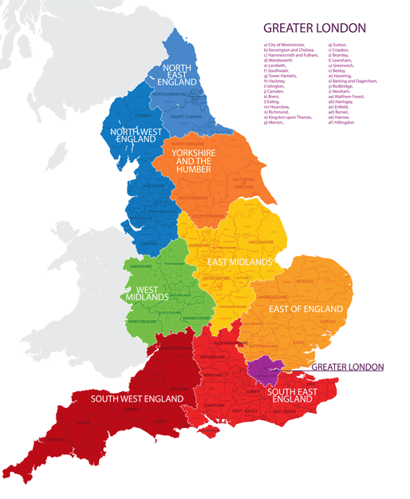

Slide 7
National role

Slide 8
National Planning
Influence central government
Respond to national consultations
Engage with stakeholders
Advocate for member interests on a national level
National Planning Committee
National Updates at Regional Meetings
Chair Planning Webinars

Slide 9
Devolution, Mayoral Strategic Authorities and London

Slide 10

James Stevens
Director for Cities
Home Builders Federation

Slide 11
Three core planning related areas of work:
Devolution and Mayoral Strategic Authorities
Greater London
Natural England challenges and water industry issues

Slide 12
Devolution and Mayoral Strategic Authorities
Aims
To develop constructive relationships with mayors of strategic authorities
To promote the interests of housebuilders working within mayoral strategic authorities
Respond to housing-related policies on behalf of housebuilders, e.g. construction skills
Respond to spatial development strategies where mayors have the power to make these (currently only three)

Slide 13
Devolution and Mayoral Strategic Authorities
Planning & Infrastructure Bill
Introduces universal coverage of spatial development strategies in England
Expectation that these are adopted by the end of the parliament (2029)
Coincides with a programme of local government reorganisation
Seven mayoral combined authorities commenced work:
  West Yorkshire
  West Midlands
  West of England
  North East
  Liverpool City Region
  York and North Yorkshire
  Cambridgeshire and Peterborough

Slide 14
Greater London
London Plan
London borough local plans
Relations with the Greater London Authority – e.g. supporting implementation of housing and planning related initiatives, e.g. First Dibs, London Housing Mission,
London Residential Developers Forum

Slide 15
Natural England challenges and water industry issues
Nutrient neutrality
  Will the Nature Restoration Fund provide a solution?
  CG Fry judgment and wider implications for the industry
2. Water neutrality – is the end in sight?
3. Recreational impact zones
4. Water supply and sewerage connections

Slide 16
South-East and East of England

Slide 17
Mark Behrendt
Regional Planning Manager – South-East and East
Home Builders Federation

Slide 18
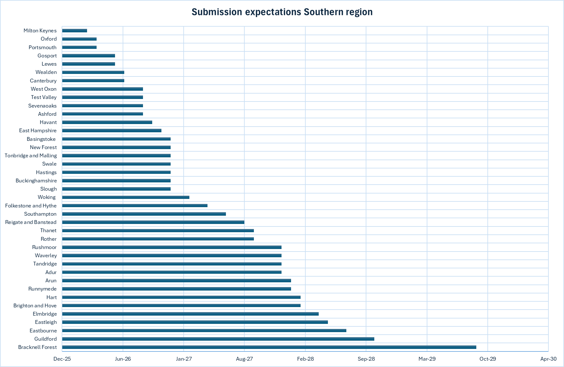
Local Plan – current expectations

Slide 19
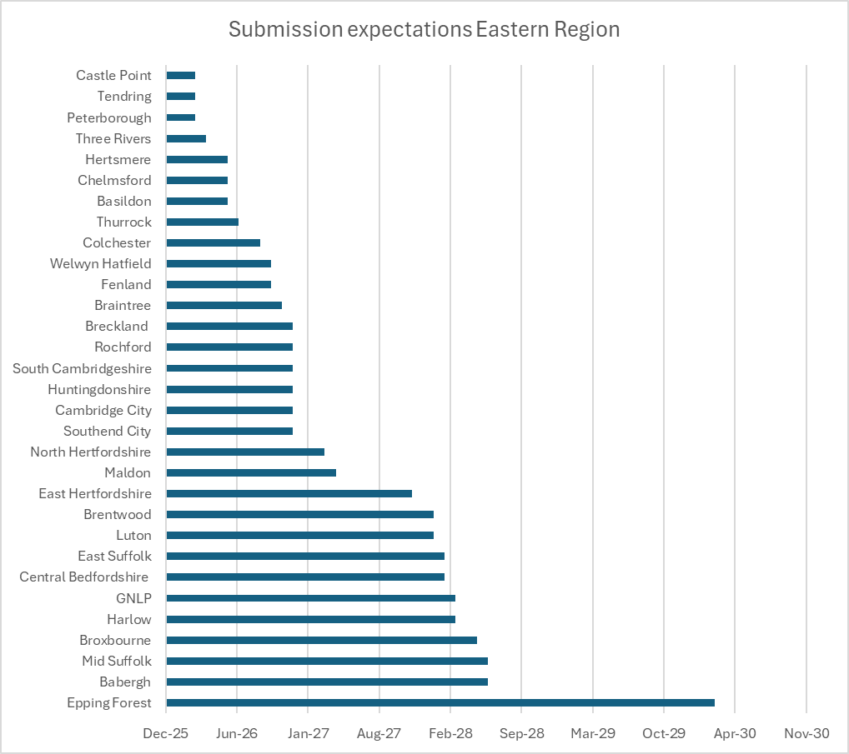
Local Plan – current expectations

Slide 20
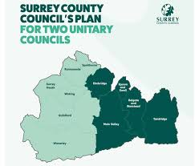
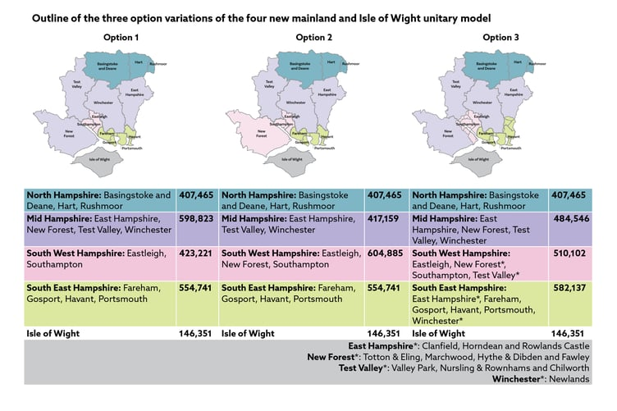
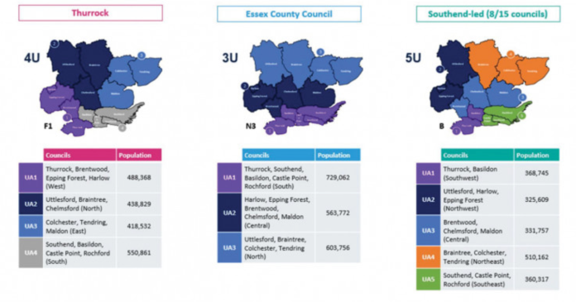
Issues and challenges
Local Government Reform

Slide 21
Key issues and challenges in local plan making
Plan periods – when should a plan start and end?
Five-year land supply and stepped requirements
20% BNG,
energy efficiency policies and whole life carbon
Pragmatic inspectors
Green Belt

Slide 22
How HBF is engaging with these challenges
  Continue to challenge all local plans though representations and at examinations
  Agreeing common positions and co-ordinating shared responses with members, where possible.
  Ensuring Central Government are aware of what is happening in plan making.
  More direct engagement with LPAs early in plan making.

Slide 23
Next meeting dates
Eastern Planning Group
  19 March 2026
  Southern Planning Group
  26 of March 2026

Slide 24
Midlands and South West

Slide 25
Rachel Danemann
Regional Planning Manager - Midlands and South West
Home Builders Federation

Slide 26
East Midlands
Nottingham and Derbyshire Green Belt impact on opportunity/locations for growth
Tightly-drawn boundary of Leicester is a similar issue, but L&L authorities have been working together on unmet need. Doing DTC properly has caused delays
Two Northamptonshire unitaries - legacy plans

Slide 27
West Midlands
Problem with unmet need from Birmingham and the Black Country – pass the parcel unmet need
Resistant to greenfield and Green Belt releases
Solihull villages to towns issues

Slide 28
South West
Wanting to be as 'green' as possible.
Unhappy with slow pace of Government response to climate change, nature crisis etc. So, wanting to go further and faster, leading to 'mission creep' in the Plan
Nutrients - Wiltshire
Higher BNG requirements- Cornwall

Slide 29
General issues
Midlands and South West
From no plans to rushed plans
Baking-in a lower number through transitional arrangements, explictly using 80% of Standard Method as the basis for a Plan to suppress housing
Planning creep - Building Regs, Future Home Standard and other environmental standards
Derbyshire deallocation consultation
Interface between Green Belt allocations and DM processes and impact from other delayed guidance

Slide 30
But it’s not all bad news…
Erewash trying to release Green Belt sites
Gedling left GNSP to plan for new SM
BANES reset for new SM
Leicestershire exemplary DTC
And some "bad" plans have failed: BCP, Wiltshire (?)

Slide 31
Biodiversity Net Gain
Future Homes Hub BNG Implementation Board and Community of Practice
Feeding into national policy
HBF BNF working group
HBF BNG member updates
Understand different issues facing large, small and medium sites, and on-site and off-site delivery
BNG support for members
Wealth of info on website including Q and As
Webinars and access to previous ones
National policy responses
Local Plan reps
Government responds better to examples, so please do examples of issues, challenges, solutions and costs.
Please sign up for BNG area of interest and get in touch if you would like to join the Working Group.

Slide 32
The Northern regions

Slide 33
Chris Martin
Regional Planning Manager – North West, North East and Yorkshire
Home Builders Federation
Notes:
Bio
Chris Martin is the Regional Planning Manager.
Joined HBF in October 2025. Background is in Planning Consultancy.
Experience in acting for housebuilders of all sizes through plan-making and development management processes.
Coverage
North West, North East and Yorkshire.
Geographically diverse area.
Total of 63 plan-making authorities.

Slide 34
North West Local Plan trends
  Most progressed with SDSs.
  Most active with regards to pushing forward with new plans.
  Greater Manchester authorities pressing ahead with new plans pursuant to Places for Everyone.
  Liverpool City Region also seeking to progress swiftly.
  Seeing progression of Local Plans despite new plan-making system regulations not currently in place.
  Also need for new authorities (Cumberland and Westmorland & Furness) to push forward to get plans in place.
  Stockport – a warning shot?

Slide 35
North East Local Plan trends
  Contains two Combined Authorities.
  Spate of Local Plan consultations in 2024 but has slowed down.
  Waiting for new plan-making regulations, local elections and for SDSs to catch-up.
  Most LPAs are at early stages of Local Plans/Plan Reviews.
  Outliers are South Tyneside and Middlesbrough (both transition plans).
  Expecting that 2026 is likely to be a busier year for plan making in the North East.

Slide 36
Yorkshire Local Plan trends
  Much more diverse situation.
  Plans at all different stages.
  Ones to watch - Leeds and North Yorkshire.
  Question mark over Green Belt authorities and speed of any reviews (eg.York).
  Seemingly less enthusiasm to work together compared to North West and North East.
  Anticipating further plan-making progress in 2026.

Slide 37
Common issues and challenges
Planning matters
  Viability – sites being continually squeezed (physically and financially) whist residential values are not keeping pace.
  Shortening plan periods.
  Local Plan 'over-reach' - encroaching on more and more matters.
  Planning based on 'nice to haves' rather than 'need to haves’.
  Failing to see the bigger picture of how policies fit together.
  'Stepped' requirements to shield against 5YHLS/HDT risk.
  Funding for infrastructure improvements that can unlock development.

Slide 38
Common Issues and Challenges
Wider matters
  Reluctance locally to take politically tough decisions
  Using wider changes to delay plan progression
  Lack of resources
  Lack of expertise
  Not wanting to engage (sometimes)

Slide 39
How HBF is engaging with these challenges
  Seeking to engage with Members to find out local issues and what is most important.
  Relaying to Members what is coming forward in the future and agreeing common positions, where possible.
  Seeking an open dialogue with LPAs from early on in the plan-making process to flag issues and assist in technical matters where possible/appropriate.
  Making sure we represent our Members through the plan-making process – using our expertise across the organisation to help shape local plan policies and address the planning issues identified.
  Scrutinising and challenging policies and evidence in relation to Local Plans which we consider would be detrimental to the delivery of new homes.
  Engaging politically at a local level (where appropriate).

Slide 40
Next meeting dates
North West Planning Group
  Novotel Manchester West, Worsley Brow, Manchester M28 2YA, 10 March, 2pm.
  Yorkshire Planning Group
  DoubleTree Hotel, St Maurices Road, York YO31 7JA, 11 March, 9.30am
  North East Planning Group
  Durham County Cricket Club, County Ground Riverside, Chester-le-Street DH3 3QR, 26 February 2026

Slide 41
HBF and Members

Slide 42
How we can help you
How you can help us
Write Reps and Attend EIPs
Regional Meetings
Local Plan Trackers
Respond to specific queries/questions
Raise issues with Councils directly
Feedback/Monitoring - is this a bigger problem?
Local Plan working groups
Advocate on a national level
Attend meetings and contribute
Identify local/regional issues
Provide local context
Provide feedback and ask questions
Identify where HBF input would be particularly helpful locally and/or nationally
Join Local Plan working group(s)
Comment on draft responses
Provide us with evidence of costs, case studies, LPA behaviour- good and bad

Slide 43
Questions

Slide 44
More resources
Planning resources at hbf.co.uk
Member groups (you will need to be signed in to your free HBF online account)
Planning Bulletin sign up
BNG and wider issue alerts
HBF Planning Conference, 9 September 2026

Slide 45

Thank you for joining us
Follow us on LinkedIn:
the-home-builders-federation
And X: @HomeBuildersFed
Feedback on today’s session and recommendations for future sessions: comms@hbf.co.uk
Scan the QR code to view future events

