Slide 1
BNG: Understanding the small site metric

Slide 2
Introduction and housekeeping

Slide 3
Matt Dodds
Associate Ecologist
Environment Bank
Notes:
Good afternoon everyone
My name is Matt Dodds and I will be giving you a whistlestop tour of the small sites metric
I won’t be discussing everything with you but just some of the pertinent points – potential pitfalls
I would advise that you familiarise yourselves with the basic concepts though as these will help to visualise potential constraints and opportunities when you first assess a development
A basic knowledge will help you understand the blank canvas you are looking at

Slide 4
Using the small site metric

Slide 5
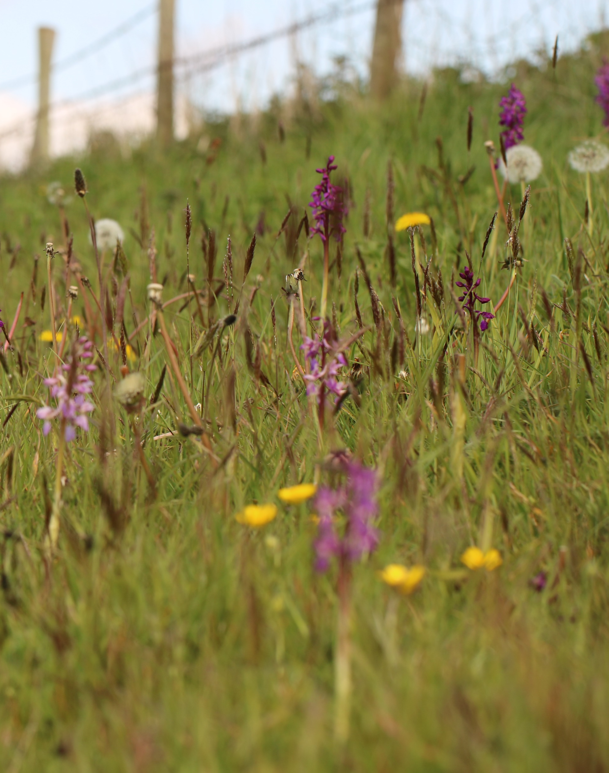
What is the Biodiversity Metric?
Uses habitat as a proxy for biodiversity
Enables relative biodiversity value to be measured
Objective not subjective
Consistent, evidential, predictable
Not perfect, but huge improvement on subjective ecological assessment
Notes:
As an ex LPA ecologist I love the metric because it leads to measurable and repeatable ecological assessments that have predictable and ecologically consequential outcomes. It is still open to abuse but it is far less vulnerable to this than the system we had before. The key is to make sure that all statements and assumptions are justified with evidence. All evidence should then be presented with the report.

Slide 6
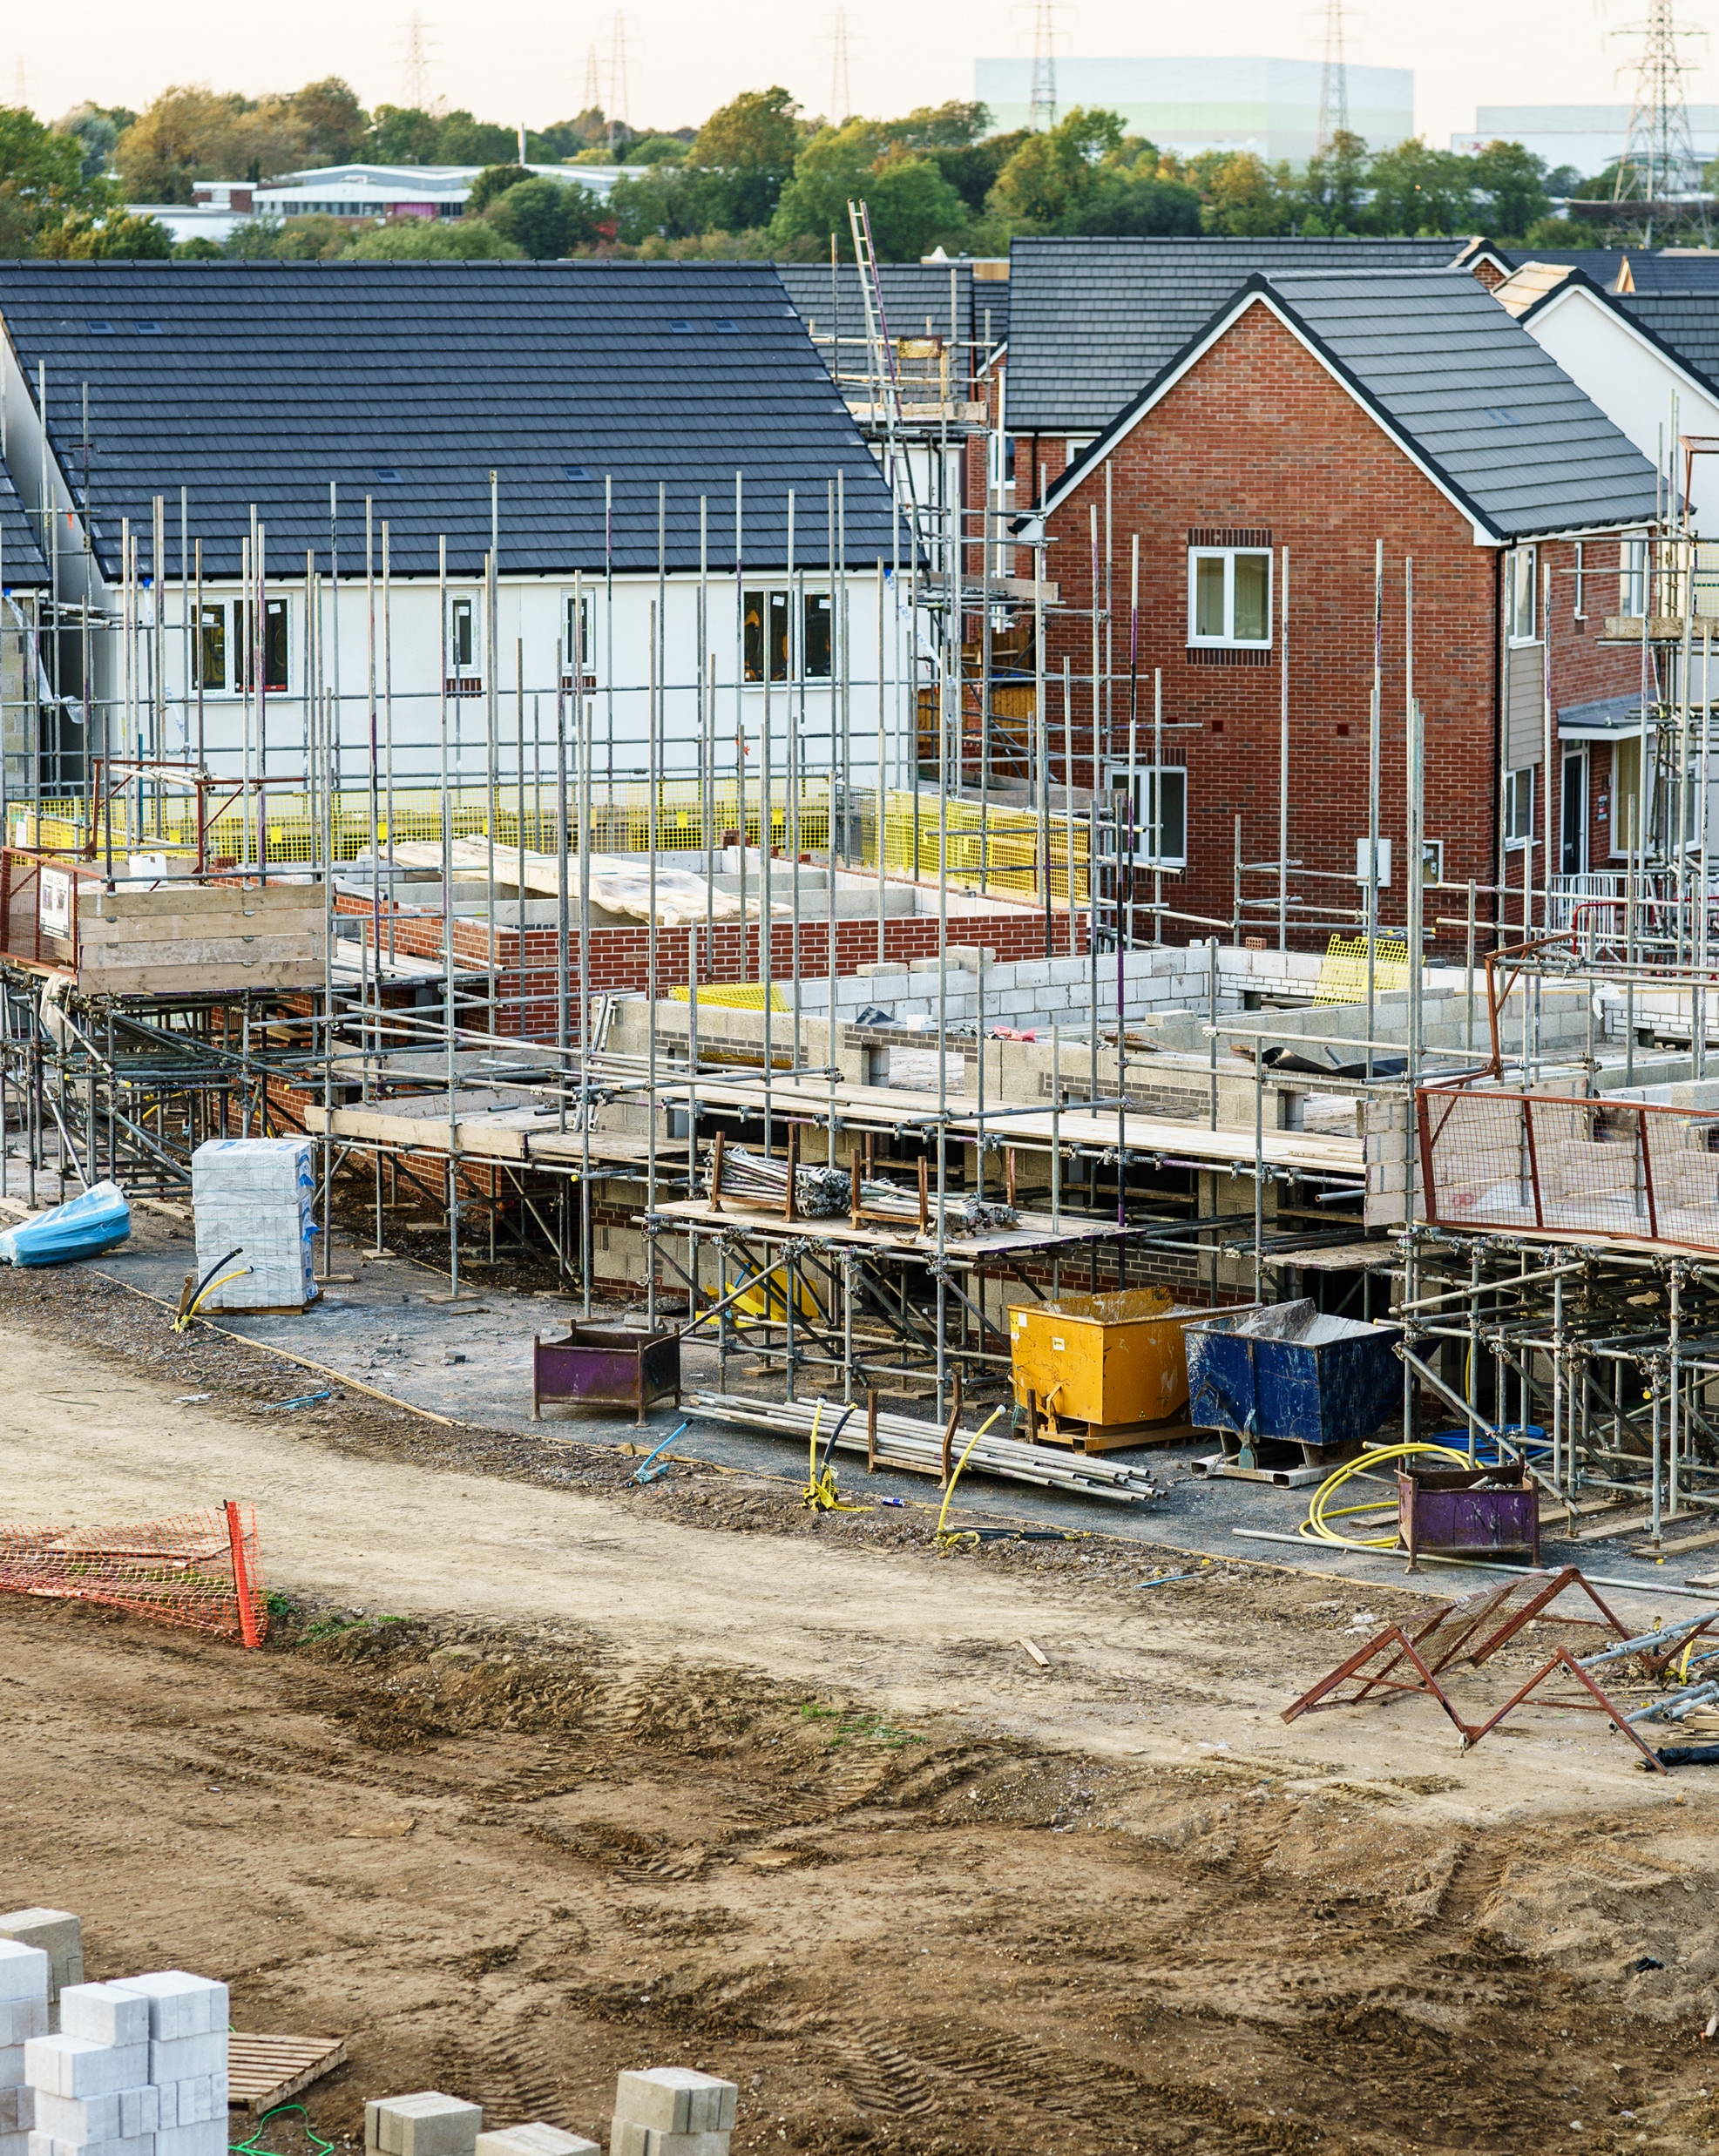
The Small Sites Metric
When can it be used?
<10 residential units on a site, area less than 1 hectare
>0.5 ha where number of units not known
<1000m2 floor space or <1ha site area, non-residential
Notes:
It is designed to be the ‘metric light’. A quicker and less complicated tool for use on smaller, simpler sites. But it is not suitable for all small sites.
So when can it be used.
Residential development where the number of dwellings is between 1 and 9 on a site of an area 1 hectare or less, or if the number of dwellings is unknown, the site area is less than 0.5 hectares, or
• commercial development where floor space created is less than 1,000 square metres or total site area is less than 1 hectare, or
• development that is not the winning and working of minerals or the use of land for mineral-working deposits, or
• development that is not waste development

Slide 7
When not to use it:
Excluded habitats present > medium distinctiveness
Priority habitats present – if > medium distinctiveness
Statutory sites present
European protected species present
Off-site interventions required
If in doubt use the main metric
Notes:
It is not possible to use the SSM on all sites defined as ‘small sites’.
It should not be used
On any site containing any habitats (including riparian zones where relevant) not included in the SSM. These are habitats above medium distinctiveness. Habitats included in the Small sites metric are in Appendix 2 of the User Guide.
On priority habitats N.B. some hedgerows and arable field margins are excluded from the above as these are medium distinctiveness habitats and are included in the SSM
• Where statutory protected sites or habitats are present
Where European protected species are present
Where off-site interventions are required – the SSM does not have an offsite function and so it needs to be transferred to a full metric to include this to achieve net gain.
If in doubt use the full metric

Slide 8
Who should use it?
A competent person has the knowledge
and skills to perform specified tasks to
complete and review SSM calculations
Able to identify habitats present on site
Able to identify management requirements post development to achieve habitat and condition
Set out in BS8683:2021: person who can demonstrate they have acquired through training, qualifications or experience, or a combination of these, the knowledge and skills enabling that person to perform a specified task
Notes:
SSM must be completed by a competent person.
A competent person is someone who can demonstrate they have the skills to complete the metric
Be careful in selecting your competent person. The temptation will be to cut corners here. The more corners you cut the more likely the metric will be questioned.
If in doubt check with the LPA ecologist.
Evidence is everything.

Slide 9
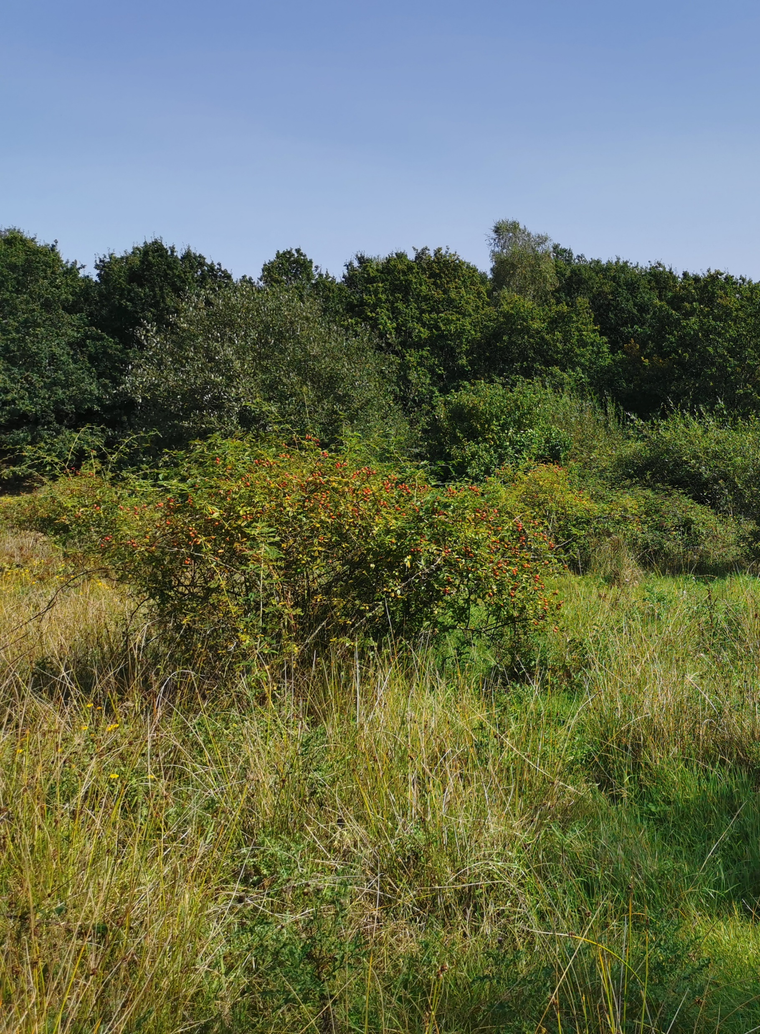
Small Sites Metric process
Identify if it can be used
Collect data requirements for the site
Identify habitats and evidence the selections
Strategic significance
Identify management actions and justify
Input data
Do it as early as possible
Notes:
Are the habitats present included in the user guide appendix?
Conduct a records search with the local records centre – or justify why one was not undertaken, e.g. isolated site in city centre
Identify habitats and evidence selections – habitat
Read the guidance on strategic significance, local and national
Justify all management actions
Use the notes section to justify selections and cross reference a supporting document WITH LOTS OF PICTURES!
Show don’t tell.
Input the data

Slide 10
Understanding residential market conditions
Justify habitats in comments section
Justify here
Emily Williams
Director of Residential Research, Savills
Notes:
Use the user comments section to justify selections and cross reference a supporting document if required WITH LOTS OF PICTURES!
Show don’t tell.

Slide 11
Understanding residential market conditions
Justify habitats tab 4
Photos here
Emily Williams
Director of Residential Research, Savills
Notes:
Show don’t tell. Quadrat photos from above of typical community components and landscape showing context

Slide 12
Small Sites Metric:
Off-site units
No off-site section
If on-site net loss – send metric to off-site provider
They will enter data into full metric to justify units required for net gain and for your Biodiversity Gain Plan
Trading rules must be satisfied to deliver net gain onsite
Notes:
The SSM does not have an off-site section. If your small site requires any off-site units, you can still use the SSM to calculate any on-site gains and you should submit this when required by the planning authority. Your biodiversity gain plan will need to summarise how you have met your BNG requirement, including details of the off-site habitat enhancements and the trading summaries.
The Biodiversity gain plan template is available online. LPAs like templates because they are consistent, so use it and don’t be tempted to create your own.
You should send your completed SSM to the off-site provider you are buying units from. The off-site provider can then enter this in the statutory biodiversity metric calculation tool and complete the off-site tab to submit this when recording the allocation on the biodiversity gain sites register

Slide 13
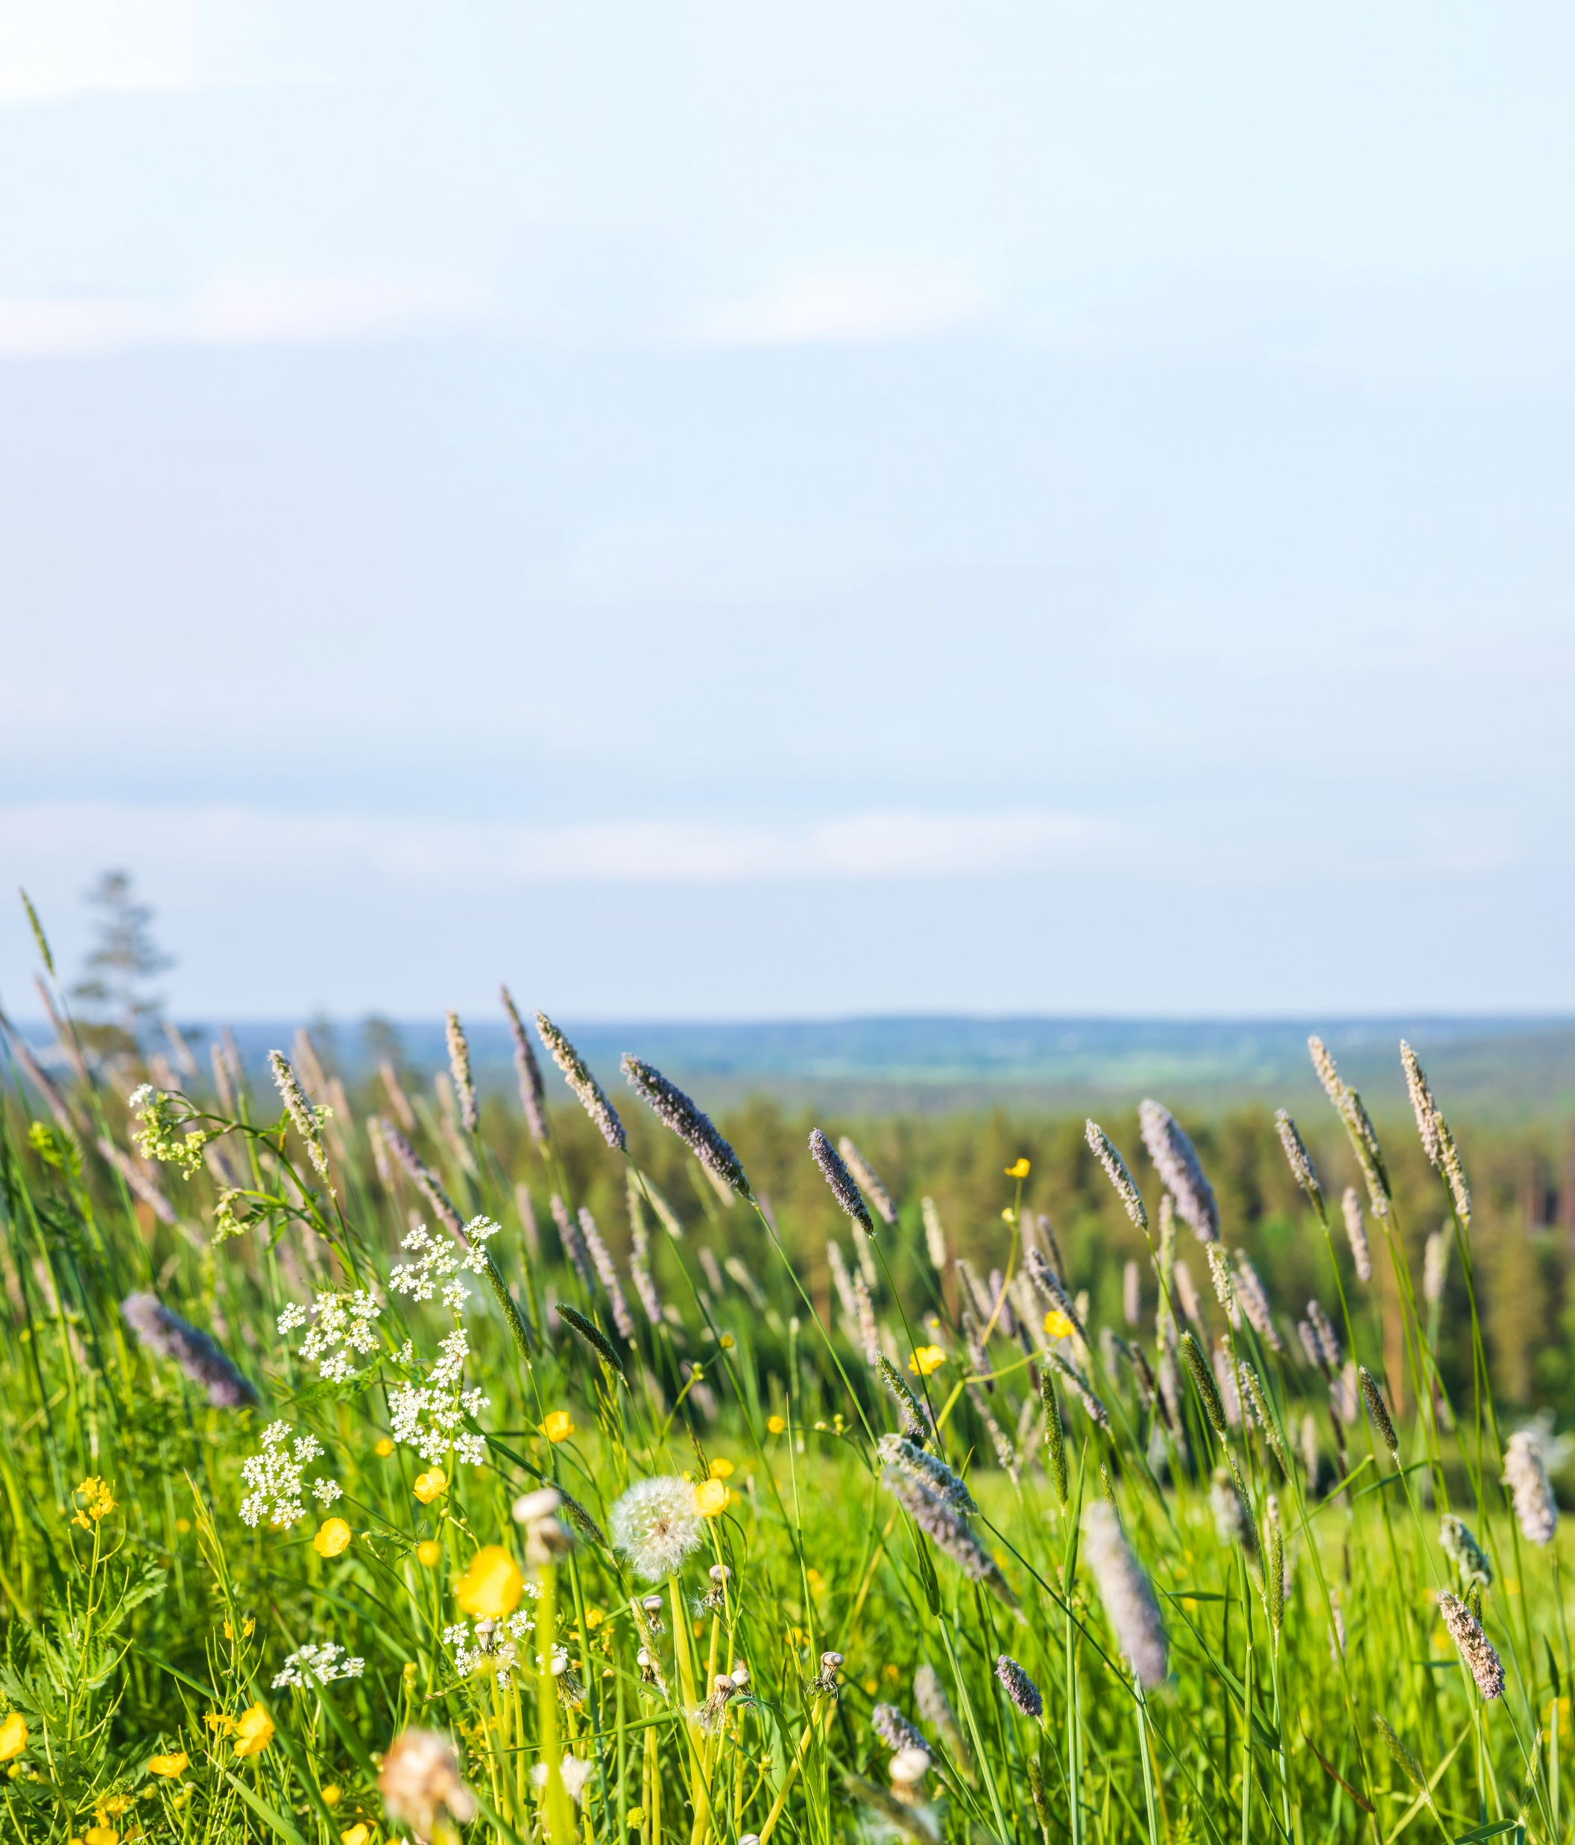
Trading rules
Medium distinctive habitats
Replaced within same broad
habitat type
Low distinctiveness habitats
Replaced with same or higher
habitat band
Very low
Replace with habitat of greater
unit value
Notes:
Only certain habitats can be created – these are listed in tab 11 – Lists, of the metric
E.g. if medium distinctiveness other neutral grassland poor present, could be replaced with ONG medium to satisfy the trading rules. If you don’t satisfy the trading rules you need to go offsite.
If modified grassland (low distinctiveness) replace with any medium habitat, e.g. scrub, other broadleaved woodland,
The trading rules only apply to the point of no net loss. Once trading rules have been met, biodiversity net gain requirements can be met by the creation and enhancement of any habitat type, provided it is within the relevant module.

Slide 14
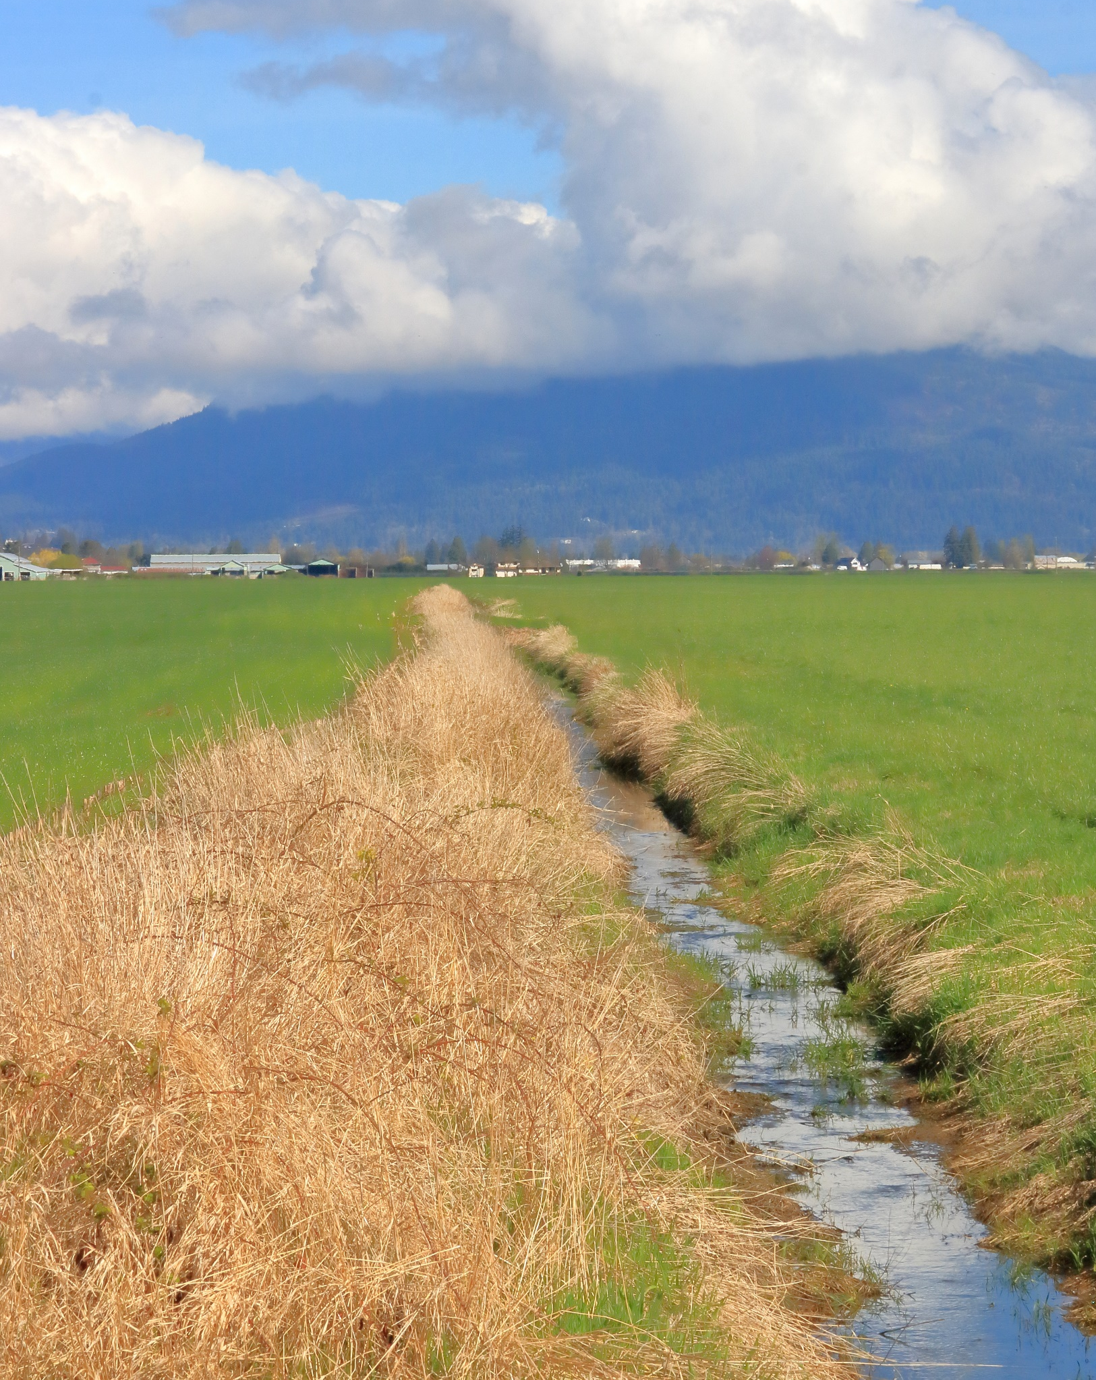
Watercourse unit trading
Enhancement or restoration of rivers or streams must be calculated using the statutory biodiversity metric tool
Compensate with similar habitat features
• Impacts on canals cannot be offset
on rivers
• Impacts on ditches cannot be offset
on canals or rivers
Notes:
Only applies to ditches, canals and culverts – not rivers or streams
Any enhancement or restoration of rivers or streams must be calculated using the statutory biodiversity metric tool.
The small sites metric only contains canals, ditches and culverts
Creation of new culverts is not suitable compensation for the loss of any watercourse habitat.
Compensation for the loss of any watercourse units should be on a section of watercourse with similar habitat features. For example:
• impacts on canals cannot be offset on rivers
• impacts on ditches cannot be offset on canals or rivers

Slide 15
Data required for Small Sites Metric
Habitat type
Size
Baseline condition automatically assigned
Target condition of created/enhanced habitats
Area/length retained, enhanced, lost
Strategic significance
Notes:
The SSM takes the size of a habitat and accounts for the three core quality components which contribute towards the calculation of biodiversity units, these are:
• distinctiveness
• condition
• strategic significance
All components require data values for both baseline and post development, in the SSM some of these are automatically applied e.g. baseline condition
Record all habitats measured in meters squared, such as grassland and woodland, within the area unit module of the SSM
Use the user comments to explain any difference between site area, baseline habitat area and post development habitat area.
For individual trees, the SSM contains a ‘tree helper’ which generates an area value based on the tree’s diameter at breast height.
Hedgerows
Record hedgerows and lines of trees in metres. – see metric users guide for other hedgerow rules
Watercourses
Record watercourses in metres.
Use the centre line measurement along the length of the feature, using OS maps/GIS where possible.
Strategic significance

Slide 16
Strategic significance
Just High or Low
Has the Local Nature Recovery Strategy been published or not?
No LNRS published yet
LPAs on different timescales
Notes:
When considering SS, only high or low are available.
This is important because of the impact of the multiplier
High SS Multiplier of 1.15
Low 1
You will need to find out in the LNRS has been published from the LPA

Slide 17
Strategic significance
If LNRS not published
Specified alternative
documents
E.g. BAP, Local Plan etc
Understanding residential market conditions
Emily Williams
Director of Residential Research, Savills
Notes:
This is the most likely scenario for some time
LNRS are a long way off in most areas
LPAs should specify alternative documents
Ask them
Alternative documents may include
Draft Local Nature Recovery Strategies
• Local Plans and Neighbourhood Plans
• Local Planning Authority Local Ecological Networks
• Tree Strategies
• Area of Outstanding Natural Beauty Management Plans
• Biodiversity Action Plans
• Species and protected sites conservation strategies
• Woodland strategies
• Green Infrastructure Strategies
To be high, habitat should be described as locally important in LPA documents
This is likely to apply to high distinctiveness habitats (priority habitats) so unlikely to be achieved because SSM doesn’t include these (apart from a few hedgerow types and some ponds)

Slide 18
Strategic significance
If LNRS published
Understanding residential market conditions
Emily Williams
Director of Residential Research, Savills
Notes:
The Habitat to be created or enhanced must be in the LNRS and of a type consistent with the measures proposed for the location. That means it must be one of the habitats the LPA want to see created in the area.
These are likely to be priority habitats, or high distinctiveness habitats, which are not captured by the SSM.
This means that most small sites will fall into the low SS category.

Slide 19
Filling in the Metric
When to use:
Habitat retention?
Habitat enhancement?
Habitat creation?
Notes:
These terms can cause some confusion
Retention – no loss of habitat, no change in baseline, no enhancement
Enhancement – improvement in condition, a change in habitat to same broad habitat type
Within the SSM, only certain habitats can be enhanced. Condition must stay the same or improve, including when enhancing to a higher distinctiveness habitat.
The technical data sheets in the SSM sets out habitats which can be enhanced, and the habitats they can be enhanced to within the SSM. If a habitat that is targeted for enhancement to is not included within the SSM, the statutory biodiversity metric should be used.
Creation - Habitat creation is where one habitat type is replaced by another habitat type and includes:
• a loss of baseline habitat that is replaced with another
• a change in broad habitat type such as a change from grassland to woodland

Slide 20
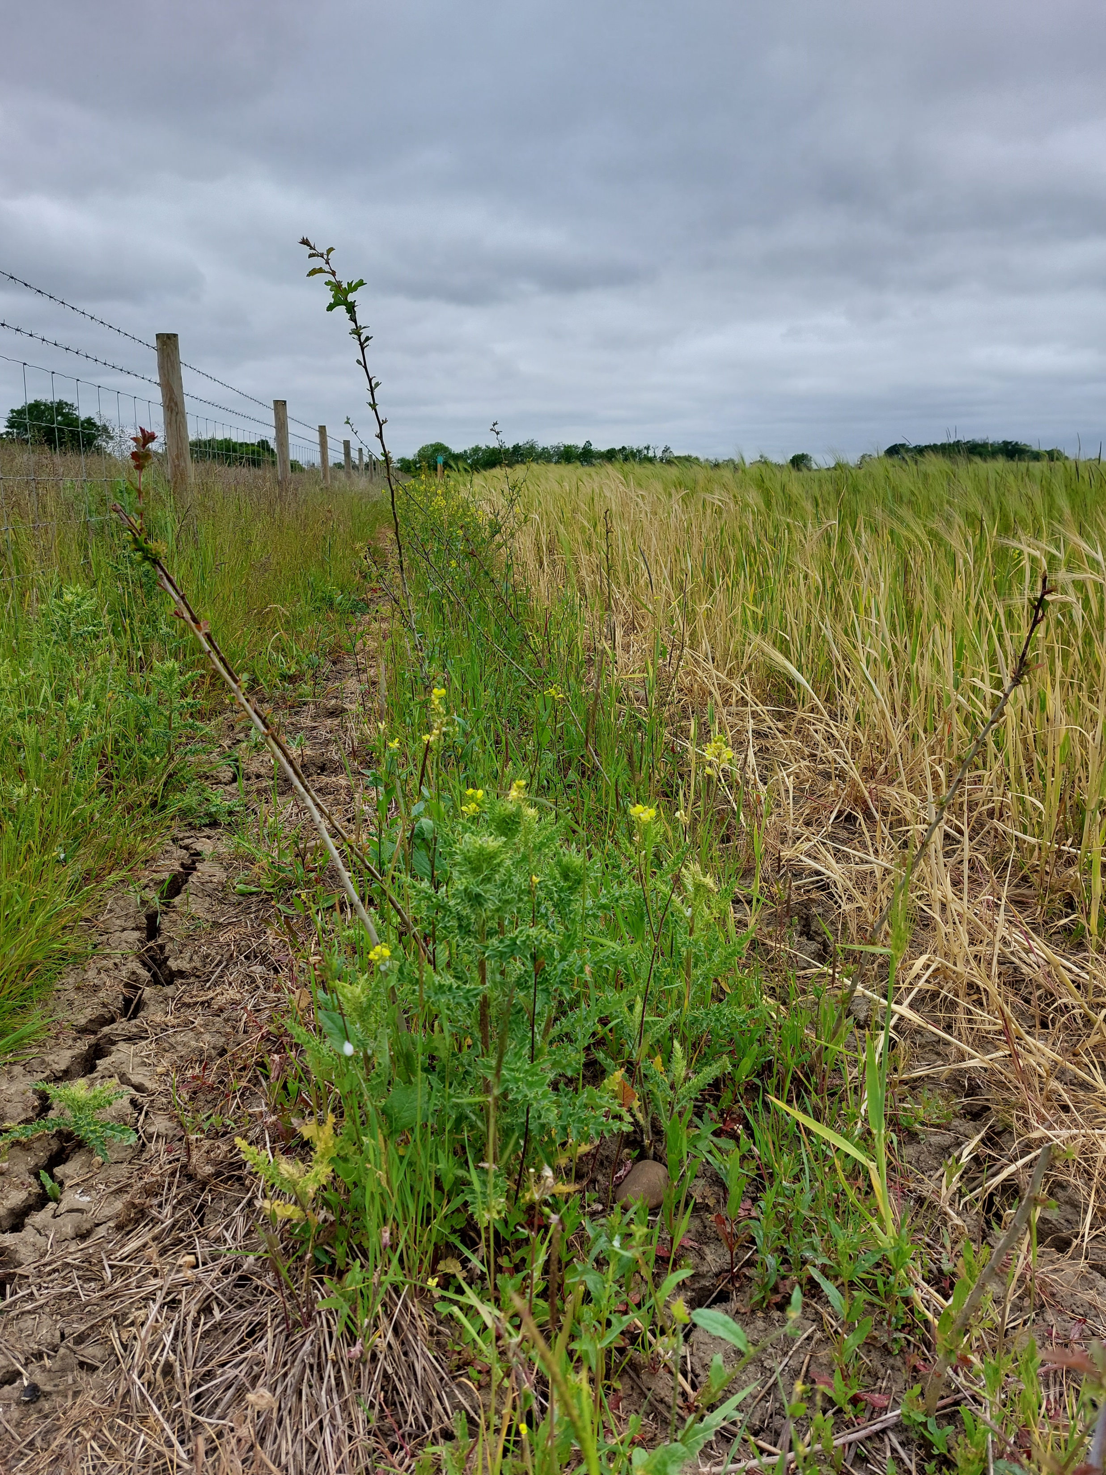
Time to target condition
Advanced or delayed creation must use full Metric
Temporary losses can use SSM
Temporary loss
Baseline habitat restored in 2 years
Baseline condition restored in 2 years
Notes:
If you are going to delay habitat creation or are planning to create habitat in advance then you must use the full metric. The SSM does not allow for this
If however the habitat loss is only temporary then you can use the SSM
The rules on temporary loss are as above but they must be justified with evidence

Slide 21
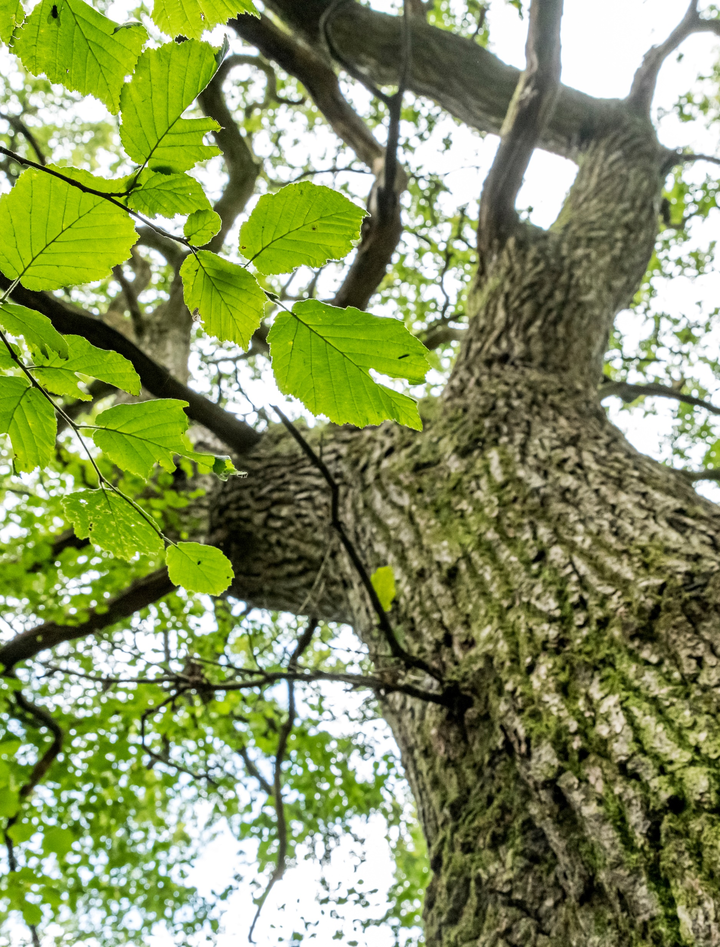
Individual trees
Ancient or Veteran use full Metric
DBH
Small >7.5cm <30cm
Medium >30cm <60cm
Large >60cm <90cm
Notes:
Individual trees can make a big contribution to net gain and also impact on your baseline if present at your site.
The metric provides a big incentive to retain trees, its almost always better to retain them if you can, particularly if they are medium and above.
Always use the full metric for ancient and veteran trees
They are measured by their diameter at breast height
Do not otherwise record individual trees if they occur within a habitat type characterised by the presence of trees, e.g. woodland,
Exemptions to this can include
• trees within private gardens
• removal of trees within hedgerows
• removal of trees within rural lines of trees

Slide 22
Individual trees
Record medium and above as individual trees in gardens
Post development
Record new trees as small unless >30cm
> 7.5 cm as small
Other habitats with trees record as that habitat
Notes:
If there is a tree in a garden it should be recorded as an individual tree if it is sized medium or above. Not if it is smaller. In this instance it should be in the vegetated garden habitat.
Note that you should not:
• record natural size increases of retained trees within post-development sheets
• record natural size increases of planted trees within post-development sheets

Slide 23
Outputs
Change in area/length of habitat
Change in units
Percentage change in units
10% is the threshold
Avoid, mitigate, compensate onsite where possible
Then off-site
Notes:
It is important to understand what the outputs of the metric mean and what they are designed to show.
They will show the change in area or length of habitats, the change in units, and the percentage change in units.
The aim is to clearly show if a net gain of 10% has been achieved and if the trading rules have been satisfied.
If your site is not achieving the statutory BNG requirement your options are to avoid impacts , e.g. can you retain that tree, mitigate, e.g. can you enhance the existing habitat, or compensate e.g. can you replace a poor quality habitat with a better one.
You are directed to do this onsite but there comes a point when no further gain is possible, and there is a very strong ecological argument against attempting to squeeze every last unit out of certain sites

Slide 24
Off-site
Assess early in the process
Contact off-site provider – LPA list?
Provide the SSM
They will populate full Metric, and provide for your BNG plan
Often the best solution ecologically
Bigger, better, more joined up
Notes:
Once you have decided that offsite is your answer to net gain, you should contact an offsite provider, like Environment Bank
Ideally you want to source units from as close to the impact as possible and strategically located. There is also a financial inducement to do so because the closer and better located they are the cheaper they are likely to be.
Check with your offsite provider where units are and the implication of that. It might be in the early stages of BNG that you are compelled to go further away, but this should settle down once more HBs are uploaded onto the net gain register.
Sometimes LPAs operate a unit matching service, e.g. Hertfordshire. This enables you to find a local site if you desire.
Once you have identified an offsite requirement and provider you will need to supply them with the SSM. They need this to populate the full metric and ensure trading rules are satisfied. You in term will need this for your BNG plan.
My advice to you would be not to be afraid of offsite. It is often the best solution ecologically. A small slice of a local habitat bank is much closer to the aims of the Lawton Report i.e. bigger better more joined up than meaningless landlocked mitigation surrounded by concrete.
Questions

Slide 25
Thank you
Please contact me with any further questions
Matt Dodds mdodds@environmentbank.com
Notes:
Your organisation’s logo can be added to the bottom-right

Slide 26
Nick White
Principal Advisor – Net Gain
Natural England
Notes:
Your organisation’s logo can be added to the bottom-right

Slide 27
Questions
Use the Q&A function to submit questions to our speakers
Notes:
Your organisation’s logo can be added to the bottom-right

Slide 28
Guidance is available at HBF.co.uk:
Planning Practice Guidance
DEFRA guidance
FAQs
HBF members can sign in to access additional resources and pose questions to our team

Slide 29
Thank you for joining us
Follow us on LinkedIn: the-home-builders-federation
And X: @HomeBuildersFed
Feedback on today’s session and recommendations for future sessions: info@hbf.co.uk
Scan the QR code to view future events

