Slide 1
Virtual Work Experience (VWEX) Framework
Home Building Skills Partnership
Early Careers

Slide 2
1Virtual Work Experience
Virtual Work Experience Framework
The ongoing and ever evolving Coronavirus pandemic has changed the way we work and the way we can offer work experience to young and early talent. This Virtual Work Experience (VWEX) framework aims to address the need for high quality work experience and can sit alongside any other programmes run within an organisation even in a post-pandemic world.
1.1 Why take part?
In 2020, the Coronavirus pandemic saw approximately one million secondary school students lose the opportunity to undertake work experience. At the same time, the working landscape had to adapt and change dramatically with day to day business being carried out online at home.
In the 2020 Youth Voice Census, 86% of the young people surveyed felt that work experience helped them to make decisions about their futures, while 45% cited a lack of experience of as their key barrier to gaining employment.
VWEX can have a huge impact. Unrestricted by physical space and travel requirements, VWEX can open the door of opportunity for any young person anywhere, perhaps for the first time. Young people can have the chance to experience the evolved way organisations are now operating with the work experience itself being manageable for an organisation to deliver.
Organisations can give students structured online activities to complete independently and/or within teams. A variety of staff can engage with students for briefings, work reviews, specific workshops and informative sessions. A blend of independent/team working, insight sessions and workshops removes the need for constant student supervision, making VWEX extremely manageable.
Greater geographic reach
Real experience of the evolved virtual operating environment
Manageable for your organisation
Parts of the country where you don't have a physical presence. Areas that are in high need.
Blend online activities and tasks/independent learning with specific workshops and meetings removing the need for constant supervision.
The workforce is now more nomadic, flexible, online and embracing advancing technologies.

Slide 3
1.2 How does it work?
This framework proposes a built programme of pre-recorded/developed content with set tasks for students to work through, interspersed with guest speakers from your organisation and career development sessions such as interview preparation or CV workshops.
The series of tasks should be realistic and relevant to your organisation and once completed, can be discussed and compared against model answers. The tasks could also combine into a project they can present at the end of the programme.
Whilst some time is required to create the tasks and develop your content, delivery can be designed with manageability in mind ranging between a little to a lot of interaction to suit your organisation. 'Live' input is needed for any speaker and full engagement sessions where, being virtual, you will have the opportunity to use representatives from across your organisation.
Building transferable skills:
Senior inspiration:
Guest speakers.
Tasks and speakers from across your organisation.
A challenge:
A report, proposal or mini presentation. Give students the chance to show what they've learned.
Pathways in:
How to get from the bottom up and what to expect at entry level.
1.3Attracting Participants
Your organisation may already have contacts and relationships with schools/colleges/work experience facilitators for you to utilise. They may have their own protocols, guidance or platforms you may need to follow/use.
There are many options here, such as advertising via your own website directly to students across the UK or working with teachers, offering VWEX places to students at specific schools or colleges. Using facilitators who can promote your VWEX via their platform, such as Speakers for Schools, is an another option, as is using the STEM network.

Slide 4
1.4 VWEX Activity Examples
General Knowledge
Use these sessions to give students an overview of your organisation, how it works, your company values and careers in the housebuilding industry. Run sessions such as 'Meet the apprentice/trainee/Graduate' and CV/interview workshops.
Departmental seminars
Hold seminars giving students a rundown of the different departments in your organisation. Consider inviting department specific Guest Speakers or using pre-recorded videos. You could introduce a department per day and give students a task or independent work in the afternoon that is related to that department.
Specialist Presentation
There is more to the housebuilding industry than building a house! Consider giving presentations on topics such as sustainability, diversity and inclusion, the environment and placemaking.
Task Work
Give students the opportunity to apply the knowledge they are learning. This can take various forms, for example, a project that runs all week culminating in the chance for students to present back their work or stand alone department specific tasks.
Use some time after lunch to refocus students, this could consist of icebreaker games or mini quizzes.
Useful resources can be found with Go Construct.
Please see appendix 1 for further detail of VWEX Activity examples.

Slide 5
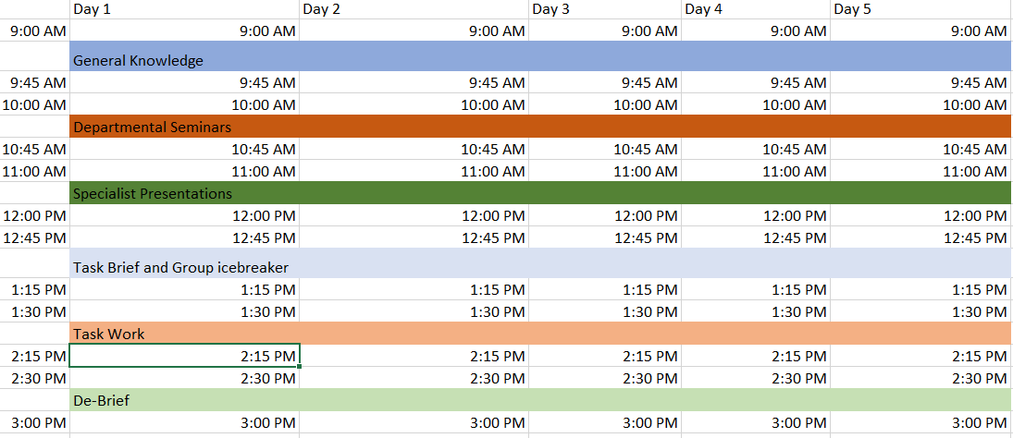
1.5 VWEX Week Plan
This is an example timetable and can be adapted to suit your organisation. You can follow this example schedule or borrow elements to create your own.
Before the placement: Students should be emailed a link to join your chosen delivery platform when they are enrolled onto the VWEX. We recommend a short preparation, expectations and IT troubleshooting session to be held before commencement of the VWEX to ensure a smooth start to your week.
For examples and how to use different timetables please see appendix 2.

Slide 6
VWEX Plan 1.6
Prepare
(Content in advance. Recruit and train staff in 8 weeks before)
Create your content and draft your timetable
Recruit guest speaker volunteers from your organisation. Familiarise yourself and your team with virtual platforms and delivery – carryout test delivery and activity.
How are you attracting participants? E.g. Sign up with a facilitator or if you are opting to work with specific schools/colleges establish a point of contact.
Post VWEX
(3-4 weeks later)
Follow up with students.
Further communication about careers and opportunities depending on audience and programmes offered by your organisation.
Launch
(Schools/colleges/facilitators may have their own timeframe you need to work to. Suggestion: Launch 8 weeks before, keep applications open for at least 2 weeks)
Promote VWEX
Arrange communication e.g. through your website, points of contact or facilitator. You may need to have discussions around choice of delivery platform and what works best.
VWEX
(5 days, Mon-Fri)
Review and compare task/activity work against model answers throughout week or project presentations.
Participants to complete daily reflections diary. Collect feedback from students and any teachers involved via a survey at the end of the week.
Introduce
(week before VWEX)
Send out a welcome pack including a welcome letter and workbook (if using).
Your organisation may also want to include small tokens such as pens, branded magnets, keyrings etc. Parental consent forms, codes of practice and other requirements/safeguarding materials sent out and returned ahead of VWEX.
Send out Timetable and virtual platform information such as logins/meeting invitations.
Hold a short troubleshooting/introductory session at the end of the week before VWEX.
All participants registered to use chosen platform and have tested it.
All required forms returned.
Select Participants

Slide 7
1.7 Engaging Young People and What to Expect
Guidance and support will help students to get the most out of their experience. VWEX can give students a real insight into your organisation and professional life and point them in a direction for the future. Please remember:
It's a new environment
Working remotely might be a very different environment for many students and their focus may need support. Most teenagers will be surprised at how different a professional environment is from school (more personal responsibility, new expectations).
The technology may need explaining
Use the advance session to troubleshoot any IT issues, introduce your chosen platform and how it works.
Keep tasks relevant to the house building industry
At times your students will be working without supervision, this is a great opportunity for them to experience how people really work remotely in the housebuilding industry.
Provide enough information
Clearly explain tasks, give students the opportunity to ask questions, provide links to helpful resources. Issue briefs that students can refer back to and break down a large task into several small tasks that can be brought together at the end. Explain your organisations language/jargon!
Do they know who to contact?
If they are stuck on a problem make sure students have clear instructions on who to contact if they require assistance. Set clear guidelines on how to get in touch with someone at the beginning of the placement or in guidance notes and be there to support when necessary.
Check-in
Some students may be confident and quick to ask questions, others may be more shy and reserved. Use icebreakers to ease students in and check in daily with their progress on tasks if you are asking them to work independently.
It's not common sense
Professional etiquette, a good attitude, sticking to meeting schedules, sharing ideas and reporting on progress may not be how students usually work. Make sure you set expectations at the start as these transferable professional skills are invaluable in preparing them to do well in their next steps. You are required to be a lot more independent at work than you are at school and students will need you to tell them this explicitly.
Provide and ask for feedback
Positive feedback and constructive criticism will be a valuable takeaway, improving a student for their future study and the world of work. For the experience to have a high impact provide feedback on any work students complete. Set time aside specifically for feedback and make sure your organisation obtains feedback from students and
teachers as well.

Slide 8
1.8 Online systems and Tools
Communicating easily and working effectively with the students during VWEX is important.
Every company uses different systems and tools to deliver work e.g Zoom, WebEx, Microsoft Teams. Consider and understand the technical/IT requirements both of your organisation and the students as well as other requirements such as the use of break out rooms when selecting your platform.
There are also organisations such as Speakers for Schools who facilitate work experience programmes and use the platform Google Classroom. You may want to get in contact with a facilitating organisation to aid delivery or perhaps your organisation already has an existing relationship.
1.9 Preparing Employees and Students
Suggested process:
Open VWEX opportunity on your organisation website or advertise via your chosen facilitator e.g. Speakers for Schools Promote VWEX as required (partner schools/colleges, targeted areas or national).
Keep applications open for 2 weeks. You may want to have a screening process such as a question for the students to answer as part of their application or even hold interviews.
Select students and send out any materials, email addresses and links as required. Advance troubleshooting session and host VWEX.
Follow up with your students 3-4 weeks after. Is their any more information or guidance they need? Do they want to pursue a different work experience/placement offered by your organisation?
Ahead of VWEX:
It is recommended that you set students up with a email addresses they can use for the duration of their placement only. Email students a link to join your platform and invite them to a short troubleshooting session ahead of the placement to ensure that everyone is able to connect. If you are contacting students every day send them calendar/email reminders at least a week in advance with a clear timetable.
Make sure all employees and students have the right hardware to access these tools, as well as an understanding of and ability to use them. Online guides are available for most virtual connection platforms and choose to offer training sessions for your employees as required.
For employees -
Have a meeting with employees who will be involved in any sessions before the VWEX. Explain which platform you are using, its functionality and facilitation of the programme.
Ask employees to independently try out your chosen platform at least a week before your VWEX begins. This will give them the time to find and solve any potential problems. Check online for guides and training videos as required.

Slide 9
1.10 Safeguarding and GDPR
Student and employer safety is paramount and you will need to take certain measures.
Every employee and student taking part in the VWEX programme should sign a Code of Practice which outlines what is expected from them throughout. Guidance from the Department of Education on keeping children safe in out-of-school settings is available on gov.uk here.
Alongside this, the following measures should be taken:
Verify that all employees work for their named company and all teachers for their named schools before granting them access to the VWEX programme.
All VWEX placements should take place on your chosen platform via an account administered by the Programme Lead or using a facilitator such as Speakers for Schools for full visibility of student and employee activity. Ensure that any employees cannot see any student personal contact data.
Record all meetings that take place within VWEX.
Unique email addresses should be generated for all participants to use for the duration of VWEX, meaning that personal email addresses are not used.
VWEX should take place with a minimum student cohort of five to ensure there are never one - to - one meetings or calls with employees.
Schools are likely to have their own safeguarding procedures in place and it is the responsibility of the provider to meet the requirements stipulated by the school.

Slide 10
2.0 Appendix 1 - Activity Examples
Example 1:
Sustainability Presentation
Aim:
Give participants an understanding of building sustainably.
Description:
Deliver a presentation on what the industry has done to build more sustainably using examples from your organisation. Detail moves for the future and highlight any targets the industry must meet.
What you need:
PowerPoint presentation using examples from the industry and your organisation. Consider using a guest speaker such as a sustainability champion from your organisation.
Activity Duration:
30-45 presentation including a Q&A.
Further Action:
Ask participants to come up with their own ideas of how the industry could become more sustainable.
Example 2:
CV Workshop
Aim:
Give participants an understanding of the purpose and function of a CV, including what information it needs to include and how best to organise that information.
Description:
Deliver an interactive learning session with a task looking at example student CV's. Ask participants to compare examples and discuss.
Consider different layouts and what they can do to make themselves standout. Give the opportunity to ask questions throughout.
What you need:
Examples of student CVs and CV layouts.
Activity Duration:
30 mins learning. 1hr tasks and discussion. 30 min review and reflect.
Further Action:
Ask participants to draft their own CVs. You could ask them to submit their CVs and review with them.
Example 3:
Health & Safety Seminar
Aim:
Give students an understanding of working safely and it's importance.
Description:
Deliver a seminar on the importance of H&S, the part everyone plays in ensuring it, safe practices and legislation within the industry. Hold a quiz at the end and give opportunity to ask questions throughout.
What you need:
Industry examples. Consider a guest speaker such as a Site Manager or Health & Safety Advisor to deliver the presentation. H&S quiz.
Activity Duration:
45 min interactive seminar, quiz and Q&A.
Further Action:
Have an open discussion on H&S and reflect with participants on what they have learnt. Deliver the quiz as a separate task with content such as identifying the difference between images of good and bad examples.

Slide 11
2.0 Activity Examples continued...
Example 4:
Technical Task
Aim:
Give participants a practical understanding of the Design & Technical function.
Description:
Ask participants to design a site layout on a given piece of land. Detail constraints and opportunities on the piece of land as well as specify things they must include e.g. a planning requirement for Public Open Space or housetype mix based on target market.
What you need:
Criteria for participants to meet. Examples of site layouts to show students.
Activity Duration:
30 min briefing. 1 hr to complete task. 30 mins to review, discuss and reflect.
Further Action:
Build on this in a Production/Construction activity. Ask participants to plan a build route of their layout and discuss reasoning as a group.
Example 5:
Meet the Team Member
Aim:
Give participants an insight into a particular job role and the path to the position.
Description:
Introduce a particular team member e.g a Quantity Surveyor or Site Manager who is relevant to your VWEX or participants interest.
Deliver a presentation on the job role and host a Q&A.
What you need:
A team member from your organisation to deliver a presentation on their role and answer questions.
Activity Duration:
45 min presentation and Q&A.
Further Action:
Introduce participants to GoConstruct and their resources such as Routes into Construction and this Construction Personality Quiz.
Example 6:
Commercial Seminar
Aim:
Give students an understanding of the Commercial department.
Description:
Deliver a seminar on the role the commercial department plays in housebuilding with a Q&A.
What you need:
A presenter, this could be someone from the commercial department to deliver a presentation and answer questions.
Activity Duration:
45 min including Q&A.
Further Action:
Hold a session with a commercial task later the same day e.g. a tendering or costing exercise on the materials required to build a house.
NB: Consider your participants age group and capabilities when planning activities and adapt your approach accordingly. Everyone learns differently so mix the style of your activities to ensure you are engaging with your participants.

Slide 12
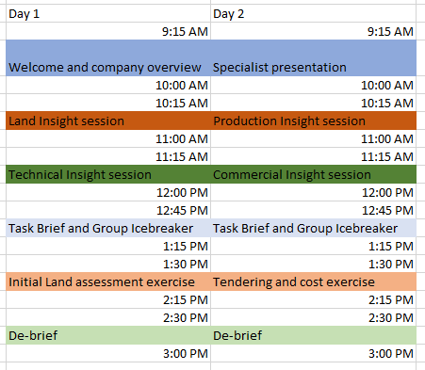
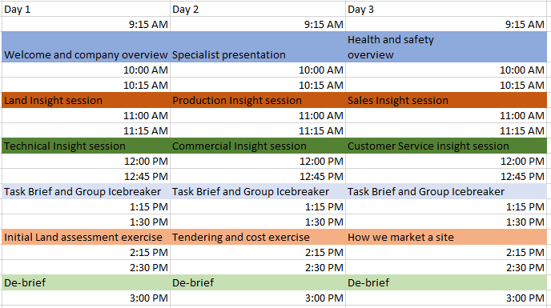
2.1 Appendix 2 - Timetables
Two day timetable
Three day timetable
Choose the length and content of your VWEX programme to suit both your organisation and your participants. If you are working with a particular school/college you may need to work with teachers and be flexible around a school timetable.
A shorter programme could focus on a specific area of interest within housebuilding e.g. Health and Safety or Quantity Surveying. A longer programme could be an opportunity to explore multiple areas of housebuilding or give an overview into all the departments within your organisation.

