Slide 1
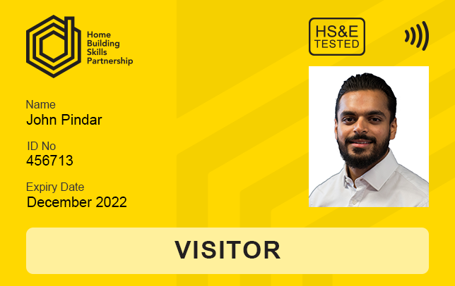
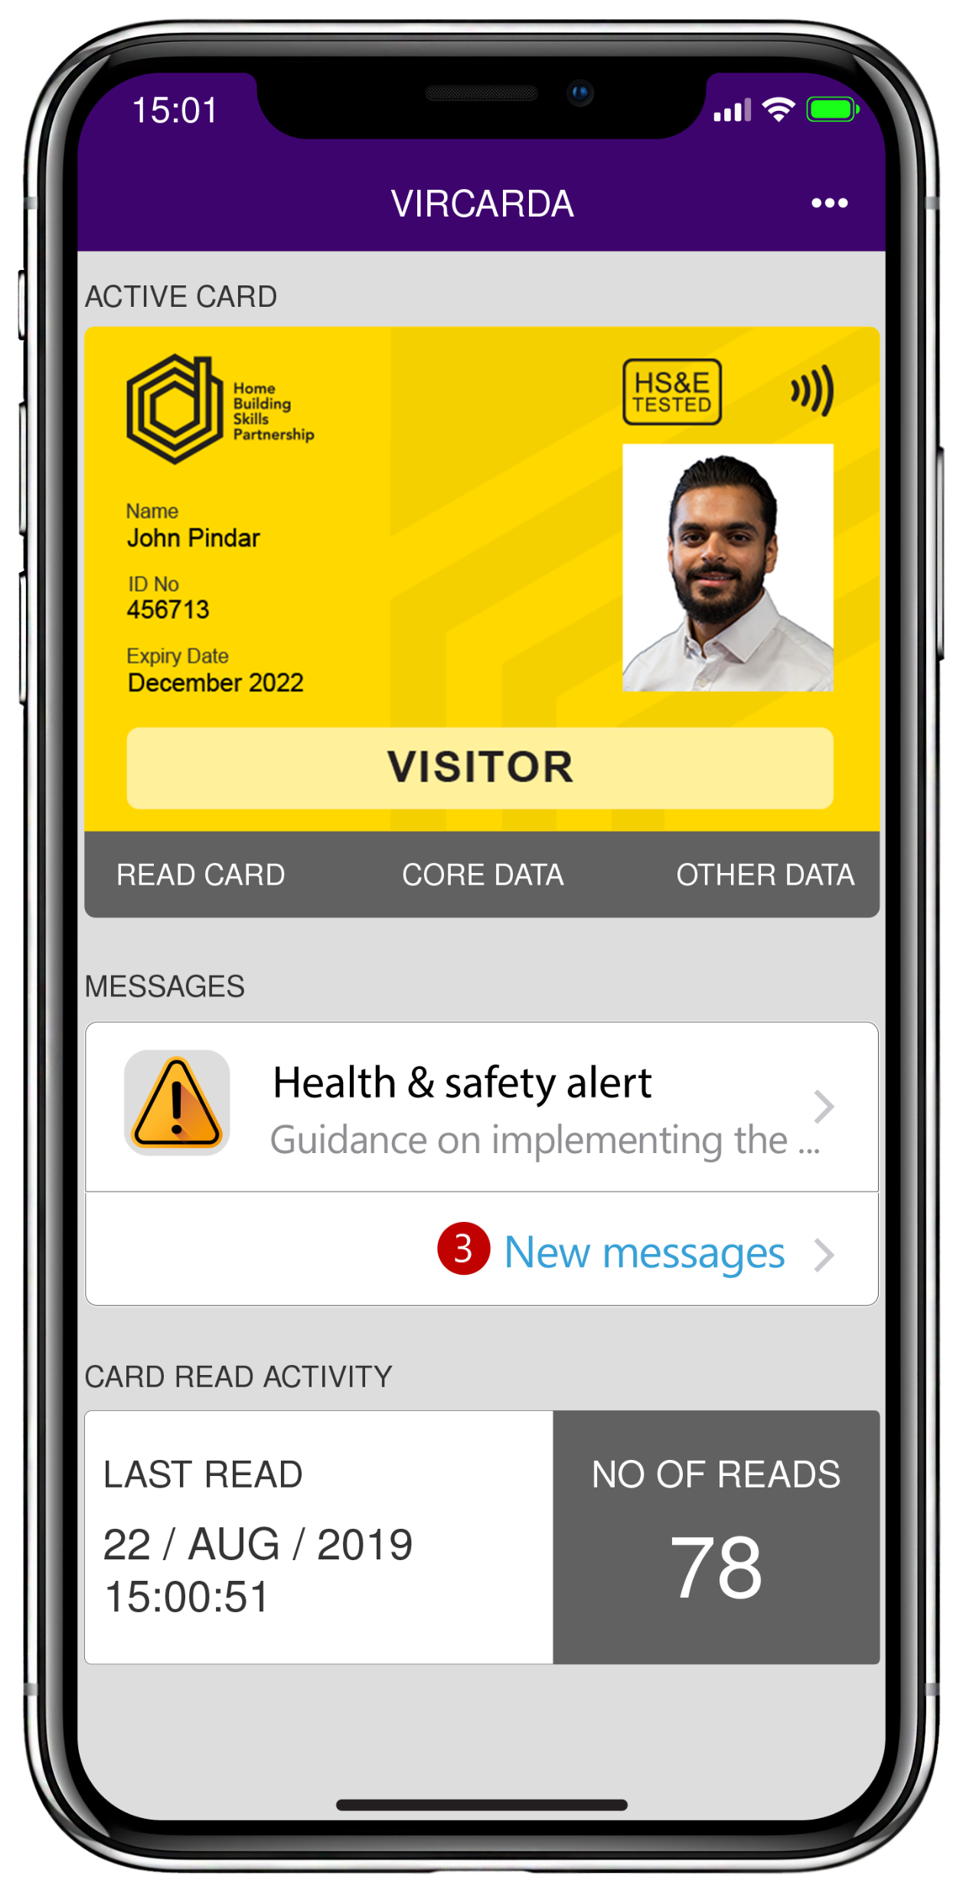
The Home Builders Virtual Visitor Card
A handy guide

Slide 2
About the card
How and why it was created
In 2018, CSCS announced they would withdraw Construction Site Visitor Cards
Home builders asked the Home Builders Federation to create one for industry
Key dates
All CSCS cards issued from 3 Sept 2018 expired in Aug 2020 & are non-renewable
Who creates the cards?
The Home Building Skills Partnership (skills arms of HBF) heads up the card
What’s next?
The Home Builders Virtual Visitor Card is the first in a suite of a further 12 roles to be created via an app for the home building industry
The card was for people with non construction-related jobs e.g. sales advisors
Withdrawal left a high number of home building staff without a card
Reference Point and CIGA create and distribute the cards, and maintain the website
Notes:
In June 2018, the Construction Skills Certification Scheme announced that they would be withdrawing the Construction Site Visitor card. The card had been in use to ensure that workers who often visited construction sites, but did not perform a construction related job (such as HR and Sales Advisors), were accounted for and could be assured to have an appropriate level of Health and Safety Awareness by passing the CITB Health, Safety and Environment test. CSCS has consulted with the wider construction industry and agreed a plan that will pave the way for the eventual withdrawal of its current Visitor card. This will, however, affect a high number of staff involved in the home building industry, so in response to home builders’ wishes HBF’s Home Building Skills Partnership developed with members an option to replace the CSCS Visitor card with something a little more specific to the home building industry in the form of a Home Builders Virtual Visitor Card. Whilst the wider Home Building competency scheme will be linked to CSCS and take into consideration other card schemes within the supply chain, the Visitor Card is as a result of the sectors requirements and therefore not linked to CSCS. All Construction Site Visitor Cards issued from 3 September 2018 by CSCS expired on 31 August 2020 and are non-renewable.

Slide 3
Who should apply?
The Virtual Visitor Card was created for non-construction related roles
These include, but are not limited to:
- Sales advisor
- Commercial director
- Cleaner
- Delivery driver
Notes:
When the CSCS announced that they would be withdrawing the Construction Site Visitor card, the home building industry realised that this would leave a gap in the sector and approached HBF and the Home Building Skills Partnership to keep this going, as the cards were widely used.
HBF consulted with members and recognised that the demand was still there, and significant enough to keep it going.
The card is for non-construction roles, but those who find themselves needed on site quite often. Each person who applies must make sure they have passed their CITB HS&E test within the last 2 years, to ensure they have a level of knowledge suitable to keep themselves and others safe on site.
If you have the following type of job, then the Virtual Visitor Card is for you: sales advisor, commercial director, cleaner, delivery driver.

Slide 4
How to apply
Before you apply make sure you’ve passed the CITB Health, Safety and Environment Test for Operatives within the last 2 years
https://www.citb.co.uk/courses-and-qualifications/hse-test-and-cards/about-hse-test/
If you’ve got your HS&E qualification, then visit the application page on the Virtual Visitor Card website
https://www.homebuildskillscard.co.uk/apply/
Choose which kind of card. There is the option to have a virtual card, which can be downloaded onto an app and scanned on site, and/or a physical, plastic card.
Notes:
Before you apply please ensure that this is the right card for your job role.
To apply for a card you must first make sure you have passed the CITB Health, Safety & Environment Test for Operatives within the last 2 years. This is required for the visitor card application.
It is a multiple-choice test on health, safety and environmental issues in construction. It can be booked at venues around the UK.
The test can be booked online through the CITB website (https://www.citb.co.uk/courses-and-qualifications/hse-test-and-cards/about-hse-test/), there are also links to this through the Home Building Skills Card website. The test costs £21, and you’ll either need your national insurance number, or a CITB or CSCS registration number.
The Home Building Virtual Visitor Card is available in both digital or plastic form, but we’d like to encourage more people to use the digital version, which can be used by downloading the Vircarda App on your phone.
For those responsible for checking cards and controlling access to site, you will need an approved smart card reader or Go Smart app on your mobile device.
More information for both is available here: https://www.homebuildskillscard.co.uk/download-the-app/

Slide 5
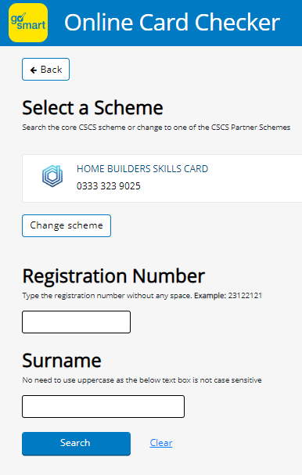
Using the app on site
Are you responsible for checking cards and controlling access to site?
You will need the Go Smart online card checker system https://cardcheck.gosmart.co.uk/
Select the Home Builders Skills Card scheme
Enter card number and surname of card holder
Notes:
If you’re in charge of checking people’s cards before they enter site, then this will give you a bit more explanation and detail on how that’s done.
Do you have responsibility for checking cards and controlling access to site? - The new Go Smart online card checker system is now live, through this link: https://cardcheck.gosmart.co.uk/
Simply click on the ‘Change scheme’ button and select the Home Builders Skills Card scheme
Then enter the card number and surname of card holder.
If you’re in charge of applying for a group of people:
Make sure each applicant has an in date CITB HS&E test (within the last 2 years). You can check here: https://www.citb.co.uk/courses-and-qualifications/check-a-card-training-record/online-card-checker/
More details on checking cards here: https://www.homebuildskillscard.co.uk/card-checker/

Slide 6
FAQs
More detail about the CITB HS&E test can be found on our FAQ page, along with a few more FAQ questions.
https://www.homebuildskillscard.co.uk/faq/
How much does a card cost? Virtual - £30 Physical - £37 Both - £40 The CITB HSE test - £21
How do I use the virtual card? Download the Vircarda app on android and apple phones
Who owns the card? Cards remain the exclusive property of the HBSP Card Scheme.
How long is the card valid for? 5 years
I need to process a large number of cards for my company, can I do this online? Yes, the site has been designed to accept bulk uploads
How do I book a CITB Health, Safety and Environment test? You can book online call 0344 994 4488
How is my card checked when I am on site? Find out more about the Go Smart app here
Are CSCS phasing out visitor cards? Yes, this was replaced by the Home Builders Virtual Visitor Card in December 2019
How long will it take for my card to be sent to me? Most arrive within 5 days, virtual cards sooner as they are sent electronically
What is the CITB Health, Safety and Environment (HS&E) test? It is a multiple choice test on health, safety and environmental issues in construction
Notes:
How much does a card cost?
We encourage that you get the digital version. However, you can opt for a plastic version, digital version, or both. The prices are as follows, without VAT. Virtual cards - £30 Smart/physical cards - £37 Both - £40 The CITB Health, Safety and Environment (HS&E) test costs £21 and must be booked separately.
How long is the Visitor card valid for? The Home Builders Virtual Visitor card is valid for 5 years.
Who owns the card? Cards remain the exclusive property of the HBSP Card Scheme. Cards are issued to and must be kept in the named cardholder’s secure possession at all times. The HBSP Card Scheme reserves the right to unilaterally withdraw a card.
How do I use the virtual card? To find out more about the virtual card app and download click here. The app is called Vircarda, and can be downloaded to your android or apple phone.
If you have responsibility for checking cards and controlling access to site, you will need to have either an approved smart card reader on site or the Go Smart application on your mobile device or telephone. For further details on how to check a card and to download the Go Smart application then go to www.gosmart.co.uk
I need to process a large number of cards for my company, can I do this online? Yes absolutely, the site has been designed to accept bulk applications for ease of use. See here for more information on bulk uploads. As a summary – there’s a bulk uploads page, which provides a CSV file for data input. Any errors or changes can be easily amended after upload.
How do I book a CITB Health, Safety and Environment test? You can book online or you can call the information and booking line on 0344 994 4488. You’ll need a credit or debit card to pay the £21 fee and either your NI (national insurance) number or a CITB or CSCS registration number.
How is my card checked when I am on site? This is done through the Go Smart app.
Are CSCS phasing out visitor cards? Are other cards being phased out? Yes, this was replaced by the Home Builders Virtual Visitor Card in December 2019. Construction Site Visitor Cards are currently being phased out, and most will not be valid after the end of August 2020. For information about all the other CSCS cards and their validity period, please visit the CSCS website.
How long will it take for my card to be sent to me? Most cards arrive at their requested destination within 5 days of application and virtual cards will be sooner as they are sent electronically. If your card has not been delivered to your requested destination within two weeks of your application, please contact the HBSP Card Scheme Provider. After 20 days your application will be considered closed and a further payment will be required to reprocess a new application.
What is the CITB Health, Safety and Environment (HS&E) test? It is a multiple choice test on health, safety and environmental issues in construction. It can be booked at venues around the UK. This is required for the visitor card application. Find out more about the test and how to make a booking here

Slide 7
The Home Builders Virtual Visitor Card
Have you heard of the brand new site visitor card for the Home
Building industry?
It’s for non-construction workers on sites, such as a sales advisor, commercial director, cleaner or delivery driver.
Apply now! Just make sure you’ve passed your CITB HS&E test within the last 2 years. This new card is valid for 5 years.
Join the green revolution by choosing the digital version of the card, downloaded onto your
smartphone. Apply through a few clicks on our website:
https://www.homebuildskillscard.co.uk/
Notes:
This slide is the ‘poster’. Please feel free to just use this around your offices or on your intranet as a promotional tool for the card.

